Slide 1
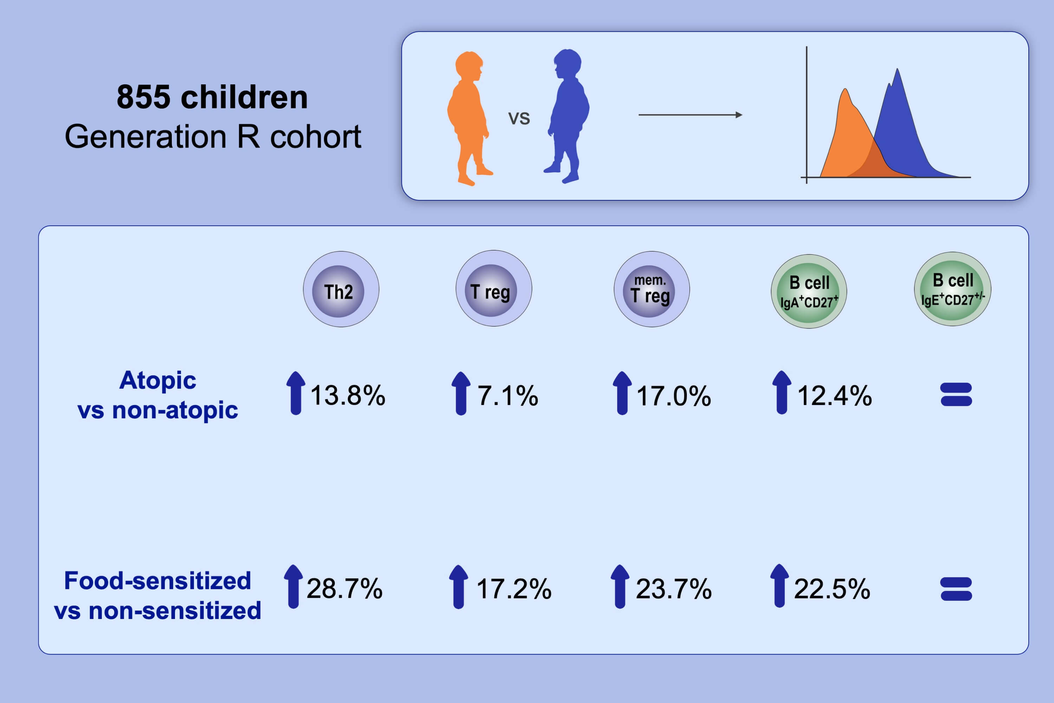
Associations of Th2, Th17, Treg cells, and IgA+ memory B cells with atopic disease in children: The Generation R Study
Kirsten I. M. Looman, Evelien R. van Meel, Christina Grosserichter‐Wagener, Floor J. M. Vissers, Janice H. Klingenberg, et al.
Allergy. 2020; 178-187 https://doi.org/10.1111/all.14010
© 2019 EAACI and John Wiley and Sons A/S. Published by John Wiley and Sons Ltd.
Notes:
HIGHLIGHTS
• This cross-sectional study including 855 children from the Generation R cohort was performed to determine immune cell numbers by flow cytometry analysis.
• Increased Th2, Treg, memory Treg, and IgA+CD27+ B cells were observed in atopic compared to non-atopic and food-sensitized compared to non-sensitized children.
• The higher IgA+CD27+ B cell number in food-sensitized children suggests TGF-β-mediated compensation for chronic inflammation.

