Slide 1
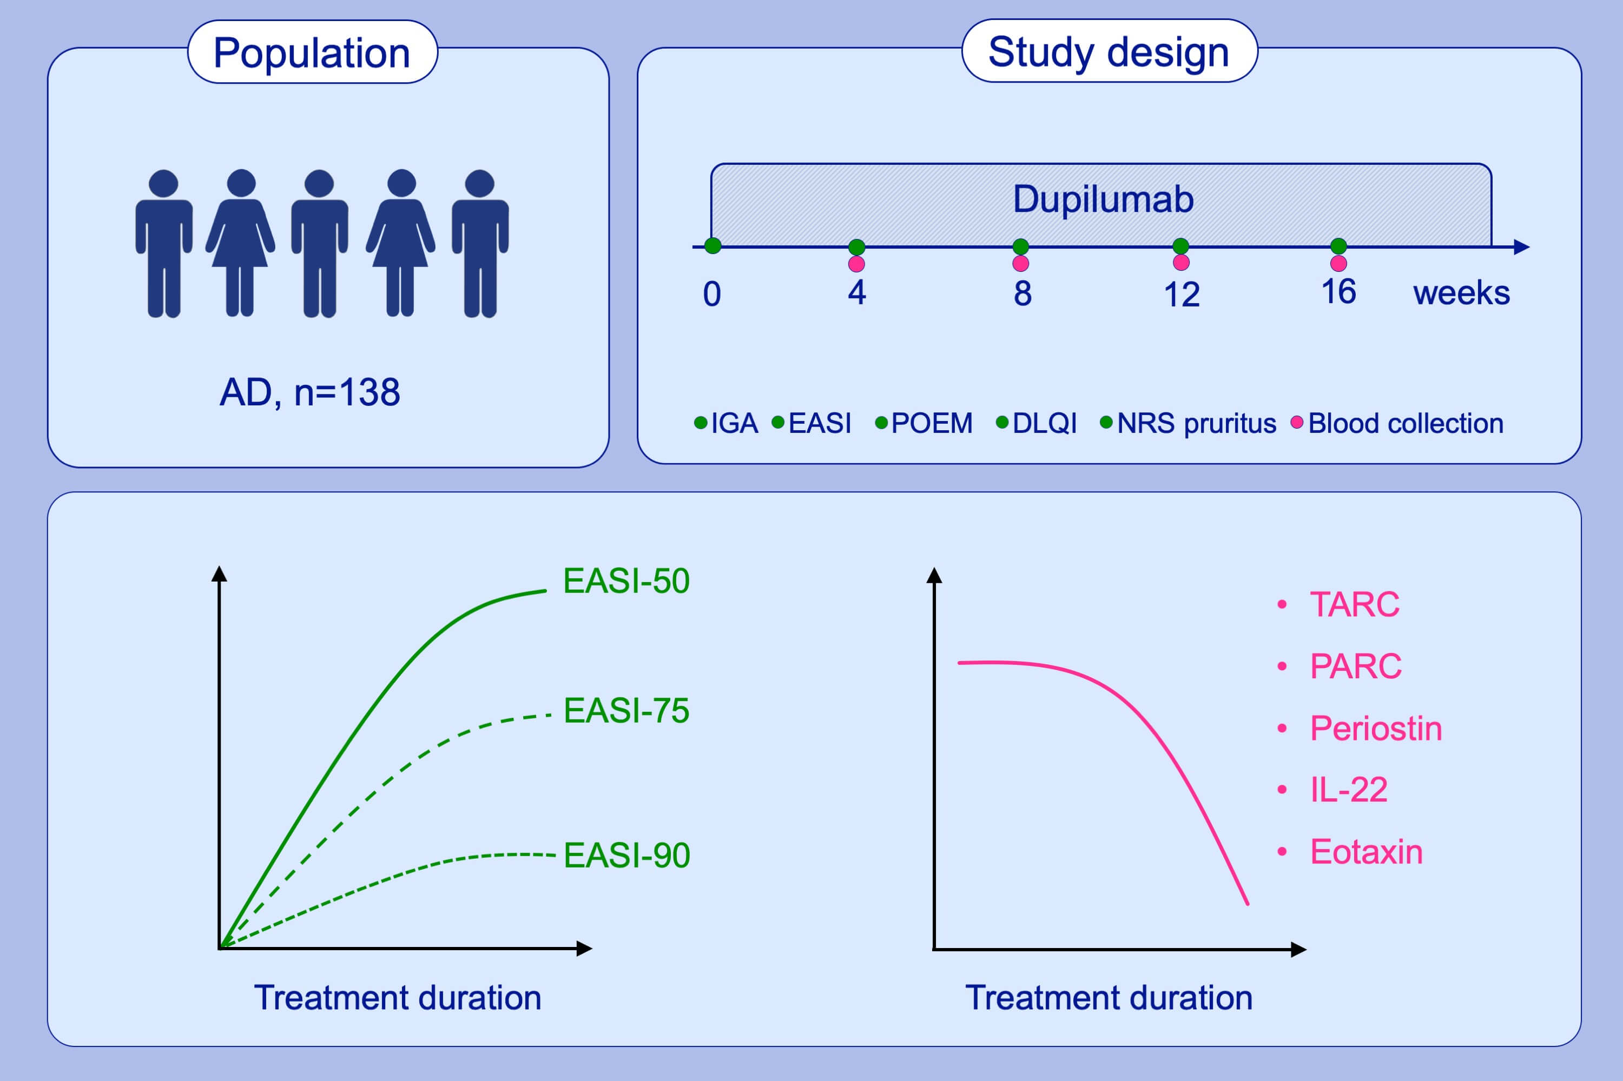
Dupilumab is very effective in a large cohort of difficult‐to‐treat adult atopic dermatitis patients: First clinical and biomarker results from the BioDay registry
Lieneke F. M. Ariëns, Jorien van der Schaft, Daphne S. Bakker, Deepak Balak, Margreet L. E. Romeijn, et al.
Allergy. 2020; 116-126 https://doi.org/10.1111/all.14080
© 2019 EAACI and John Wiley and Sons A/S. Published by John Wiley and Sons Ltd.
Notes:
HIGHLIGHTS
• This study evaluated the clinical effectiveness and safety of 16 weeks of dupilumab treatment in adults with AD.
• Dupilumab treatment significantly suppressed disease severity-related serum biomarkers and eosinophil chemokines.
• By the end of the treatment, the EASI-50 and EASI-75 was achieved by 86% and 62% of patients, respectively.
ABBREVIATIONS
AD, Atopic dermatitis; DLQI, Dermatology life quality index; EASI, Eczema area and severity index; IGA, Investigators global assessment; NRS, Numeric rating scale; PARC, Pulmonary and
activation-regulated chemokine; POEM, Patient-oriented eczema measure; TARC, Thymus- and activation-regulated chemokine

