Slide 1
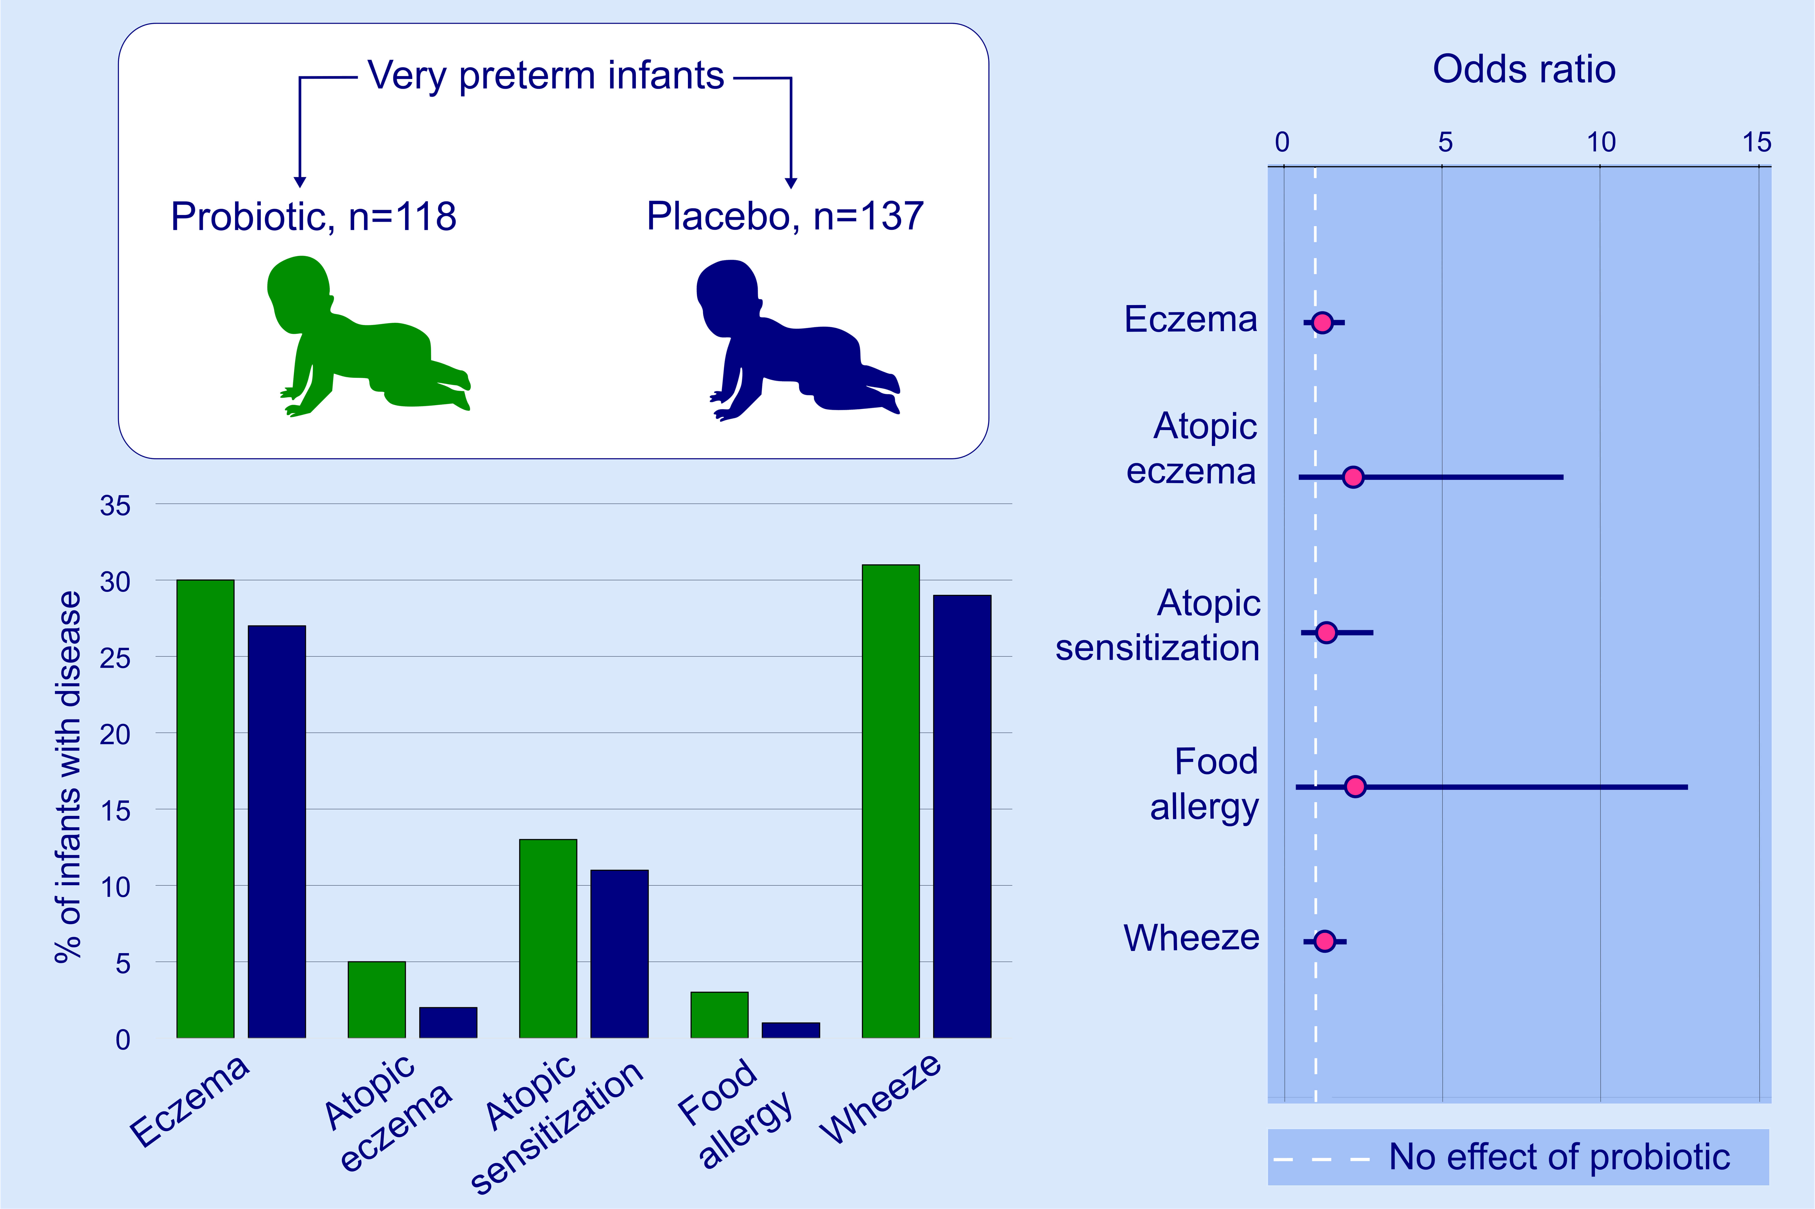
Postnatal probiotics and allergic disease in very preterm infants: Sub‐study to the ProPrems randomized trial
Erica L. Plummer, Adriana Chebar Lozinsky, Jacinta M. Tobin, Jessica B. Uebergang, Christine Axelrad, et al.
Allergy. 2020; 127-136 https://doi.org/10.1111/all.14088
© 2019 EAACI and John Wiley and Sons A/S. Published by John Wiley and Sons Ltd.
Notes:
HIGHLIGHTS
• We evaluated the effect of postnatal probiotic supplementation on the development of allergic diseases and atopic sensitization in very preterm infants.
• We found no difference in the incidence of allergic diseases or atopic sensitization between the probiotic and placebo groups.
• Although current guidelines recommend probiotics for prevention of allergic diseases in high-risk infants, our findings demonstrate that there is insufficient evidence to determine whether the guideline recommendations are applicable to very preterm infants.

