Slide 1
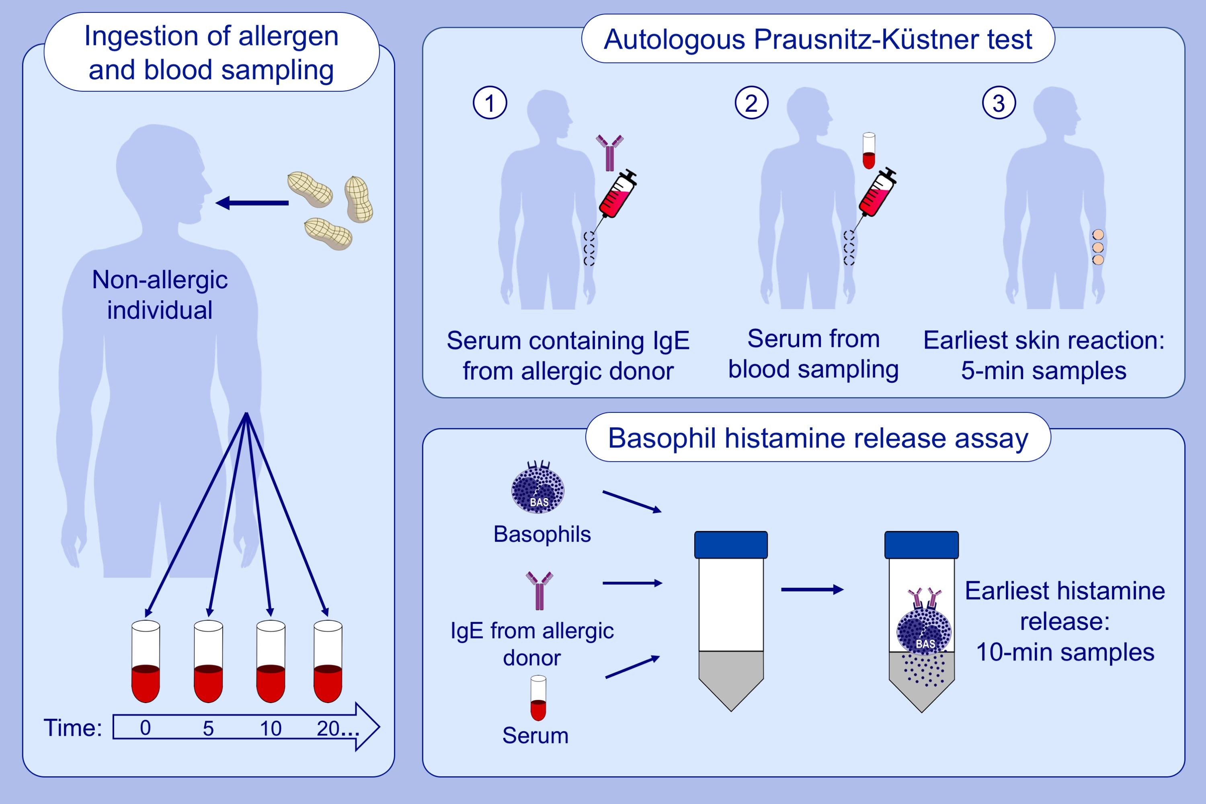
The quest for ingested peanut protein in human serum
Anja Pahlow Mose, Ejvind Mortz, Per Stahl Skov, Charlotte Gotthard Mortz, Esben Eller, et al.
Allergy. 2020; 1721-1729 https://doi.org/10.1111/all.14109
© 2019 EAACI and John Wiley and Sons A/S. Published by John Wiley and Sons Ltd.
Notes:
HIGHLIGHTS
• Ingested peanut protein is absorbed systemically and retains its immunoreactive capacity in non-allergic individuals.
• Both the Prausnitz-Küstner test and the basophil histamine release assay can reliably determine absorbed peanut reactivity with high sensitivity within 5 minutes after ingestion.
• The level of absorbed Ara h 6 in human serum was found to be up to 0.2 ng/mL, but the level of absorbed Ara h 2 could not be established using several protein assays including mass spectrometry, dot blots, Western blotting and Ara h 2 ELISA.

