Slide 1
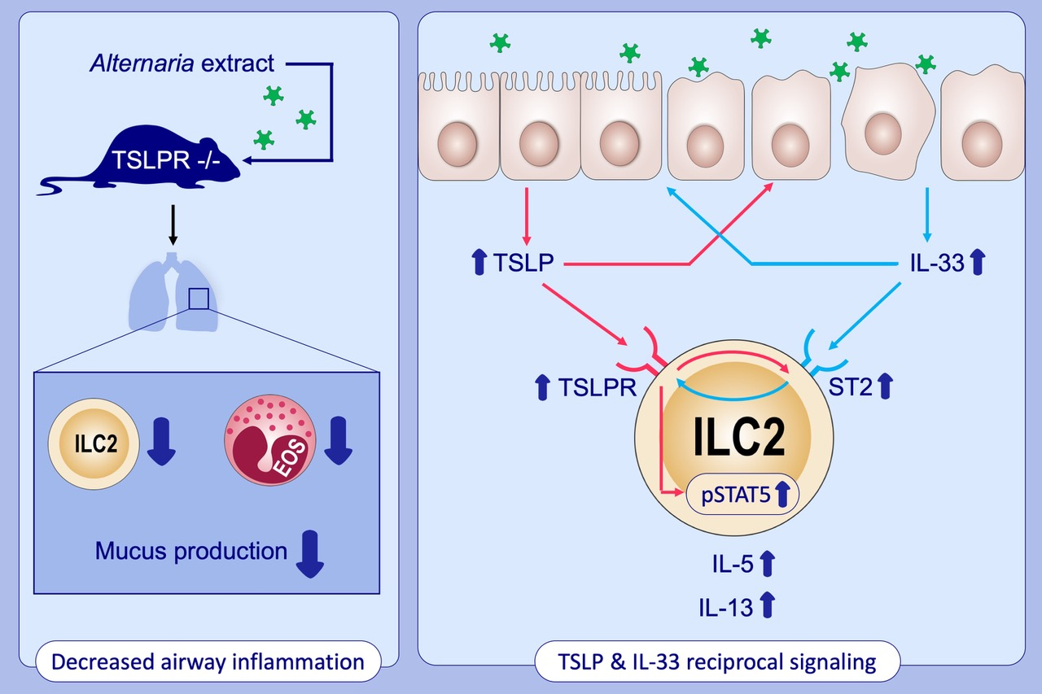
TSLP and IL‐33 reciprocally promote each other's lung protein expression and ILC2 receptor expression to enhance innate type‐2 airway inflammation
Shinji Toki, Kasia Goleniewska, Jian Zhang, Weisong Zhou, Dawn C. Newcomb, et al.
Allergy. 2020; 1606-1617 https://doi.org/10.1111/all.14196
© 2019 EAACI and John Wiley and Sons A/S. Published by John Wiley and Sons Ltd.
Notes:
HIGHLIGHTS
We found that TSLPR deficiency significantly decrease the number of lung ILC2, airway eosinophils and mucus production in mouse challenged with Alternaria extract.
TSLP-TSLPR and IL-33-ST2 signaling augments each other’s protein release and expression in the lung epithelial cells after aeroallergen challenge.
TSLP and IL-33 signaling increases each other’s receptor expression on lung ILC2, and the IL-33-augmented TSLPR expression enhances pSTAT5 in the ILC2.
Abbreviations: pSTAT5; phosphorylated signal transducer and activator of transcription 5; ST2, IL-33 receptor; TSLP, thymic stromal lymphopoietin

