Slide 1
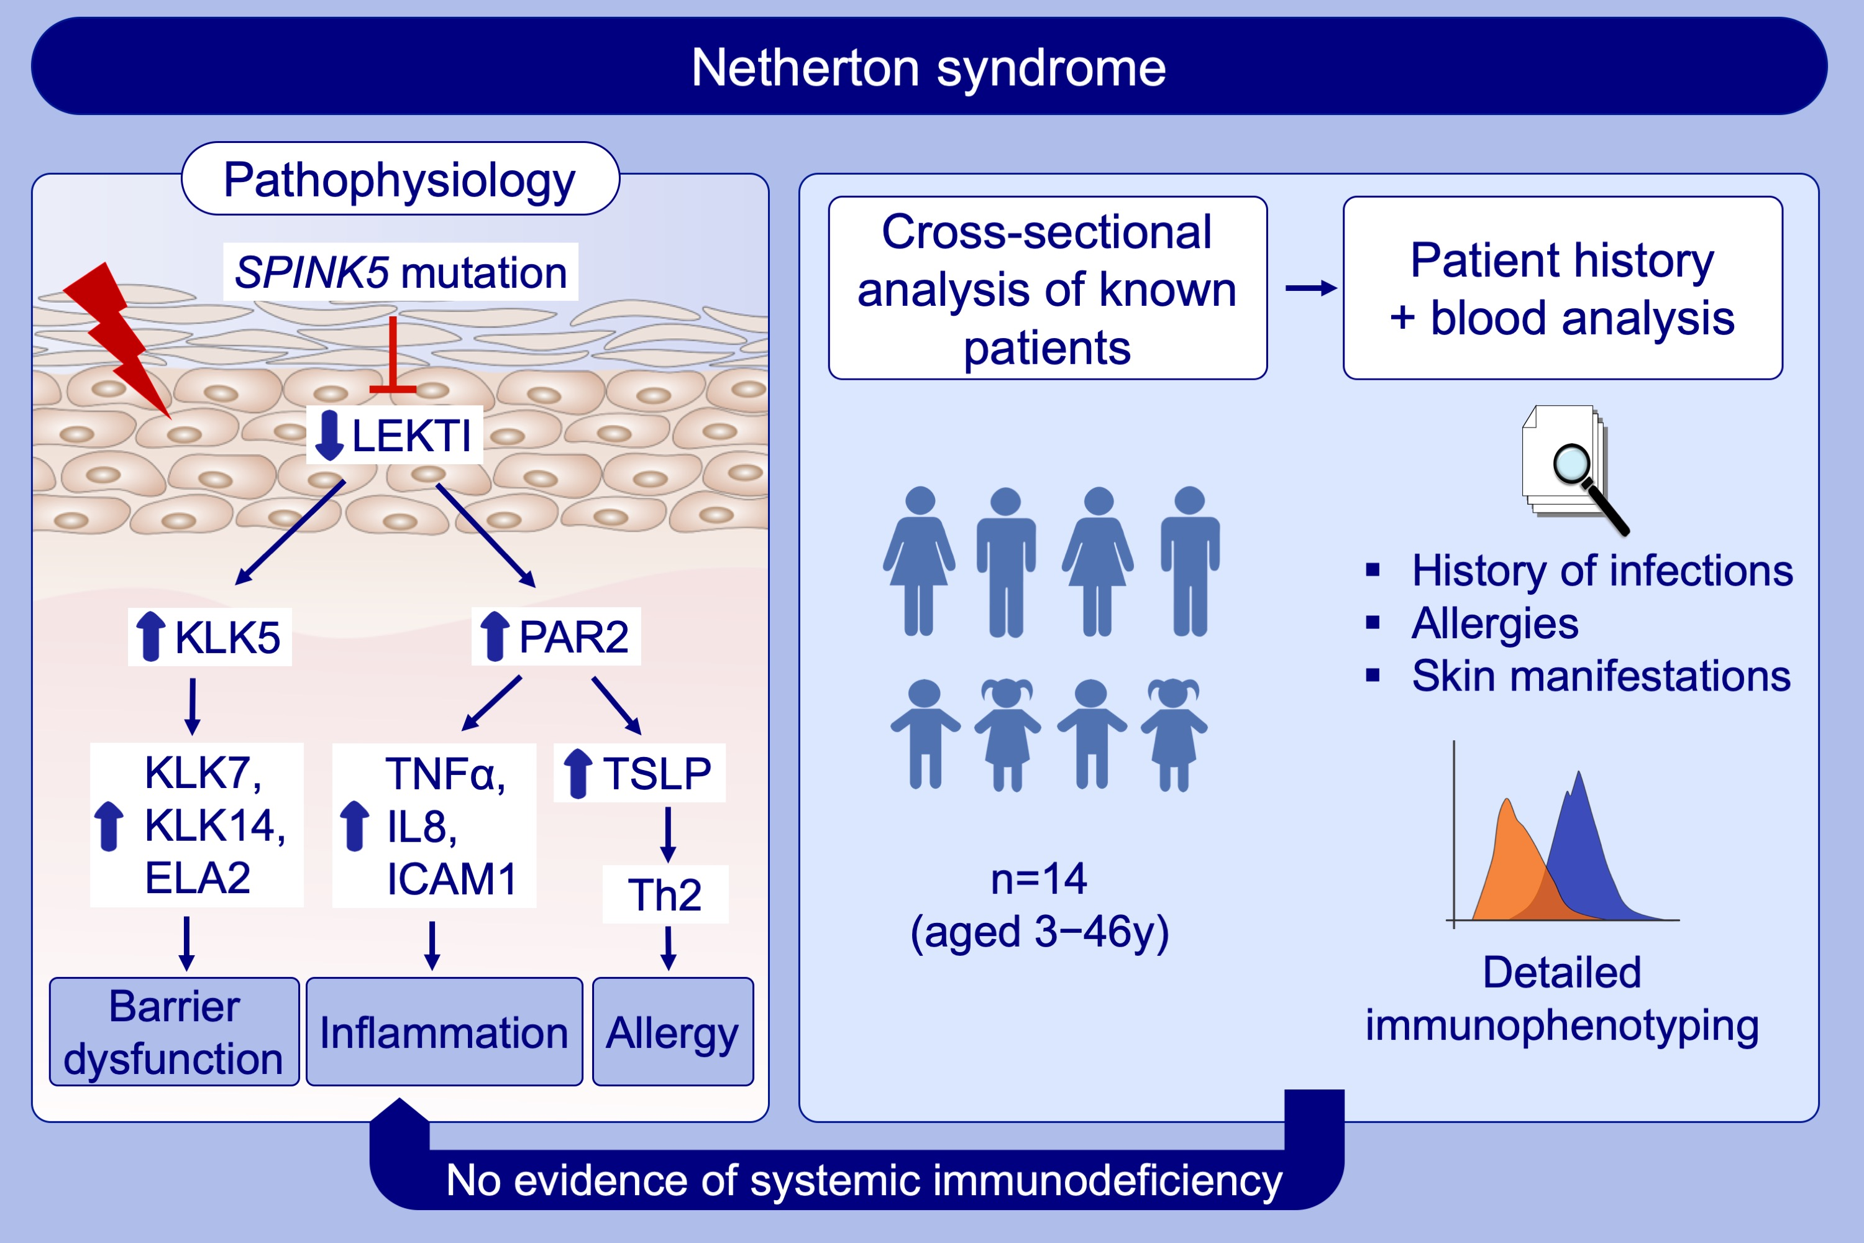
Comel‐Netherton syndrome: A local skin barrier defect in the absence of an underlying systemic immunodeficiency
Kira Stuvel, Jorn J. Heeringa, Virgil A. S. H. Dalm, Ruud W. J. Meijers, Els van Hoffen, et al.
Allergy. 2020; 1710-1720 https://doi.org/10.1111/all.14197
© 2019 EAACI and John Wiley and Sons A/S. Published by John Wiley and Sons Ltd.
Notes:
HIGHLIGHTS
• Fourteen patients with Netherton disease with varying degrees of skin involvement were evaluated for clinical and immunological characteristics.
• Multidisciplinary evaluation, including blood immunophenotyping, shows no evidence for a severe, clinically relevant systemic immunodeficiency.
• Increased risk for infections in Netherton patients most likely results from the skin barrier disruption and increased allergen penetration predisposes to allergic sensitization.
Abbreviations: ELA, Elastase; ICAM, Intercellular adhesion molecule; KLK, Kallikrein-related peptidase; LEKTI, Lympho-epithelial Kazal type related inhibitor; PAR, Protease-activated receptor; SPINK5; Serine protease inhibitor of Kazal type 5; TSLP, Thymic stromal lymphopoietin

