Slide 1
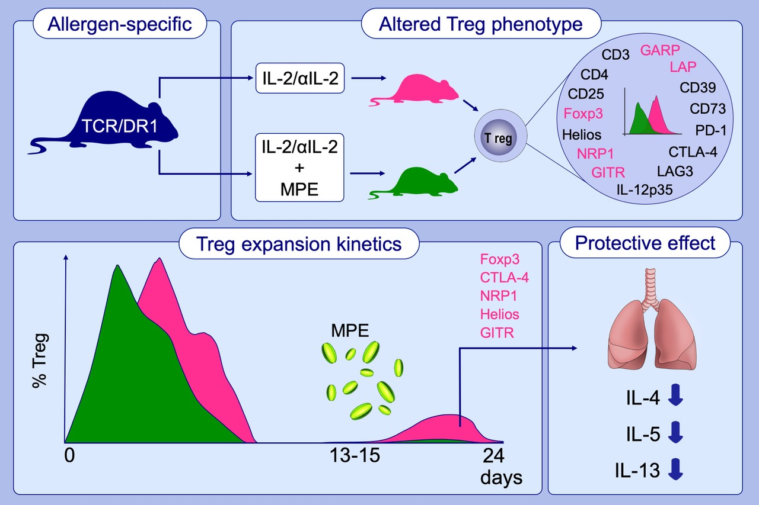
Allergen alters IL‐2/αIL‐2‐based Treg expansion but not tolerance induction in an allergen‐specific mouse model
Cordula Köhler, Ursula Smole, Bernhard Kratzer, Doris Trapin, Klaus G. Schmetterer, et al.
Allergy. 2020; 1618-1629 https://doi.org/10.1111/all.14203
© 2019 EAACI and John Wiley and Sons A/S. Published by John Wiley and Sons Ltd.
Notes:
HIGHLIGHTS
Application of IL-2/αIL-2 complexes changes the phenotype and function of peripheral blood T cells by inducing a wave of recirculating Treg cells.
Presence of MPE changes the expansion kinetics and the phenotype of the expanded Treg population and reveals lack of specificity of several Treg marker molecules.
IL-2/αIL-2 complex-induced Tregs can be recalled when mice are allergen challenged on days 13-15 and protect from allergic lung inflammation long after initial treatment.
Abbreviations: CTLA-4, Cytotoxic T-lymphocyte protein 4; Foxp3, Forkhead box protein 3; GARP, Glycoprotein-A repetitions predominant; GITR, Glucocorticoid-induced tumor necrosis factor receptor; Helios, Ikaros family zinc finger protein 2; IL-12p35, Interleukin-12 subunit α; LAG3, Lymphocyte activation gene 3 protein; LAP, Latency-associated peptide; MPE, Mugwort pollen extract; NRP1, Neuropilin-1; PD-1, Programmed cell death protein 1; TCR/DR1: Transgenic mouse strain carrying both human leucocyte antigen (HLA)-DR1 transgene and an allergen-specific T cell receptor

