Slide 1
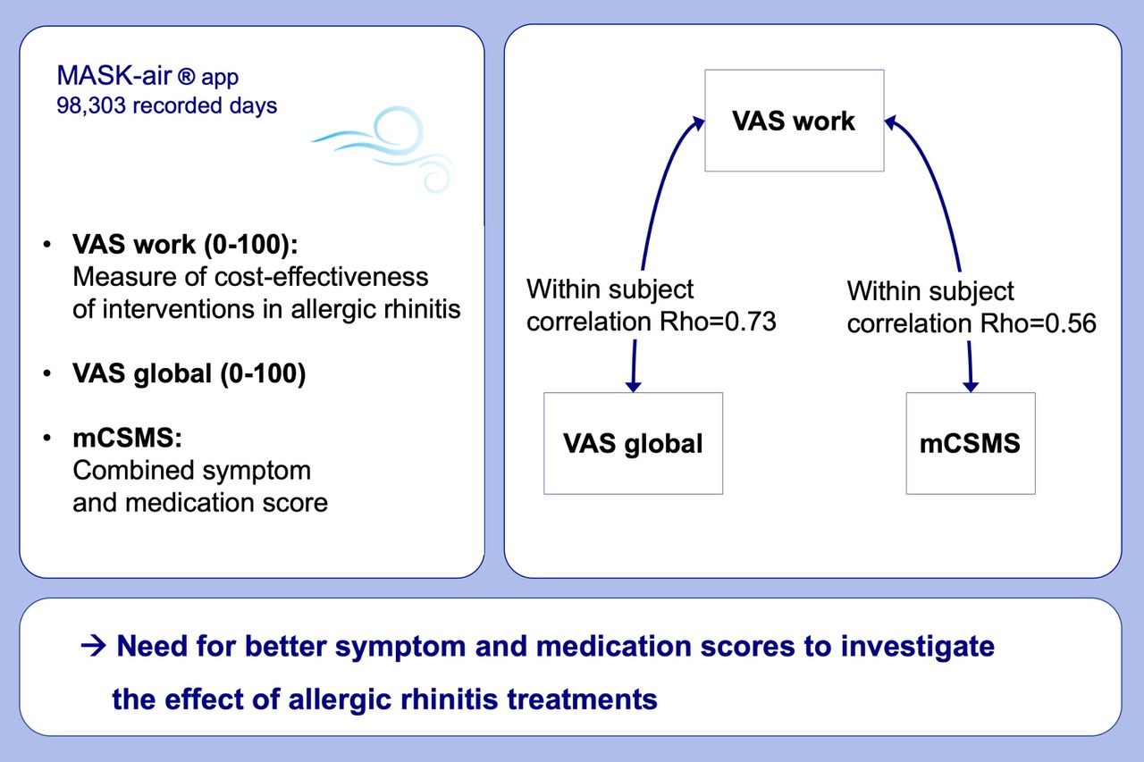
Correlation between work impairment, scores of rhinitis severity and asthma using the MASK‐air® App
Annabelle Bédard, Josep M. Antó, Joao A. Fonseca, Sylvie Arnavielhe, Claus Bachert, et al.
Allergy. 2020; 1672-1688 https://doi.org/10.1111/all.14204
© 2019 EAACI and John Wiley and Sons A/S. Published by John Wiley and Sons Ltd.
Notes:
HIGHLIGHTS
• VAS work can be used as a measure of cost-effectiveness of interventions in allergic rhinitis.
• Strong correlations were observed between VAS work and other VAS scores, which are unlikely to be explained by a low quality of data arising from repeated VAS measures.
• Lower correlations were observed between VAS work and SMSs, suggesting that better SMSs need to be defined to investigate the effect of allergic rhinitis treatments.
Abbreviations: mCSMS, modified Combined Symptom Medication Score; SMSs; Symptom Medication Scores (SMSs); VAS, Visual Analogue Scale

