Slide 1
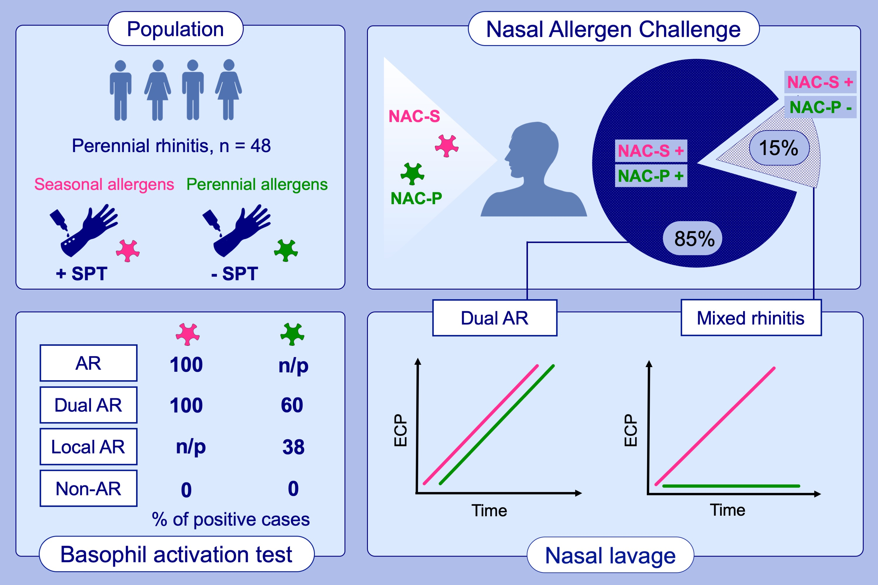
Coexistence of nasal reactivity to allergens with and without IgE sensitization in patients with allergic rhinitis
Ibon Eguiluz‐Gracia, Ruben Fernandez‐Santamaria, Almudena Testera‐Montes, Adriana Ariza, Paloma Campo, et al.
Allergy. 2020; 1689-1698 https://doi.org/10.1111/all.14206
© 2019 EAACI and John Wiley and Sons A/S. Published by John Wiley and Sons Ltd.
Notes:
HIGHLIGHTS
• We demonstrate that a significant proportion of rhinitis patients with SPT positivity to seasonal allergens only, but suffering from perennial symptoms display nasal reactivity to both perennial and seasonal allergens.
• Nasal reactivity to allergens is associated with the increase of ECP in the nasal secretions, regardless of the atopic status for the corresponding allergen.
• Nasal reactivity to allergens can be associated with positive basophil activation test responses, regardless of the atopic status for the corresponding allergen.
Abbreviations: AR, allergic rhinitis; ECP, eosinophil cationic protein; NAC-P/S, nasal allergen challenge with perennial/seasonal allergens; n/p, not performed; SPT, skin prick test

