Slide 1
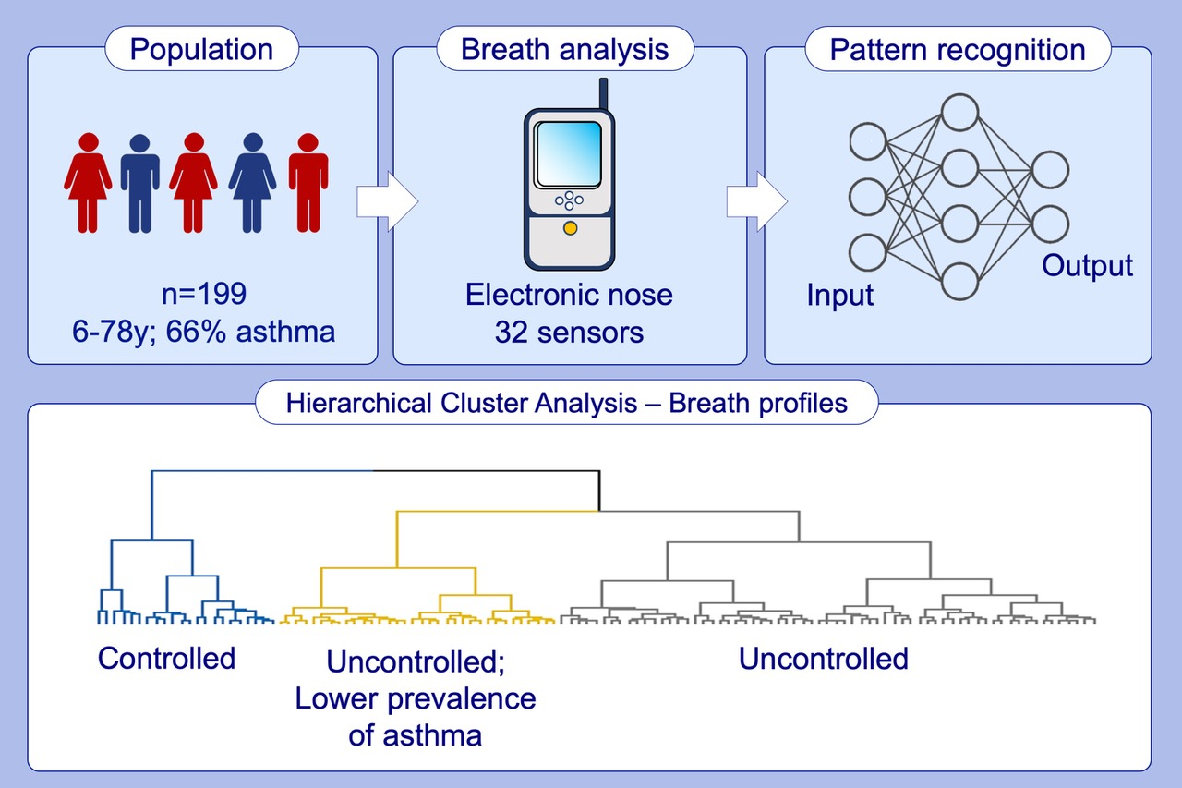
Human volatilome analysis using eNose to assess uncontrolled asthma in a clinical setting
Mariana Farraia, João Cavaleiro Rufo, Inês Paciência, Francisca Castro Mendes, Ana Rodolfo, et al.
Allergy. 2020; 1630-1639 https://doi.org/10.1111/all.14207
© 2019 EAACI and John Wiley and Sons A/S. Published by John Wiley and Sons Ltd.
Notes:
HIGHLIGHTS
In a population with asthma and suspicious of asthma (recruited from an outpatient allergy clinic), eNose-driven breath profiles distinguished three clusters, blindly to reference.
Participants with less respiratory symptoms are grouped in one cluster while, in the others, participants show poor symptoms control but the distribution of subjects with asthma is different.
eNose can screen individuals with uncontrolled asthma symptoms in a clinical setting.

