Slide 1
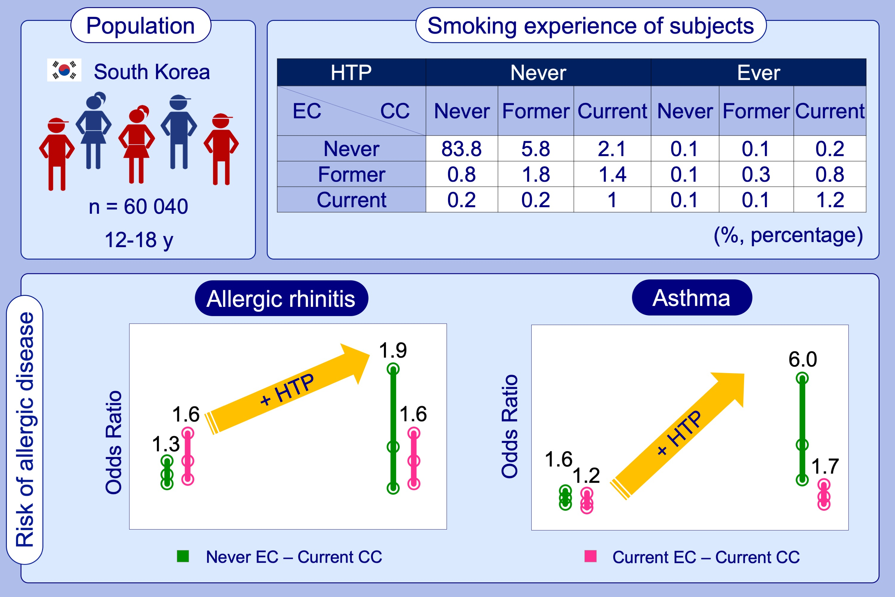
Novel tobacco products including electronic cigarette and heated tobacco products increase risk of allergic rhinitis and asthma in adolescents: Analysis of Korean youth survey
Soo Jie Chung, Byung‐Keun Kim, Ji Hyun Oh, Ji‐Su Shim, Yoon‐Seok Chang, et al.
Allergy. 2020; 1640-1648 https://doi.org/10.1111/all.14212
© 2019 EAACI and John Wiley and Sons A/S. Published by John Wiley and Sons Ltd.
Notes:
HIGHLIGHTS
• Among Korean adolescents aged from 12 to 18 years old, 6.7% and 2.7% currently use conventional cigarettes and electronic cigarettes, respectively and 2.9% ever used heated tobacco products.
• The use of conventional cigarette, electronic cigarette, and heated tobacco product, respectively and in combination increases the risk of allergic rhinitis and asthma in Korean adolescents.
• The use of heated tobacco product especially enhances the impact of conventional cigarettes on allergic rhinitis and asthma.
Abbreviations: CC, conventional cigarettes; EC, electronic cigarettes; HTP, heated tobacco products

