Slide 1
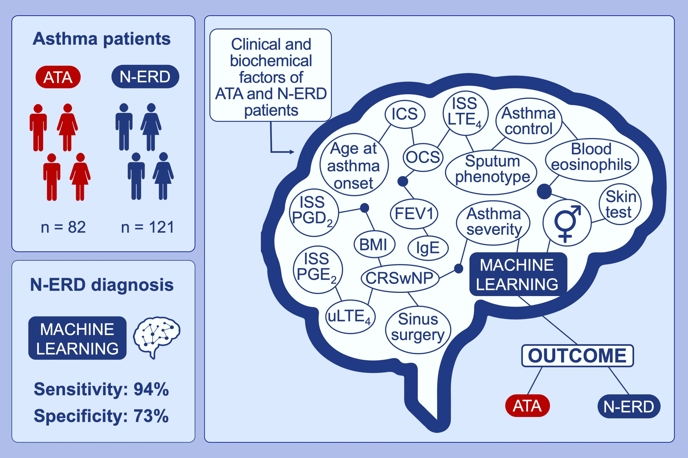
Artificial neural network identifies nonsteroidal anti‐inflammatory drugs exacerbated respiratory disease (N‐ERD) cohort
Katarzyna Ewa Tyrak, Kinga Pajdzik, Ewa Konduracka, Adam Ćmiel, Bogdan Jakieła, et al.
Allergy. 2020; 1649-1658 https://doi.org/10.1111/all.14214
© 2019 EAACI and John Wiley and Sons A/S. Published by John Wiley and Sons Ltd.
Notes:
HIGHLIGHTS
• Artificial neural network based on a set of clinical and biochemical parameters is able to stratify N-ERD patients among asthmatic population.
• The sensitivity of the present artificial neural network is 94.12% and specificity is 73.08% for the prediction of N-ERD.
• Artificial neural network could become a screening tool and allow to quickly identify patients with a high suspicion of N-ERD.
Abbreviations: ATA, aspirin-tolerant asthma; BMI, body mass index; CRSwNP, chronic rhinosinusitis with nasal polyposis; FEV₁, forced expiratory volume in the first second; ICS, inhaled corticosteroid; ISS, induced sputum supernatant; LTE₄, leukotriene E₄; N-ERD, nonsteroidal anti-inflammatory drug–exacerbated respiratory disease; OCS, oral corticosteroid; PGD₂, prostaglandin D₂; PGE₂, prostaglandin E₂; uLTE₄, urinary leukotriene E₄

