Slide 1
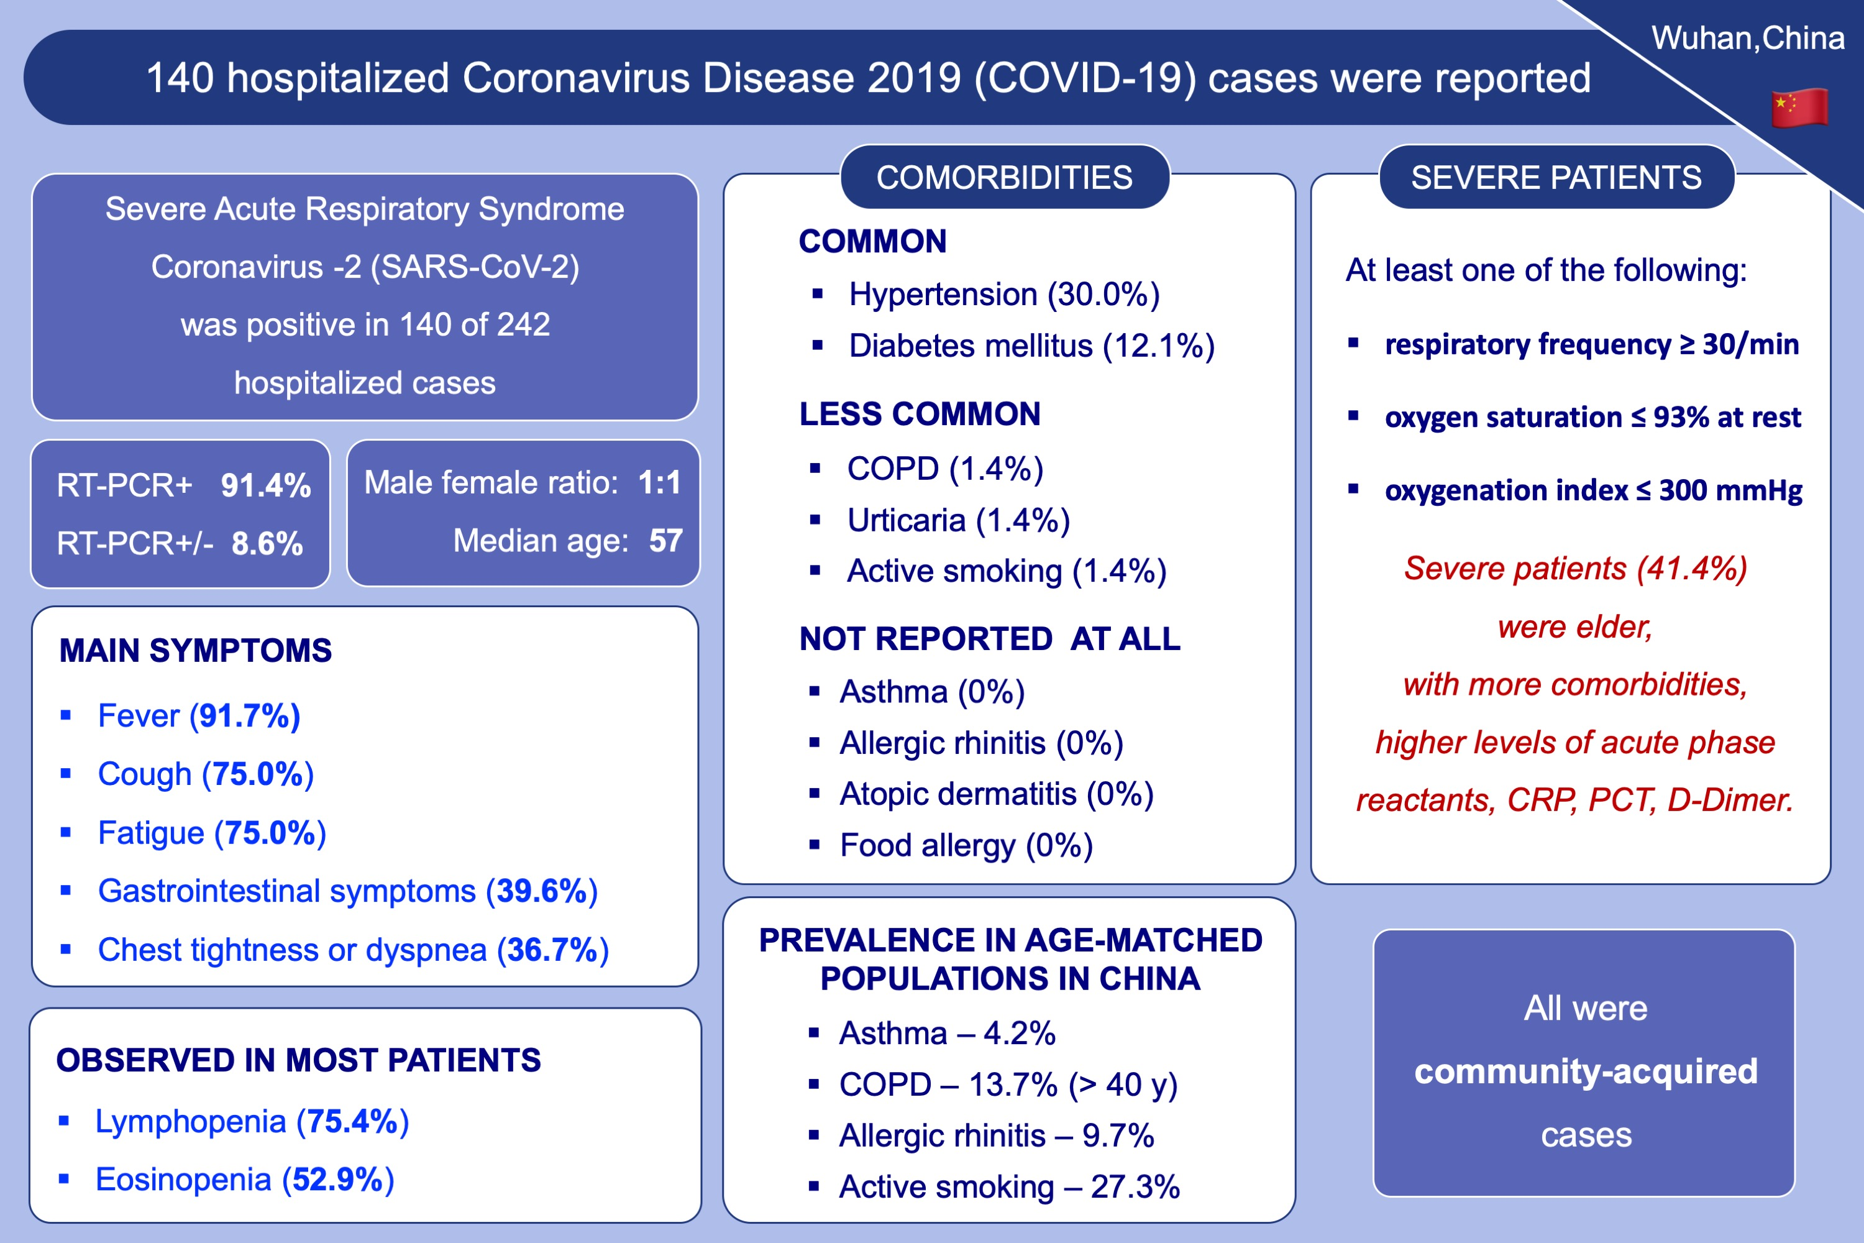
Clinical characteristics of 140 patients infected with SARS‐CoV‐2 in Wuhan, China
Jin-jin Zhang, Xiang Dong, Yi-yuan Cao, Ya-dong Yuan, Yi-bin Yang, et al.
Allergy. 2020; 1730-1741 https://doi.org/10.1111/all.14238
© 2019 EAACI and John Wiley and Sons A/S. Published by John Wiley and Sons Ltd.
Notes:
HIGHLIGHTS
• Decreased eosinophil count, which was positively correlated with lymphocyte counts, may be a potential biological indicator for diagnosing COVID-19 patients.
• Low prevalence of allergic diseases, COPD and patients with smoking history indicated they may not be the predisposing factors of COVID-19.
• Elder age, high number of comorbidities and more prominent laboratory abnormalities were associated with severe patients.
Abbreviations: COPD, chronic obstructive pulmonary disease; COVID-19, coronavirus disease 2019; SARS-CoV-2, severe acute respiratory syndrome coronavirus 2

