Slide 1
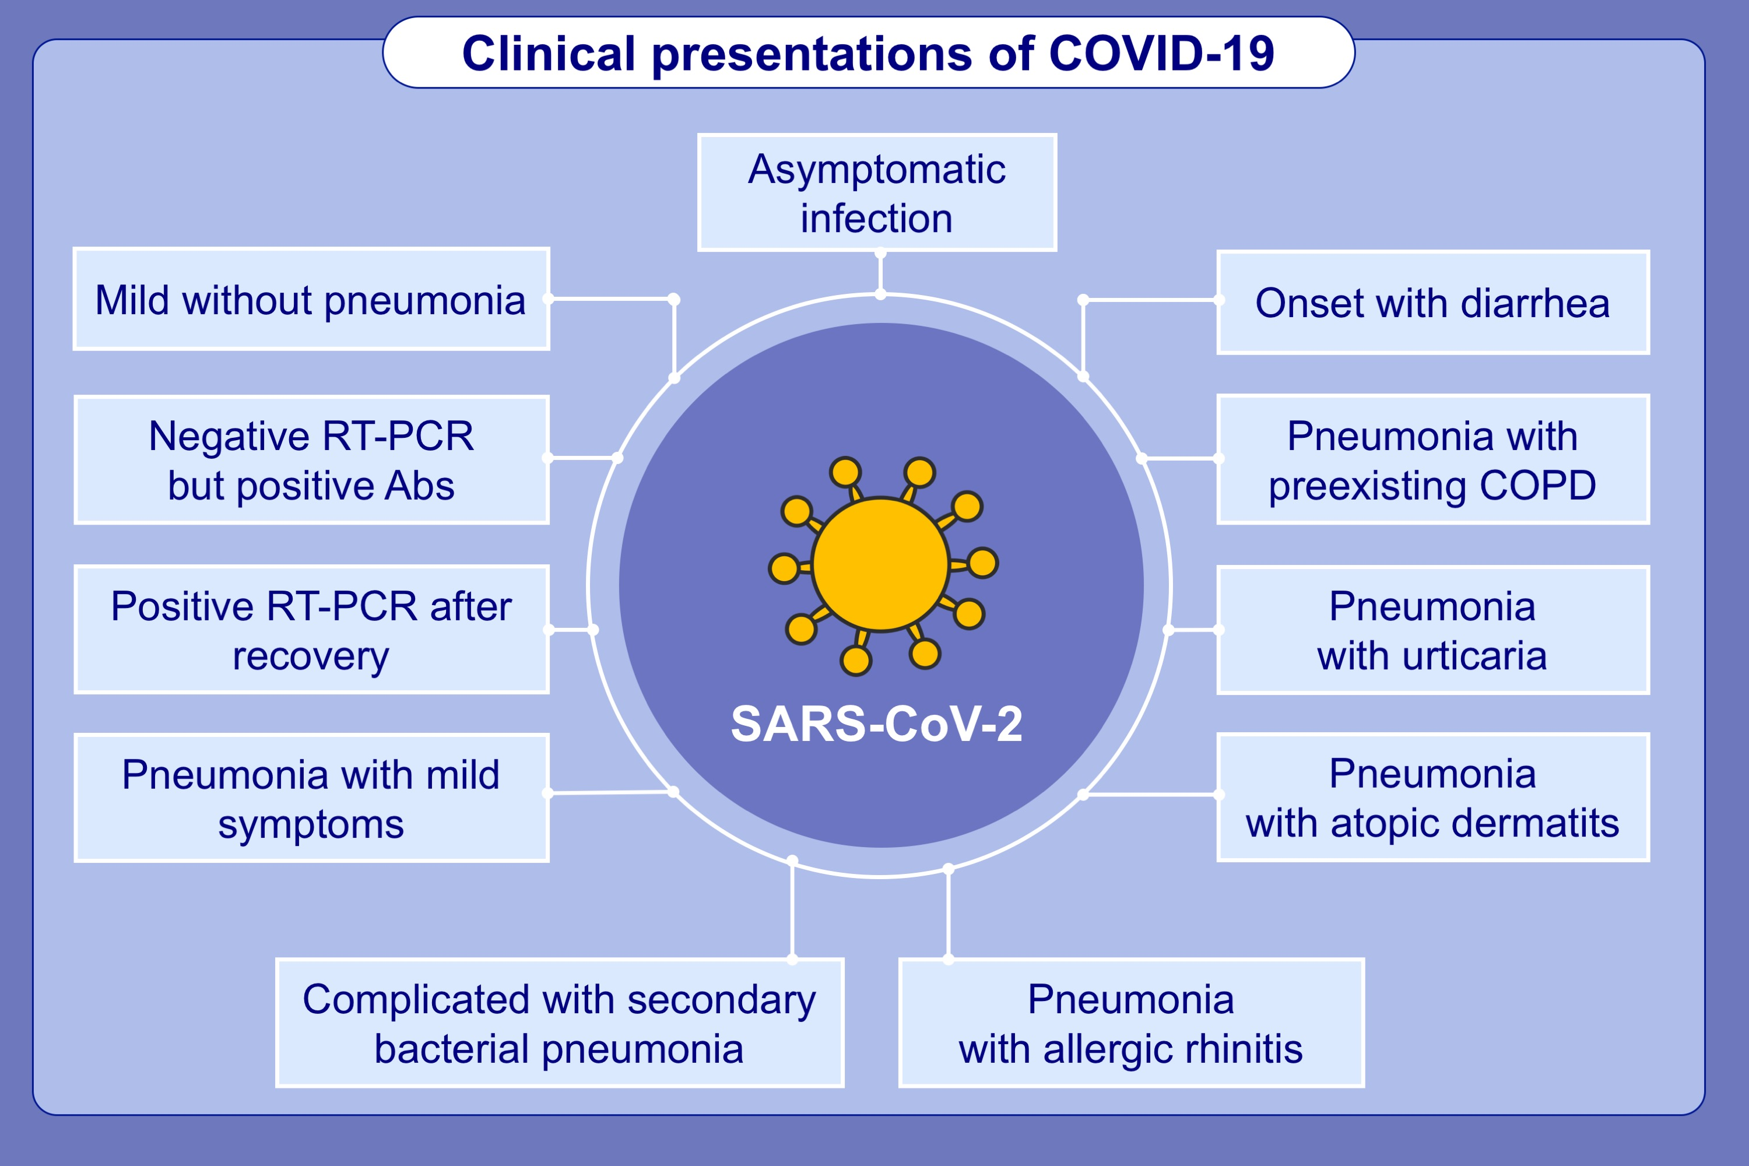
Eleven faces of coronavirus disease 2019
Xiang Dong, Yi‐yuan Cao, Xiao‐xia Lu, Jin‐jin Zhang, Hui Du, et al.
Allergy. 2020; 1699-1709 https://doi.org/10.1111/all.14289
© 2019 EAACI and John Wiley and Sons A/S. Published by John Wiley and Sons Ltd.
Notes:
HIGHLIGHTS
• Clinical manifestations of COVID-19 range from asymptomatic cases to patients with mild and severe symptoms, with or without pneumonia.
• Laboratory detection of the viral nucleic acid can yield false-negative results, and serological testing of virus-specific IgG and IgM antibodies should be used as an alternative for diagnosis.
• Patients with common allergic diseases did not develop distinct symptoms and severe courses.
Abbreviations: COVID-19, coronavirus-19; SARS-CoV-2, severe acute respiratory syndrome coronavirus 2; RT-PCR, reverse transcription polymerase chain reaction; COPD, chronic obstructive pulmonary disease

