Slide 1
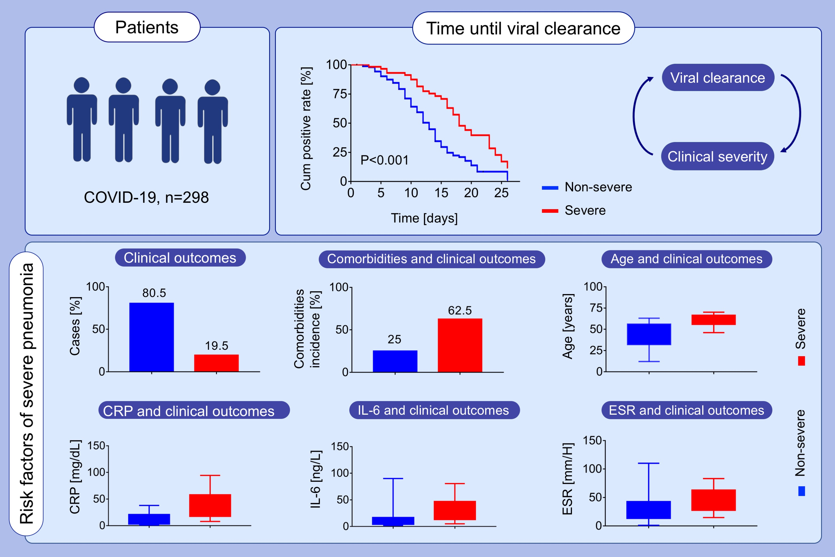
COVID‐19 in a designated infectious diseases hospital outside Hubei Province, China
Qingxian Cai, Deliang Huang, Pengcheng Ou, Hong Yu, Zhibin Zhu, et al.
Allergy. 2020; 1742-1752 https://doi.org/10.1111/all.14309
© 2019 EAACI and John Wiley and Sons A/S. Published by John Wiley and Sons Ltd.
Notes:
HIGHLIGHTS
This study analyzes the epidemiological and clinical features of all 298 COVID-19 cases in the only referral hospital of Shenzhen City.
Slower clearance of virus is associated with a higher progression to severe critical condition. Compared with the nonsevere cases, severe cases are associated with older age, underlying diseases, higher levels of C-reactive protein, interleukin-6, and erythrocyte sedimentation rate.
Abbreviations: CRP, C-reactive protein; ESR, erythrocyte sedimentation rate
.

