Slide 1
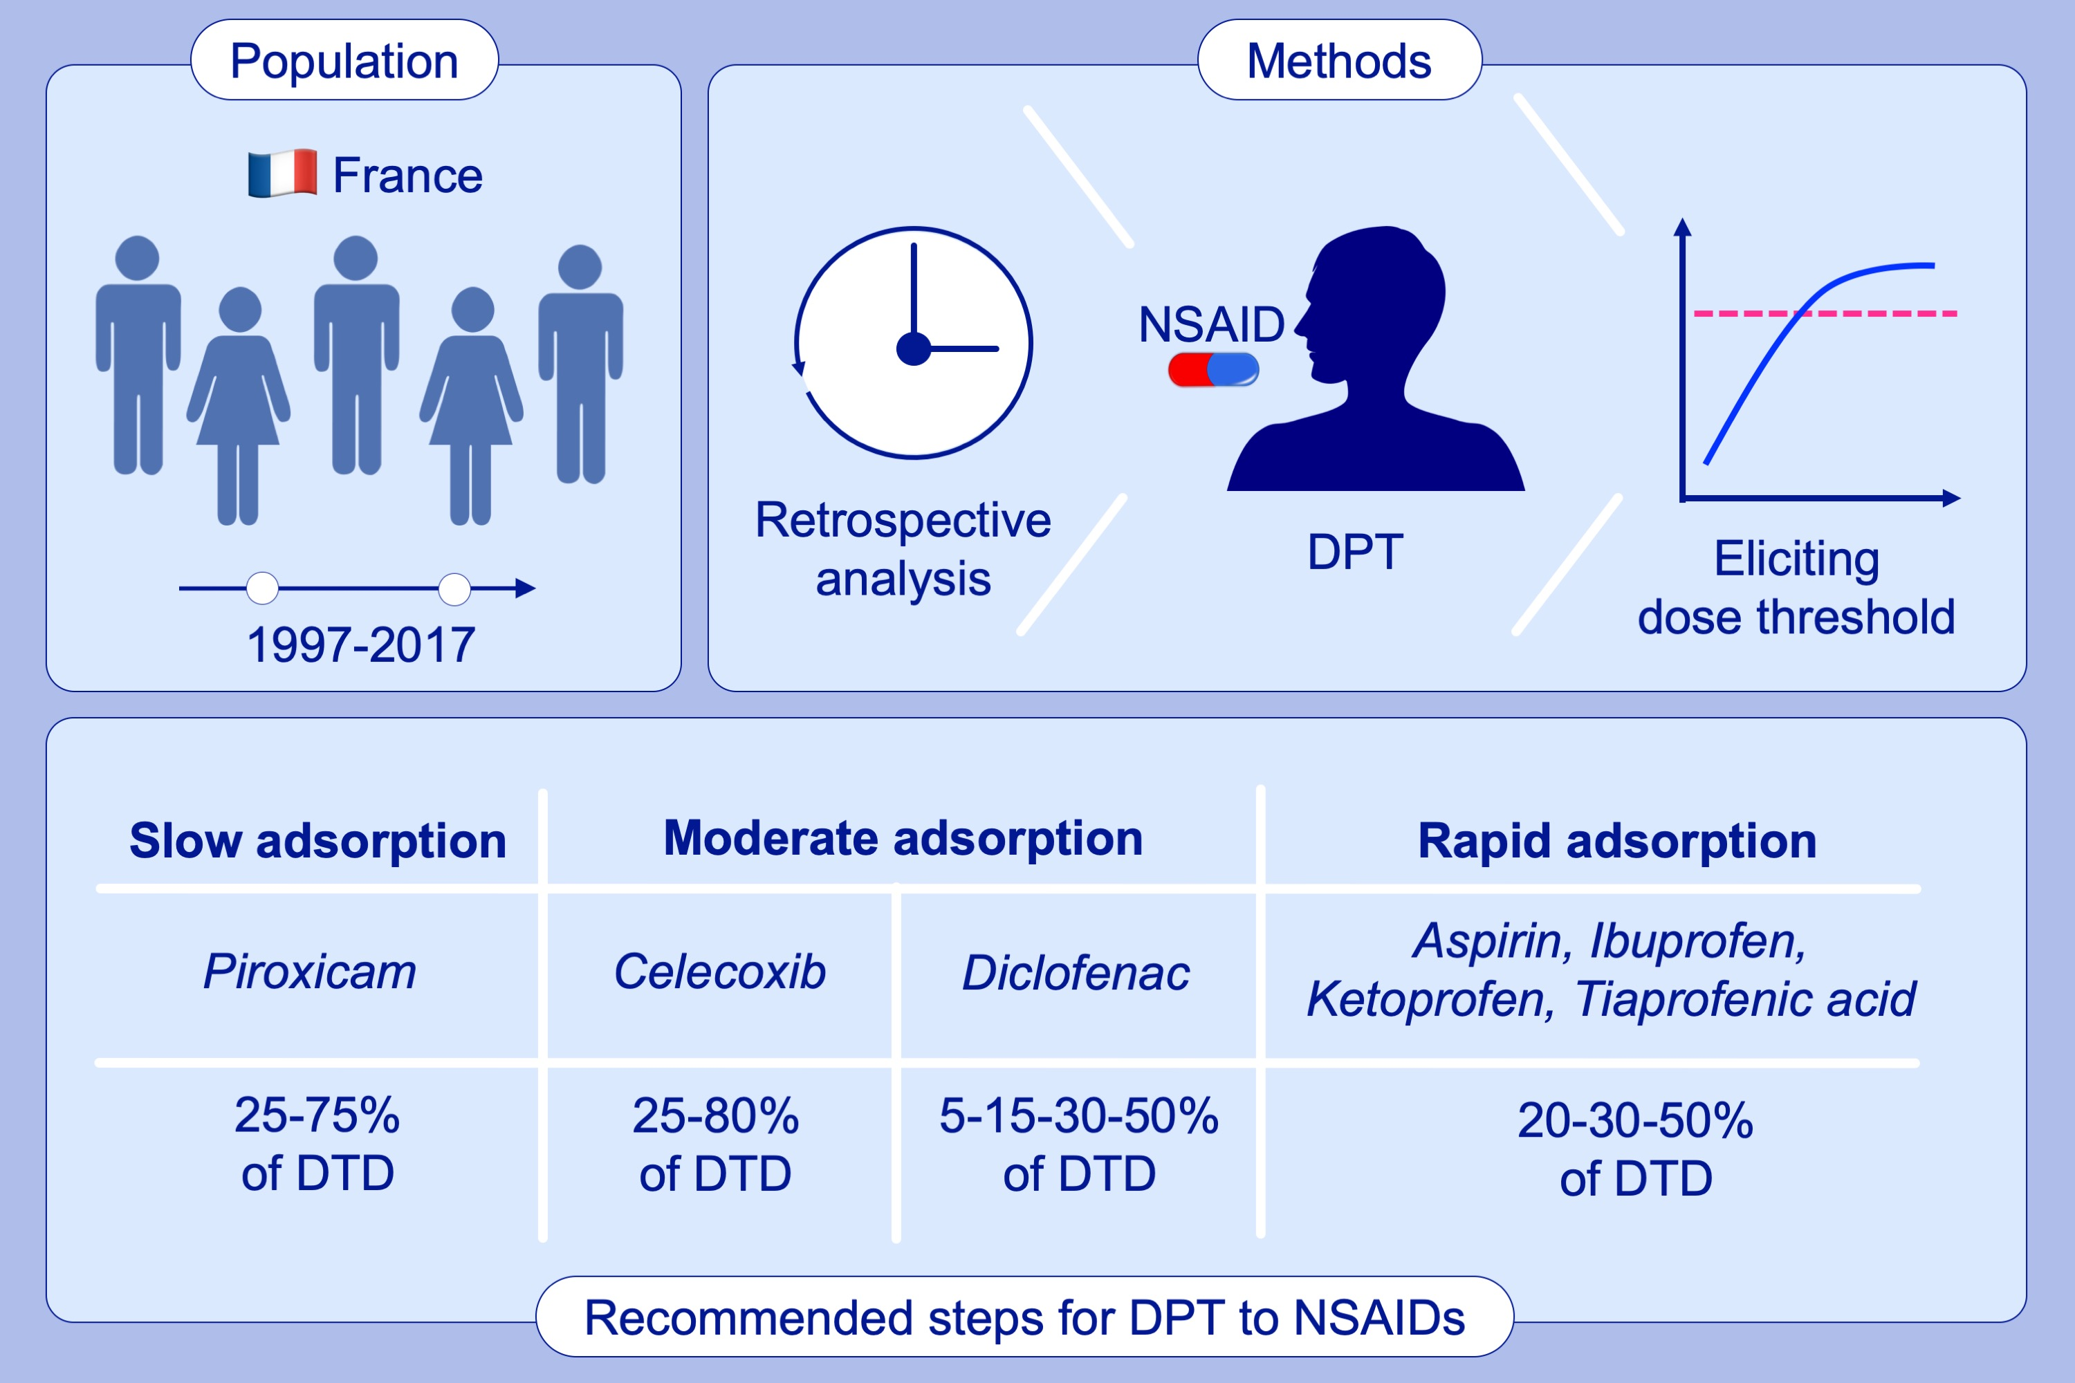
Data‐driven step doses for drug provocation tests to nonsteroidal anti‐inflammatory drugs
Dunya Nohra, Nicolas Molinari, Pascal Demoly, Anca‐Mirela Chiriac
Allergy. 2020; 1423-1434 https://doi.org/10.1111/all.14075
© 2019 EAACI and John Wiley and Sons A/S. Published by John Wiley and Sons Ltd.
Notes:
HIGHLIGHTS
• This retrospective study determines eliciting dose threshold during NSAIDs DPT in patients with positive DPT history.
• We suggest steps for DPT to NSAIDs, according to the absorption pattern of the NSAID.
• New DPT protocol for the slow absorption: 25%–75% of DTD; moderate absorption (Diclofenac and Celecoxib): 5–15–30–50% and 20–80%, respectively; rapid absorption: 20%–30%–50% of DTD.
• Abbreviations: DPT, drug provocation test; DTD: daily therapeutic dose; NSAIDs: non‐steroidal anti‐inflammatory drugs.

