Slide 1
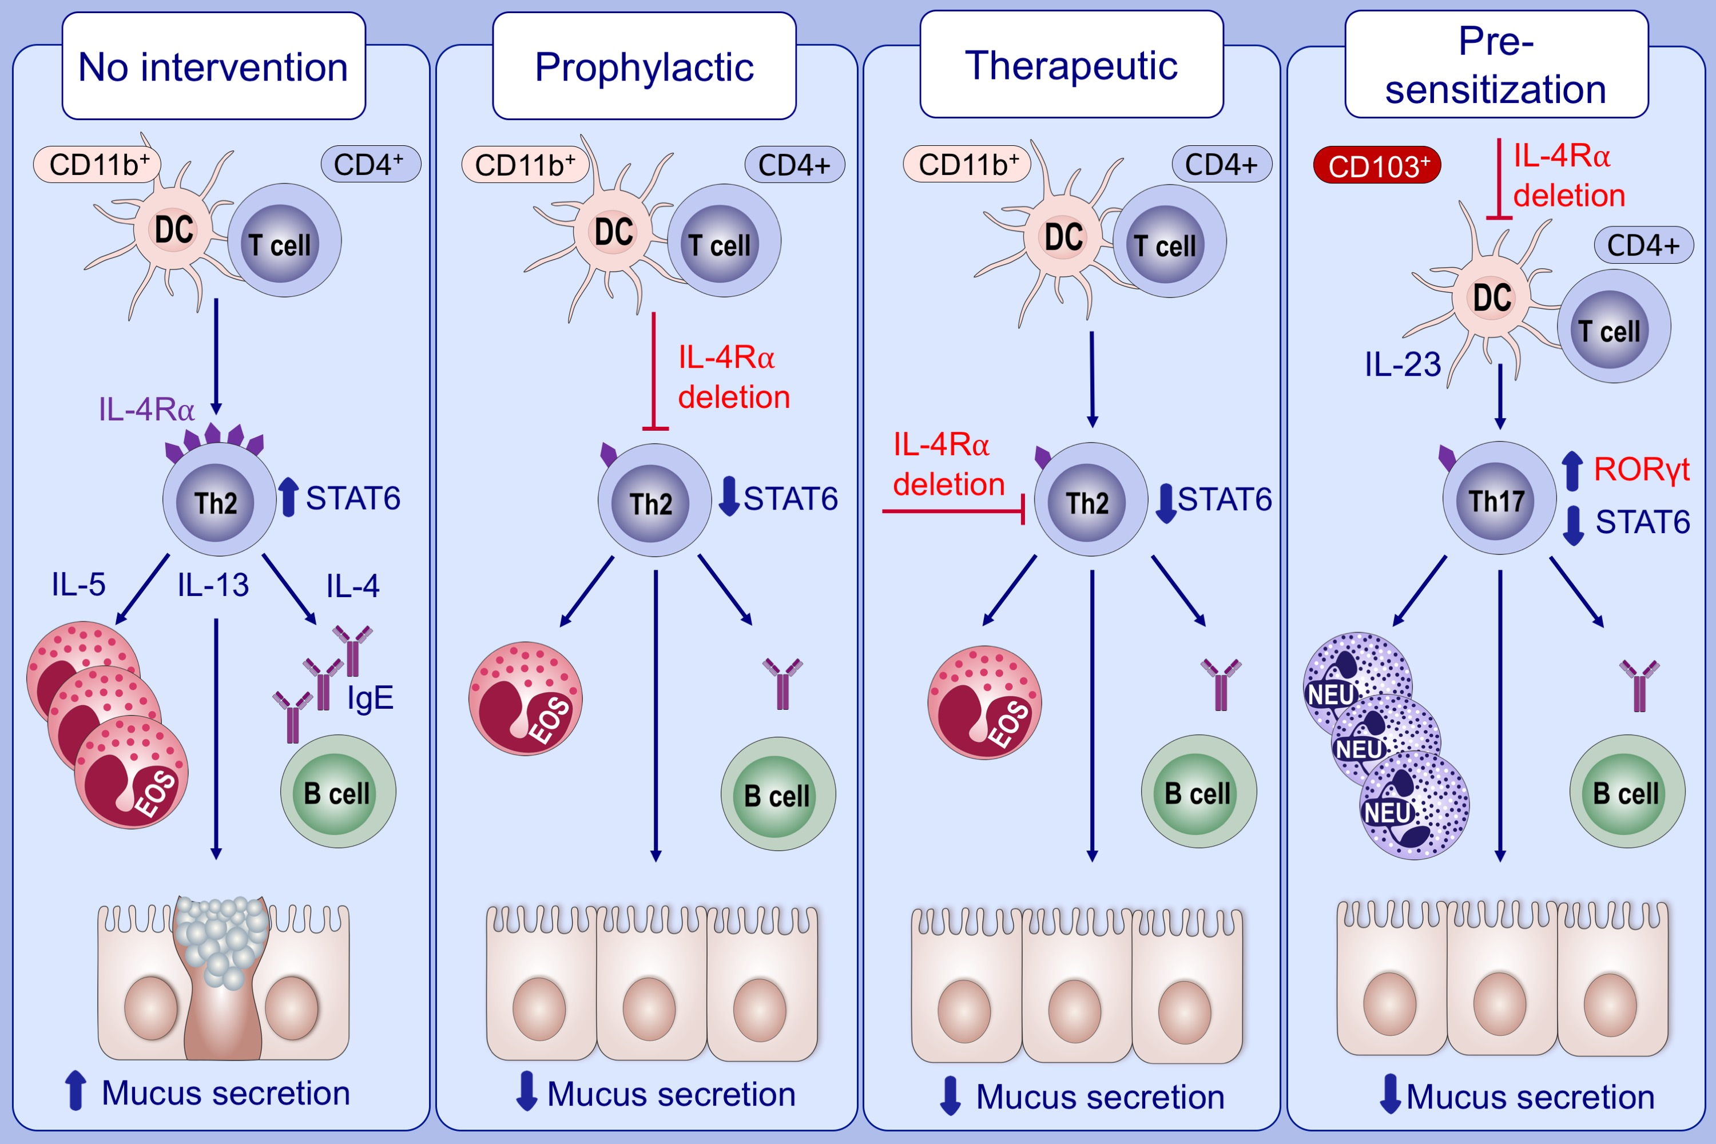
Therapeutic and prophylactic deletion of IL‐4Ra‐signaling ameliorates established ovalbumin induced allergic asthma
Jermaine Khumalo, Frank Kirstein, Martyna Scibiorek, Sabelo Hadebe, Frank Brombacher, et al.
Allergy. 2020; 1347-1360 https://doi.org/10.1111/all.14137
© 2019 EAACI and John Wiley and Sons A/S. Published by John Wiley and Sons Ltd.
Notes:
HIGHLIGHTS
• Interleukin 4 receptor alpha (IL‐4Rα) is central in the initiation and maintenance of the TH2 allergic airway disease.
• Temporal genetic deletion of the IL‐4Rα after sensitization reduced TH2 disease by abrogating effector mechanisms such as CD11b+ migratory DCs, TH2‐associated cytokines, eosinophilia, mucus production, and AHR.
• Temporal genetic deletion of the IL‐4Rα in an established disease reduced CD11b+ migratory DCs, eosinophilia, IgE, mucus production, AHR, but not TH2‐associated cytokines.
• Global deletion of the IL‐4Rα induces CD103+ DCs, neutrophilia, and TH17 cytokines, underscoring the importance of temporal genetic deletion.

