Slide 1
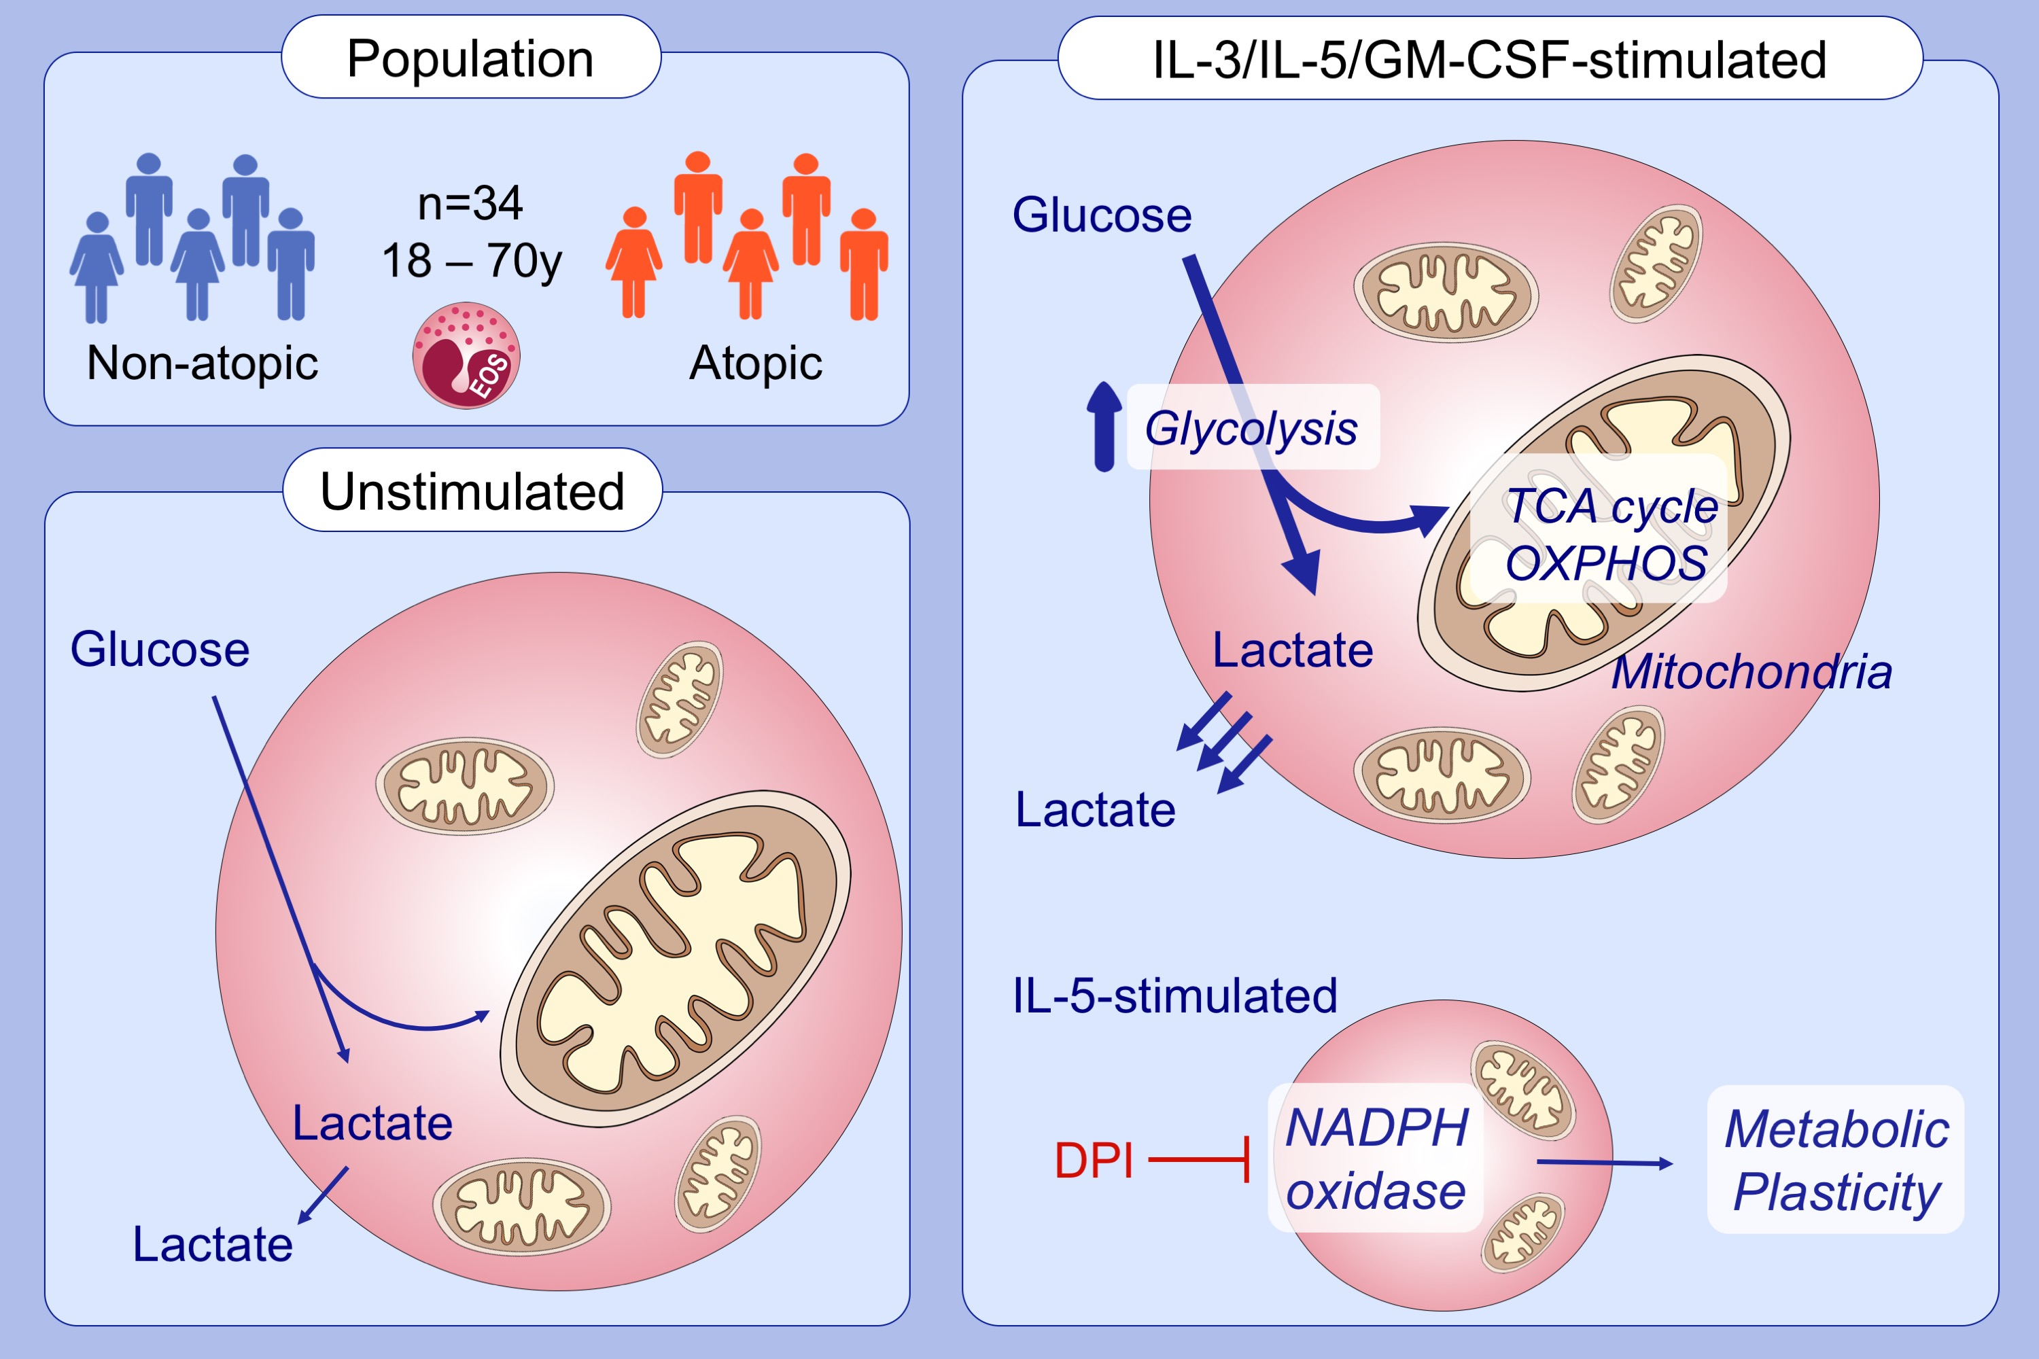
Interleukin‐5 drives glycolysis and reactive oxygen species‐dependent citric acid cycling by eosinophils
Nicholas Jones, Emma E. Vincent, Lindsey C. Felix, James G. Cronin, Louis M. Scott, et al.
Allergy. 2020; 1361-1370 https://doi.org/10.1111/all.14158
© 2019 EAACI and John Wiley and Sons A/S. Published by John Wiley and Sons Ltd.
Notes:
HIGHLIGHTS
• IL‐3, IL‐5 or GM‐CSF stimulated eosinophils increase glycolysis levels.
• Cytokine‐stimulated eosinophils depend on mitochondrial metabolism via generation of TCA cycle metabolites.
• Inhibition of NADPH oxidase activity drives metabolic plasticity of IL‐5 stimulated eosinophils.
• Abbreviations: DPI, diphenyleneiodonium; NADPH, nicotinamide adenine dinucleotide phosphate; TCA, tricarboxylic acid cycle.

