Slide 1
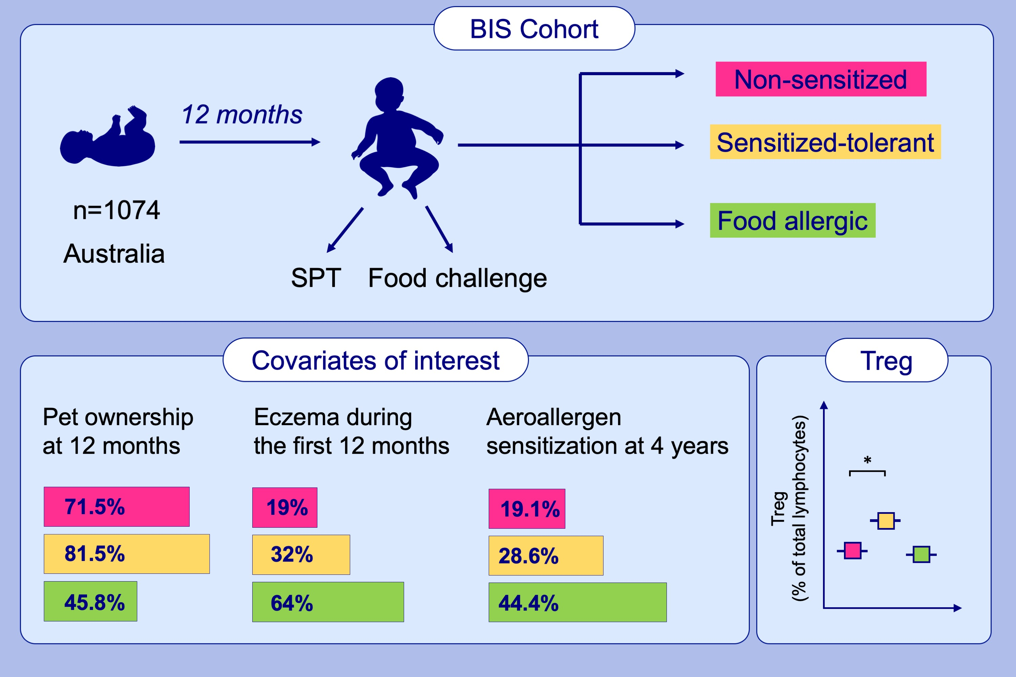
Deserters on the atopic march: Risk factors, immune profile and clinical outcomes of food sensitized–tolerant infants
Lawrence E. K. Gray, Anne‐Louise Ponsonby, Fiona Collier, Martin O'Hely, Peter D. Sly, et al.
Allergy. 2020; 1404-1413 https://doi.org/10.1111/all.14159
© 2019 EAACI and John Wiley and Sons A/S. Published by John Wiley and Sons Ltd.
Notes:
HIGHLIGHTS
• Food‐sensitized tolerance in infancy appears to be associated with a similar pattern of exposures, immunity, and outcomes to nonsensitized infants.
• Compared to infants with clinical food allergy, both sensitized‐tolerant and nonsensitized infants were more likely to be exposed to pets in infancy, had less eczema during the first 12 months and less aeroallergen sensitization at 4 years of age.
• A lower proportion of naïve regulatory T cells at birth was observed among food allergic infants than nonsensitized infants.
• Abbreviations BIS, Barwon Infant Study; SPT, skin prick test; Treg, regulatory T cell.

