Slide 1
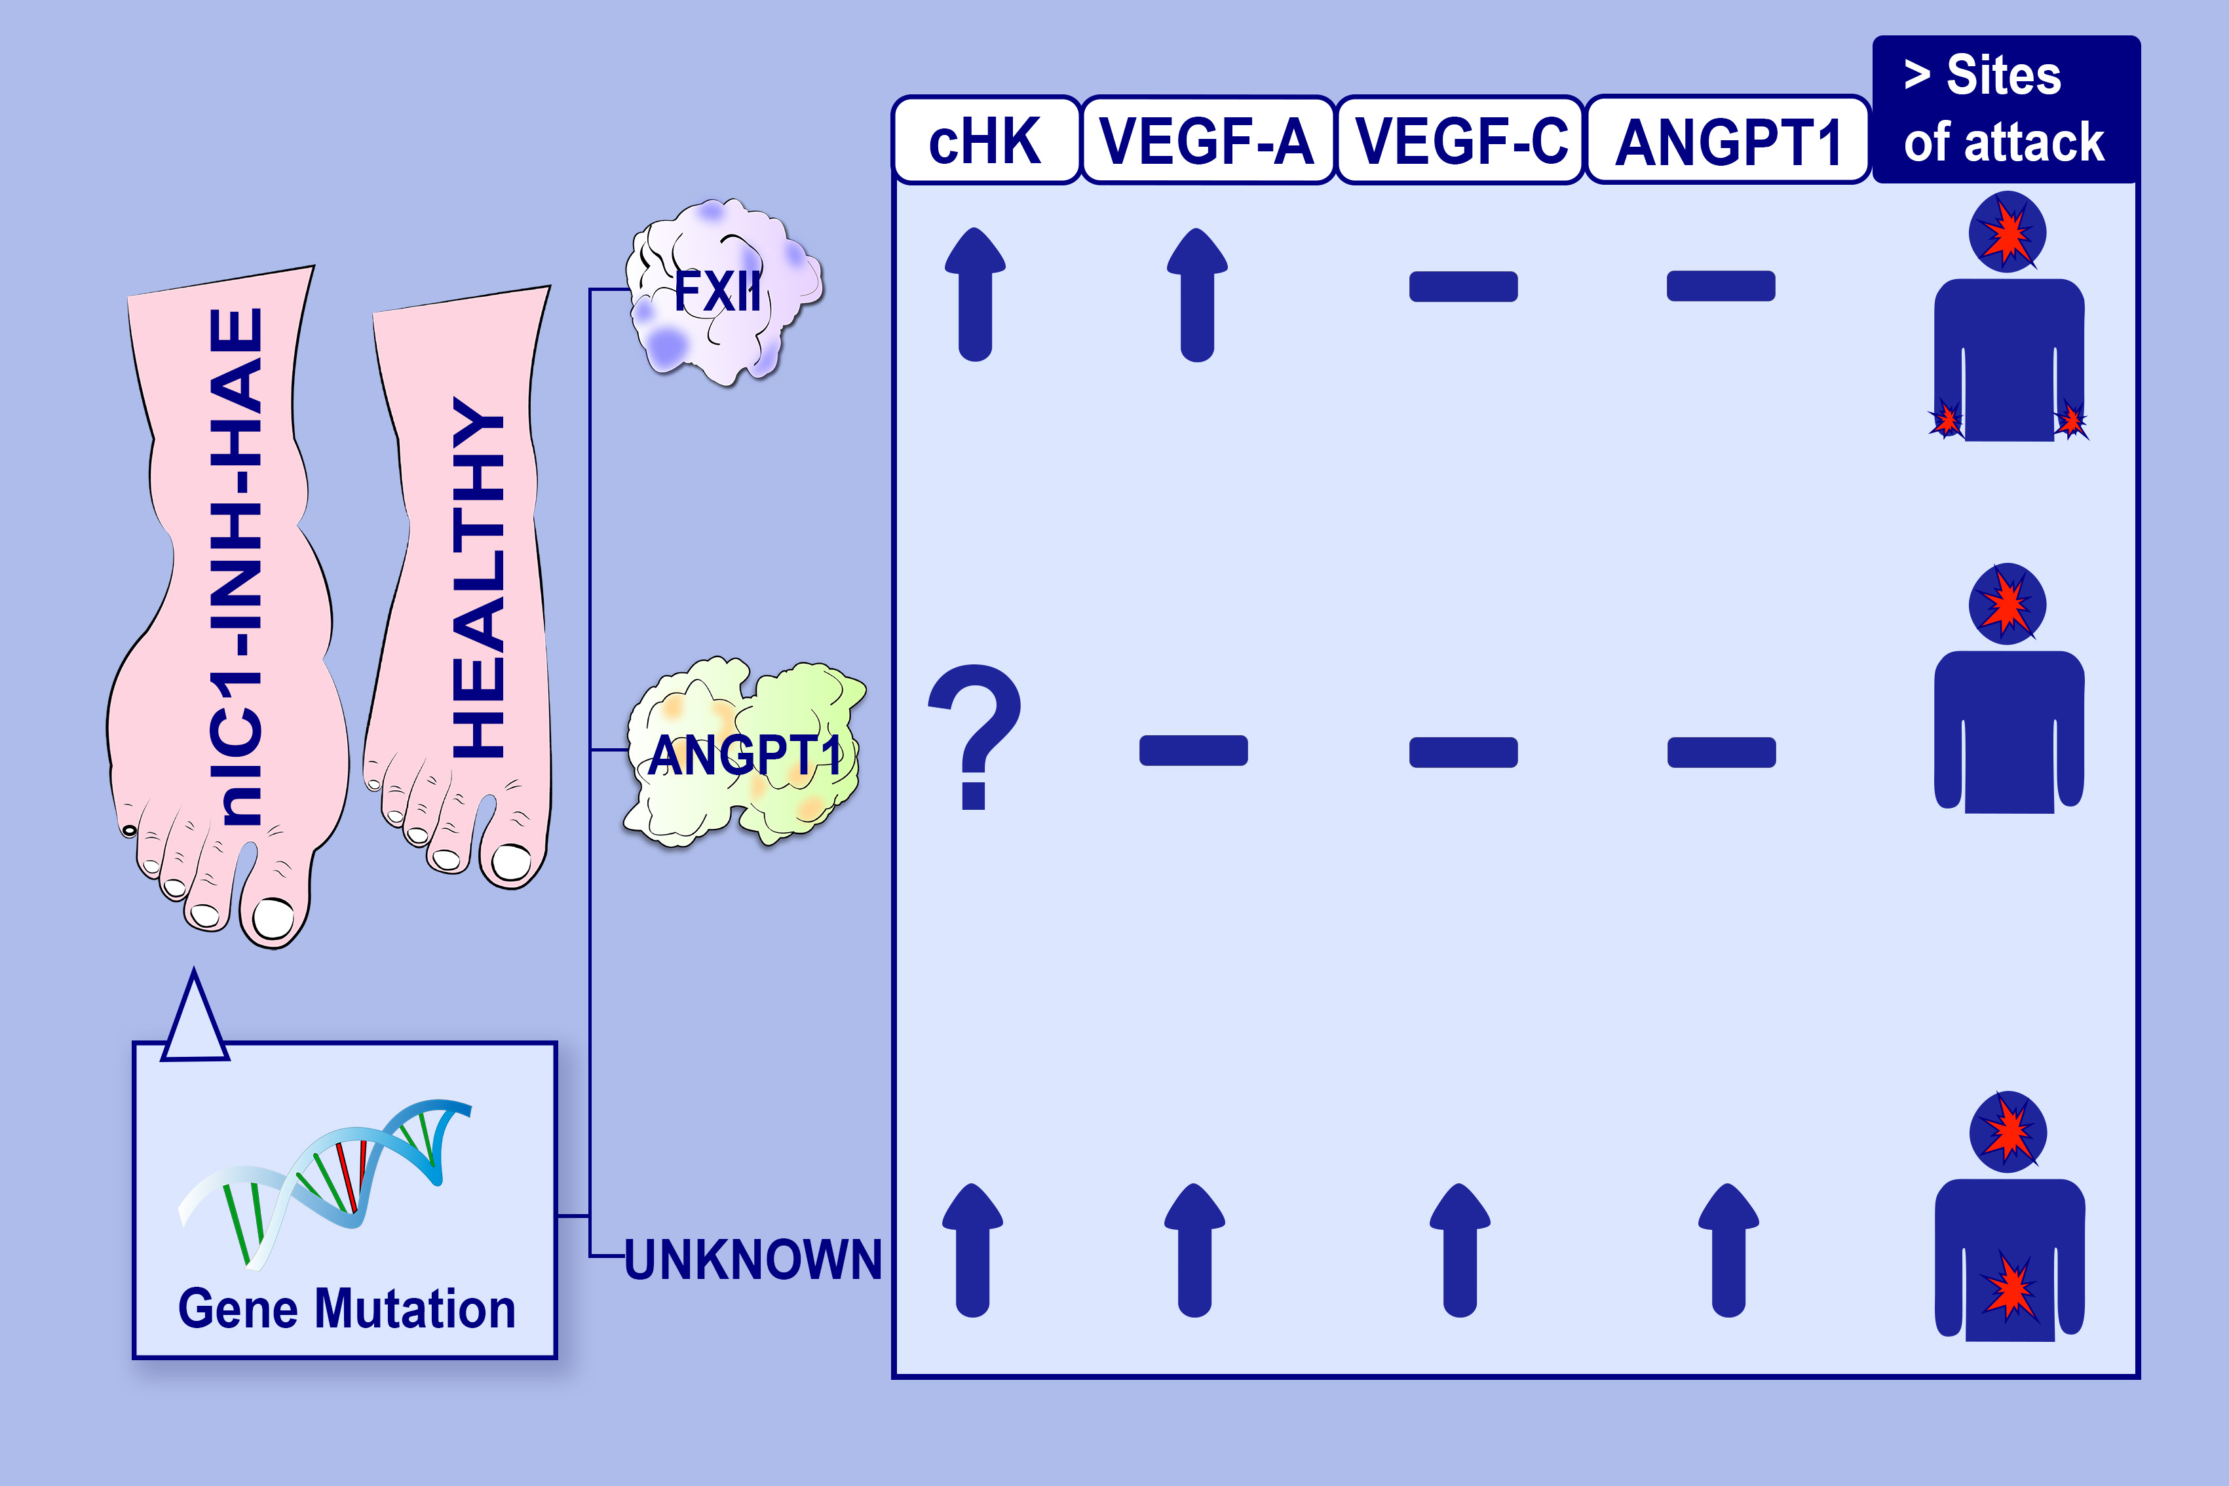
Impaired control of the contact system in hereditary angioedema with normal C1‐inhibitor
Maria Bova, Chiara Suffritti, Valeria Bafunno, Stefania Loffredo, Giorgia Cordisco, et al.
Allergy. 2020; 1394-1403 https://doi.org/10.1111/all.14160
© 2019 EAACI and John Wiley and Sons A/S. Published by John Wiley and Sons Ltd.
Notes:
HIGHLIGHTS
• cHK levels in nl‐C1‐INH‐HAE patients are higher than controls in absence of protease inhibitors.
• Pathogenesis of nl‐C1‐INH‐HAE moves through an unbalanced control of kallikrein activity, with bradykinin as most likely mediator.
• VEGFs and Ang1 seem to participate in the pathophysiology of U‐HAE increasing the basal vascular permeability.
• Frequency of angioedema location during attacks differ in the FXII‐HAE, ANGPT1‐HAE and U‐HAE cohorts.

