Slide 1
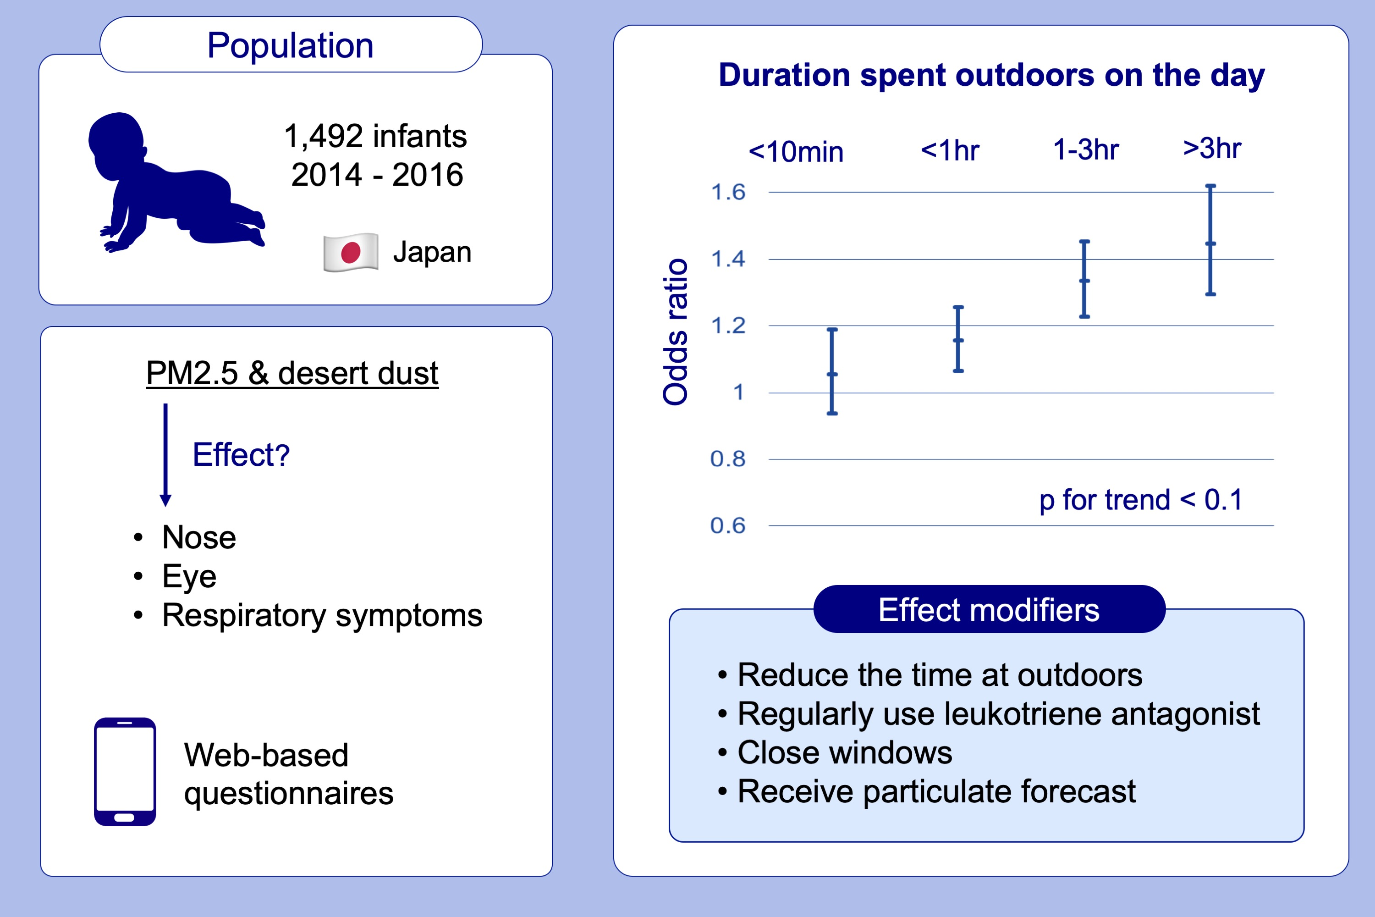
The impact of exposure to desert dust on infants’ symptoms and countermeasures to reduce the effects
Toshiko Itazawa, Kumiko T. Kanatani, Kei Hamazaki, Hidekuni Inadera, Akiko Tsuchida, et al.
Allergy. 2020; 1435-1445 https://doi.org/10.1111/all.14166
© 2019 EAACI and John Wiley and Sons A/S. Published by John Wiley and Sons Ltd.
Notes:
HIGHLIGHTS
• This is the first study to clearly demonstrate that desert dust was associated with an increased risk of nose/respiratory symptoms in infants.
• Reducing outdoor duration on the day and regular use of leukotriene receptor antagonists significantly reduces the risk at the exposure.
• Other effect modifiers include keeping windows closed and receiving particulate forecast. .

