Slide 1
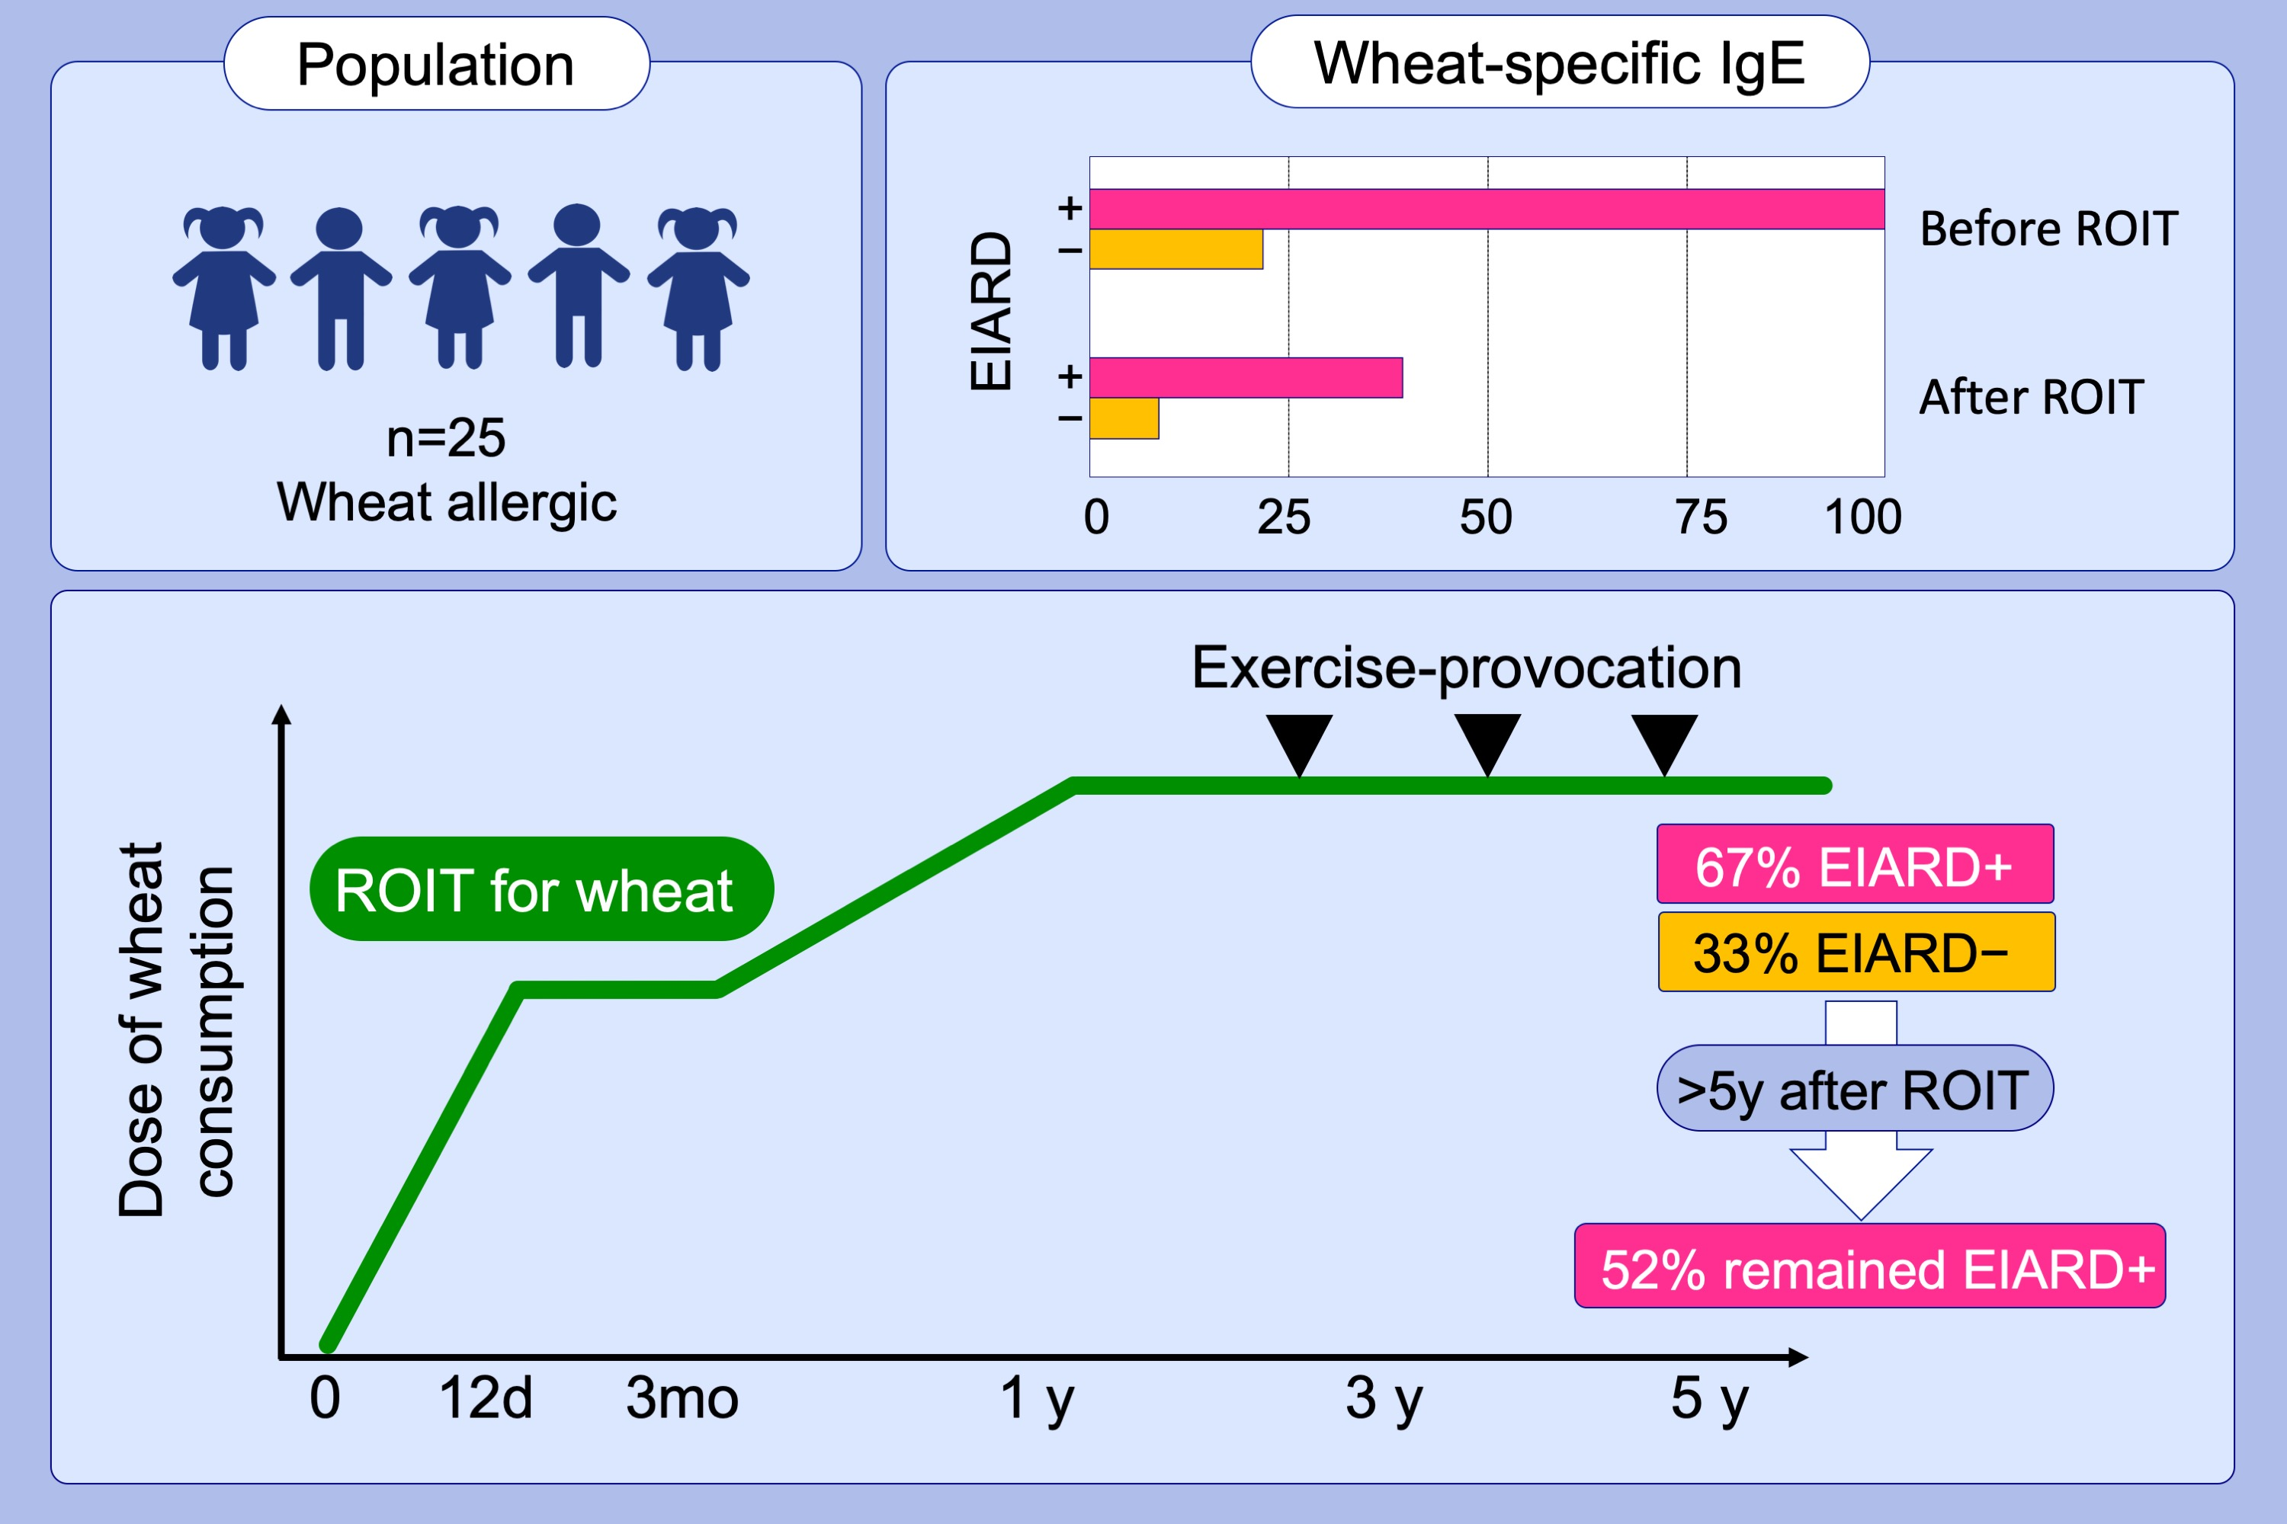
Exercise‐induced allergic reactions on desensitization to wheat after rush oral immunotherapy
Tomoko Furuta, Kajiyo Tanaka, Kazunori Tagami, Teruaki Matsui, Shiro Sugiura, et al.
Allergy. 2020; 1414-1422 https://doi.org/10.1111/all.14182
© 2019 EAACI and John Wiley and Sons A/S. Published by John Wiley and Sons Ltd.
Notes:
HIGHLIGHTS
• This study investigates the frequency and clinical features of children with EIARD remaining after oral immunotherapy (OIT).
• EIARD+ patients show significantly higher wheat components‐specific IgE levels compared to EIARD‐ patients before OIT.
• 52% patients remained EIARD+ 5 years after ROIT.
• Abbreviations: EIARD, exercise‐induced allergic reactions on desensitization; ROIT, rush oral immunotherapy.

