Slide 1
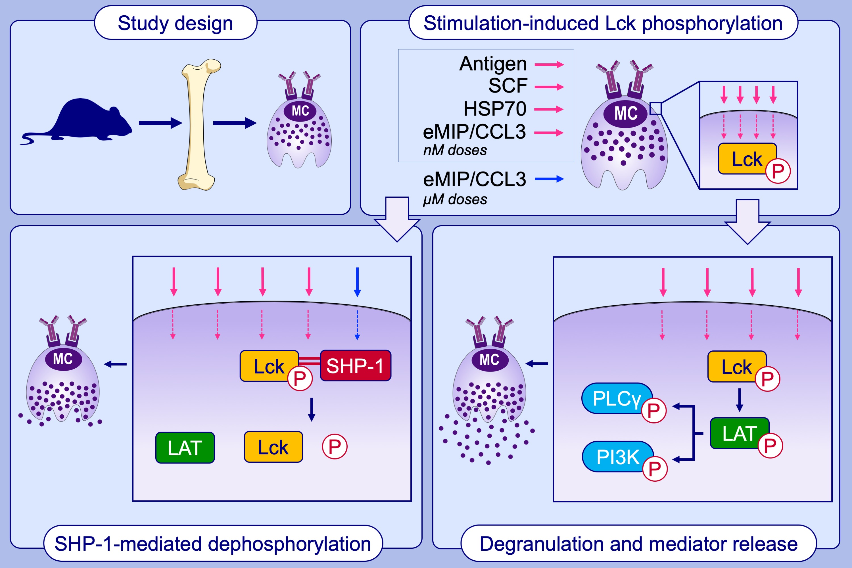
A common signaling pathway leading to degranulation in mast cells and its regulation by CCR1‐ligand
Hyeun Wook Chang, Shiro Kanegasaki, Fansi Jin, Yifeng Deng, Zhiwei You, et al.
Allergy. 2020; 1371-1381 https://doi.org/10.1111/all.14186
© 2019 EAACI and John Wiley and Sons A/S. Published by John Wiley and Sons Ltd.
Notes:
HIGHLIGHTS
• Binding of IgE/Ag, SCF, HSP70, and eMIP/CCL3 to their receptors induces Lck phosphorylation, which in turn phosphorylates LAT.
• Phospho‐LAT triggers phosphorylation of PLC, PI3K, and downstream signaling proteins leading to degranulation and mediator release.
• All receptors are internalized with the aid of phospho‐Lck.
• Activated by micromolar doses of eMIP/CCL3 or by A770041, SHP‐1 dephosphorylates phospho‐Lck, whereby receptor recycling, degranulation and mediator release are terminated.

