Slide 1
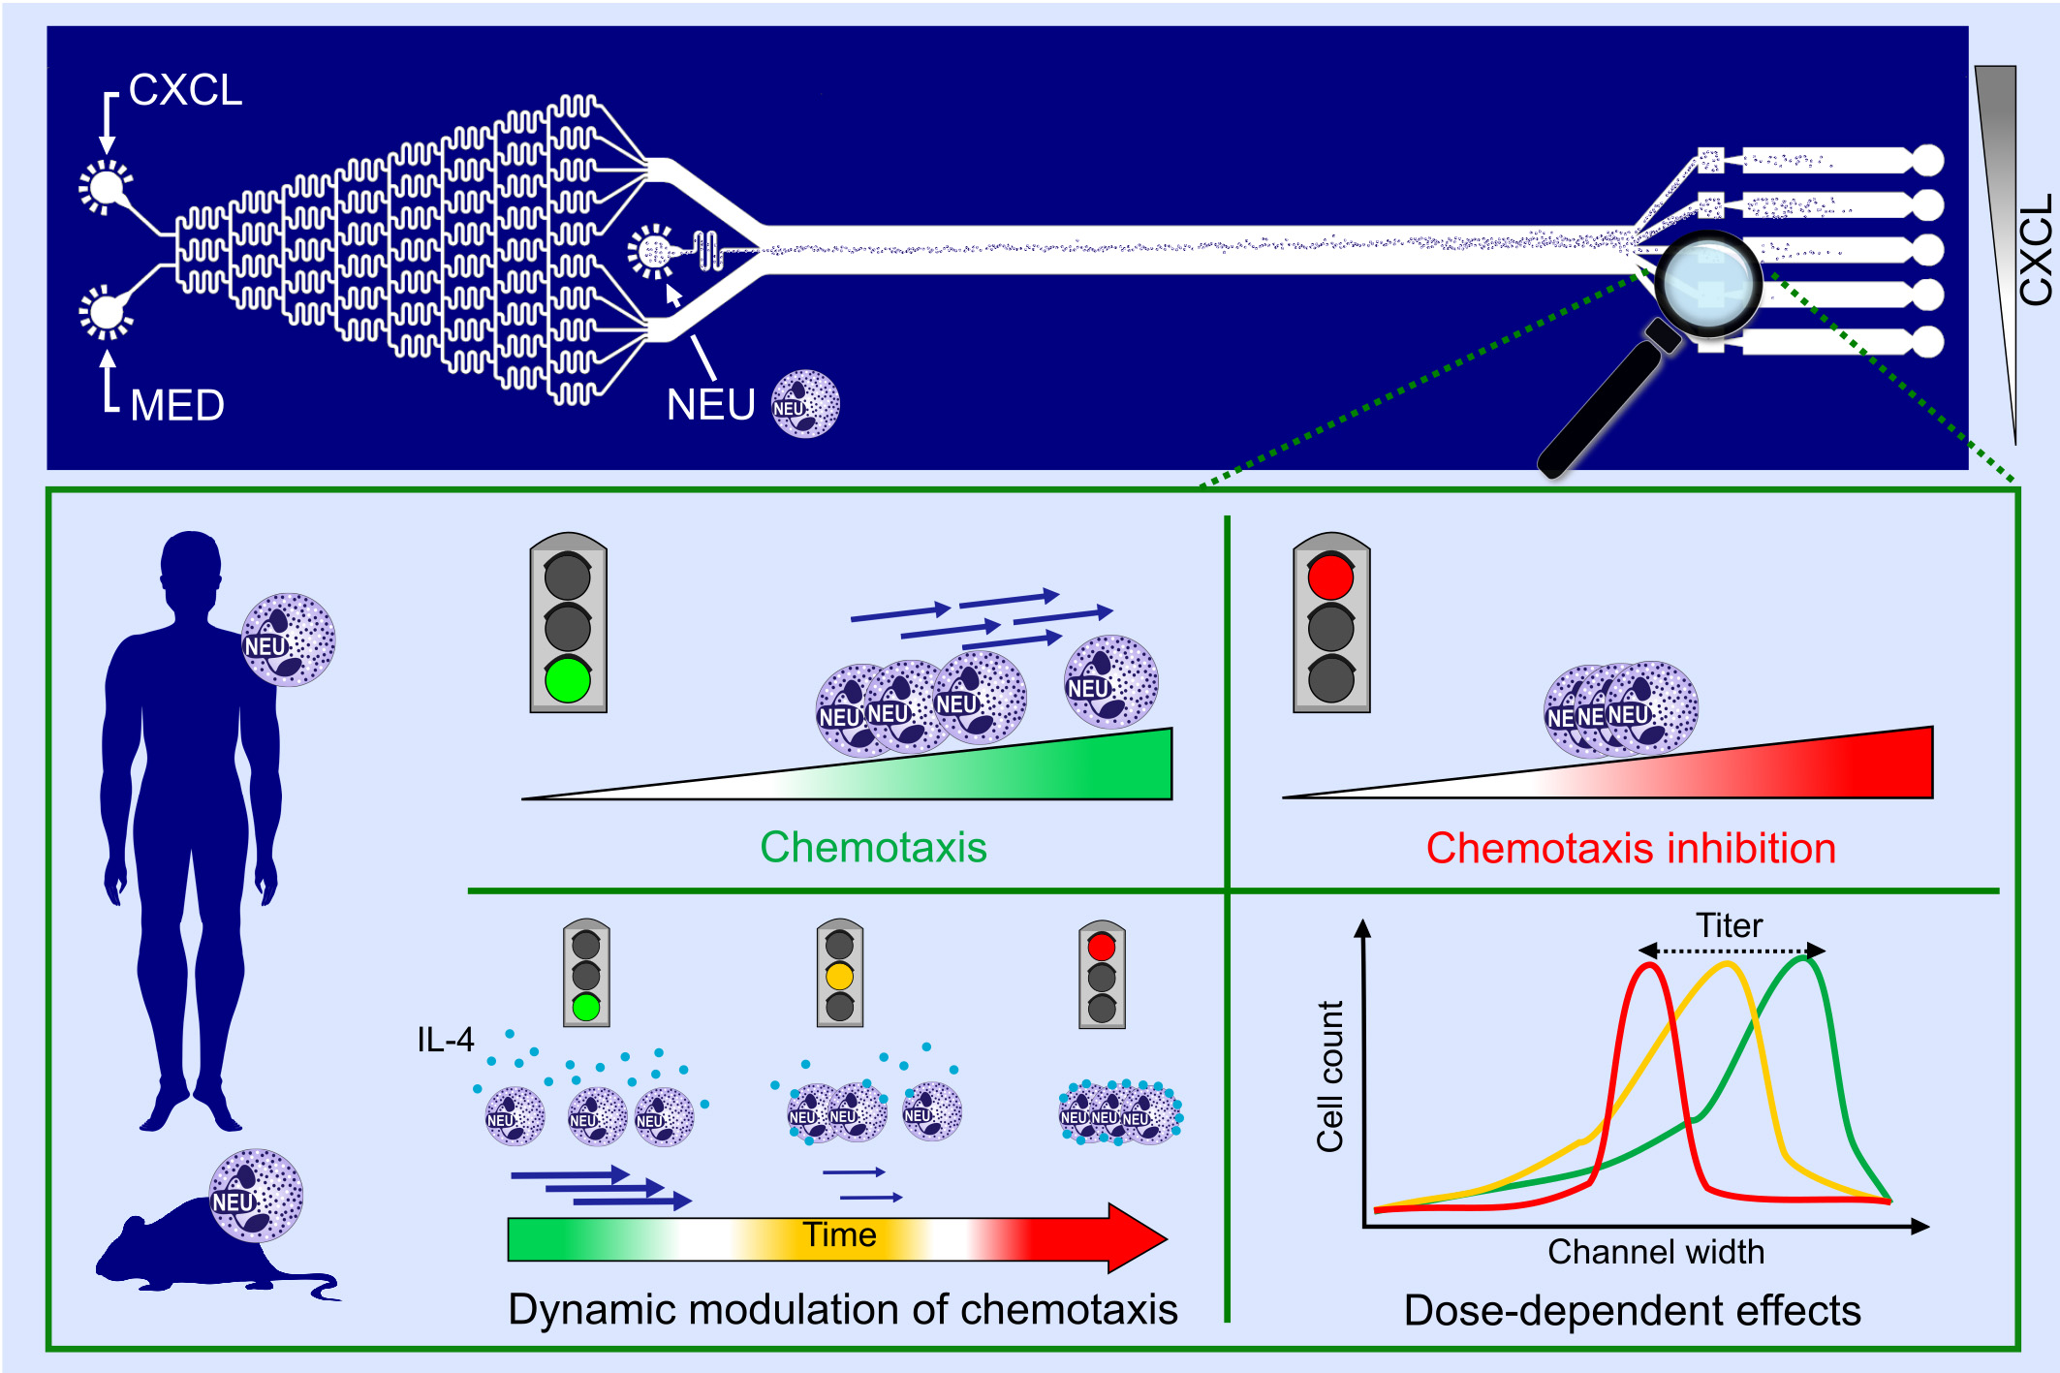
Establishment of a scalable microfluidic assay for characterization of population‐based neutrophil chemotaxis
Fulvio Grigolato, Cecilie Egholm, Daniela Impellizzieri, Paolo Arosio, Onur Boyman, et al.
Allergy. 2020; 1382-1393 https://doi.org/10.1111/all.14195
© 2019 EAACI and John Wiley and Sons A/S. Published by John Wiley and Sons Ltd.
Notes:
HIGHLIGHTS
• We established a microfluidic device for fully automated, quantitative assessment of mouse and human neutrophil chemotaxis.
• We determined the dose and time dependency of neutrophil chemotaxis toward inflammatory chemokines.
• We modulated dynamic and temporal aspects of neutrophil chemotaxis by stimulation with interleukin‐4, the prototypic cytokine of type 2 immunity, and allergic inflammation.
• Abbreviations: CXCL, C‐X‐C‐motif ligand; MED, medium.

