Slide 1
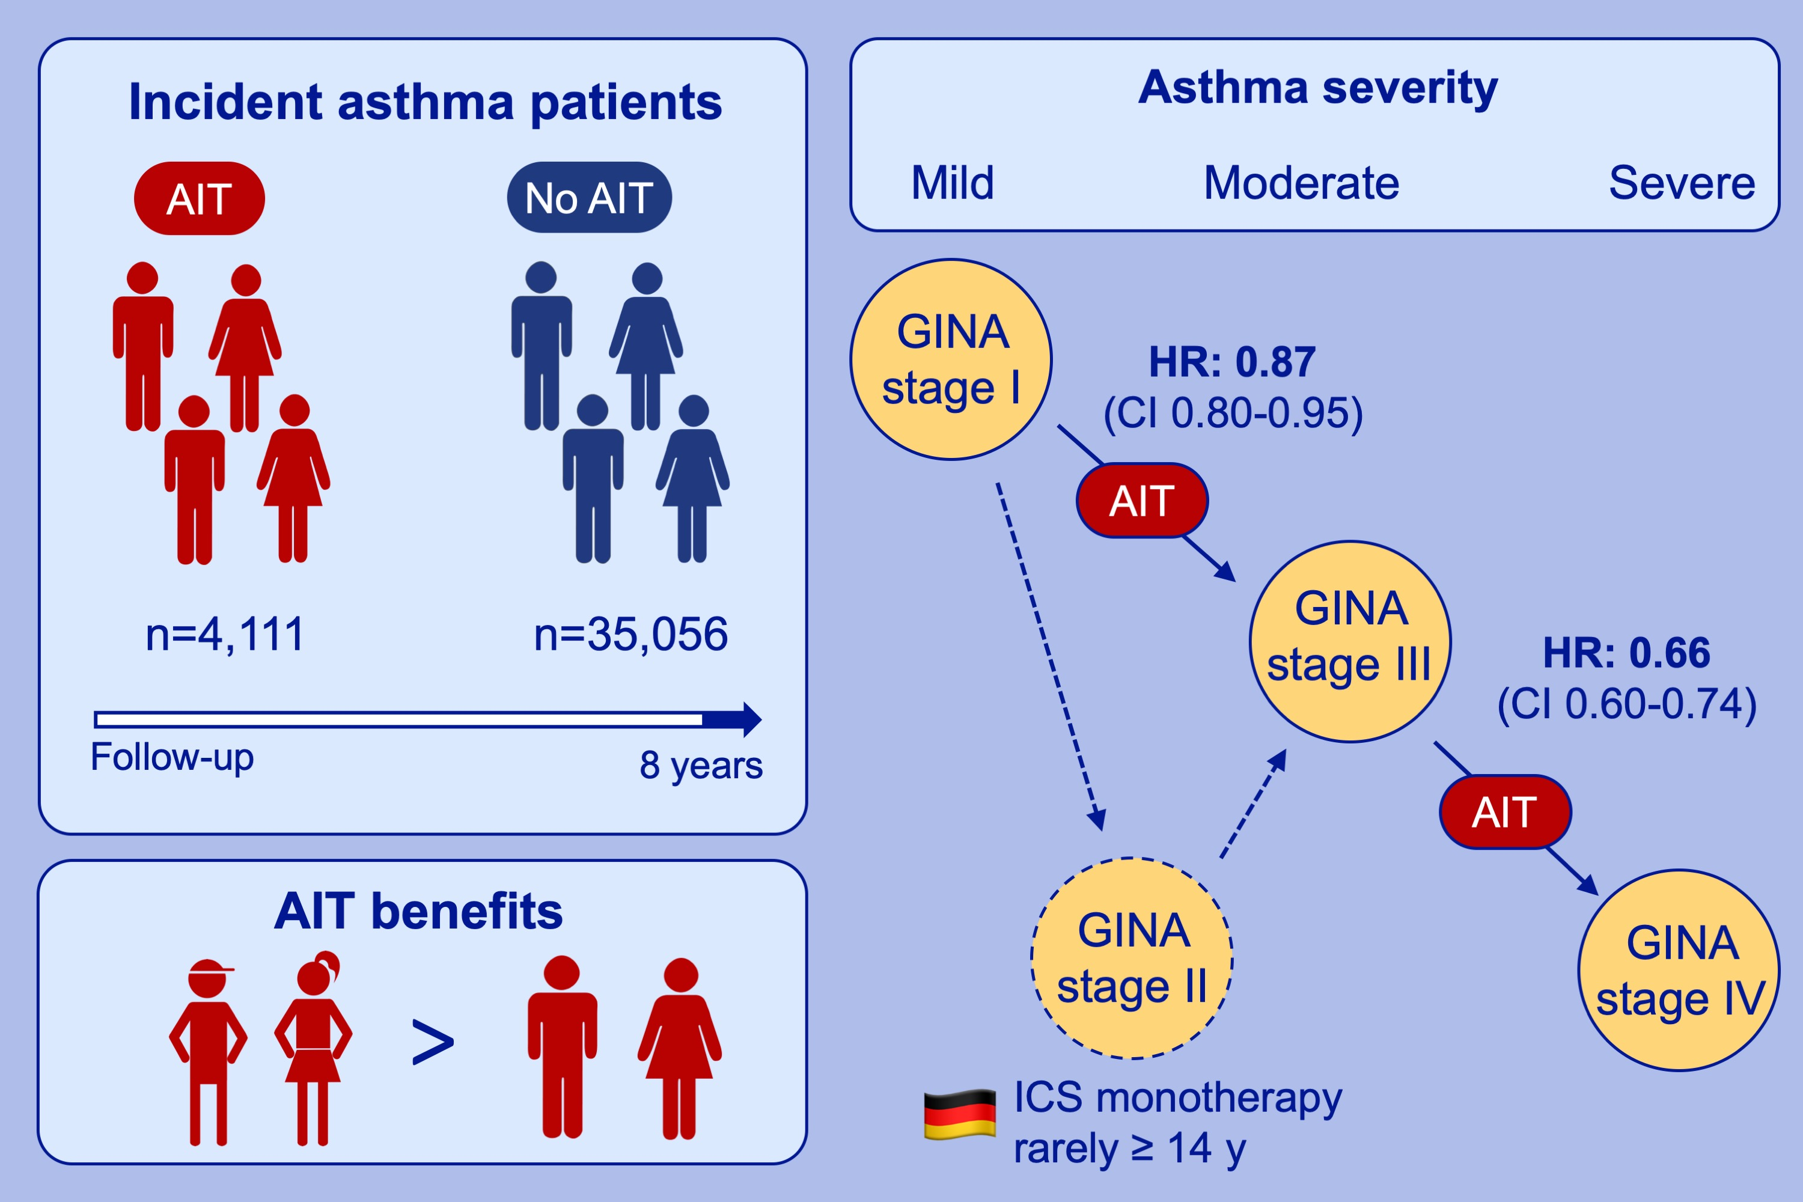
The moderating role of allergy immunotherapy in asthma progression: Results of a population‐based cohort study
Jochen Schmitt, Eike Wüstenberg, Denise Küster, Victoria Mücke, Niels Serup‐Hansen, et al.
Allergy. 2020; 596-602 https://doi.org/10.1111/all.14020
© 2019 EAACI and John Wiley and Sons A/S. Published by John Wiley and Sons Ltd.
Notes:
HIGHLIGHTS
• In a large cohort study of 39,167 asthma patients, those with AIT had a decreased likelihood for disease progression, measured in symptomatic medication according to GINA.
• Younger patients benefited most from AIT, which is reflected in prevention or delay of asthma progression.
• Inhaled corticosteroids (ICS) monotherapy (GINA stage 2) is rarely prescribed in Germany for asthma patients over 14 years.

