Slide 1
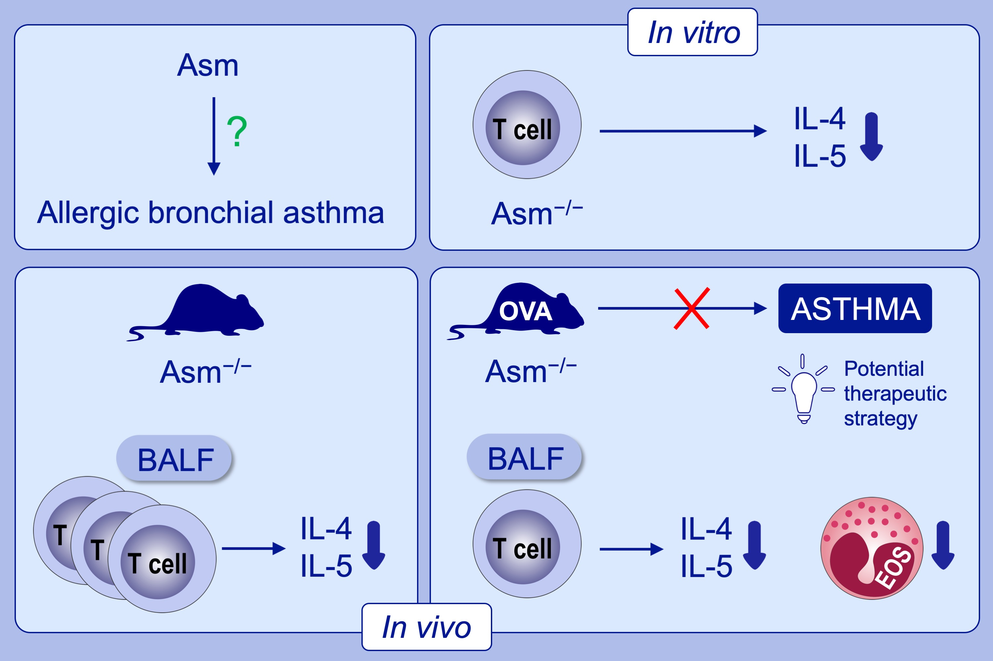
Acid sphingomyelinase regulates TH2 cytokine release and bronchial asthma
Svenja Böll, Sebastian Ziemann, Kim Ohl, Patricia Klemm, Annette D. Rieg, et al.
Allergy. 2020; 603-615 https://doi.org/10.1111/all.14039
© 2019 EAACI and John Wiley and Sons A/S. Published by John Wiley and Sons Ltd.
Notes:
HIGHLIGHTS
• This study investigated the role of acid sphingomyelinase (Asm) in allergic bronchial asthma.
• Asm deficiency resulted in reduced TH2 cytokine release both in vitro and in vivo.
• In the ovalbumin model, ASM−/− mice were protected from bronchial asthma, showed decreased production of TH2 cytokines and lower number of eosinophils.
ABBREVIATIONS
Asm, acid sphingomyelinase; BALF, bronchoalveolar lavage fluid; OVA, ovalbumin

