Slide 1
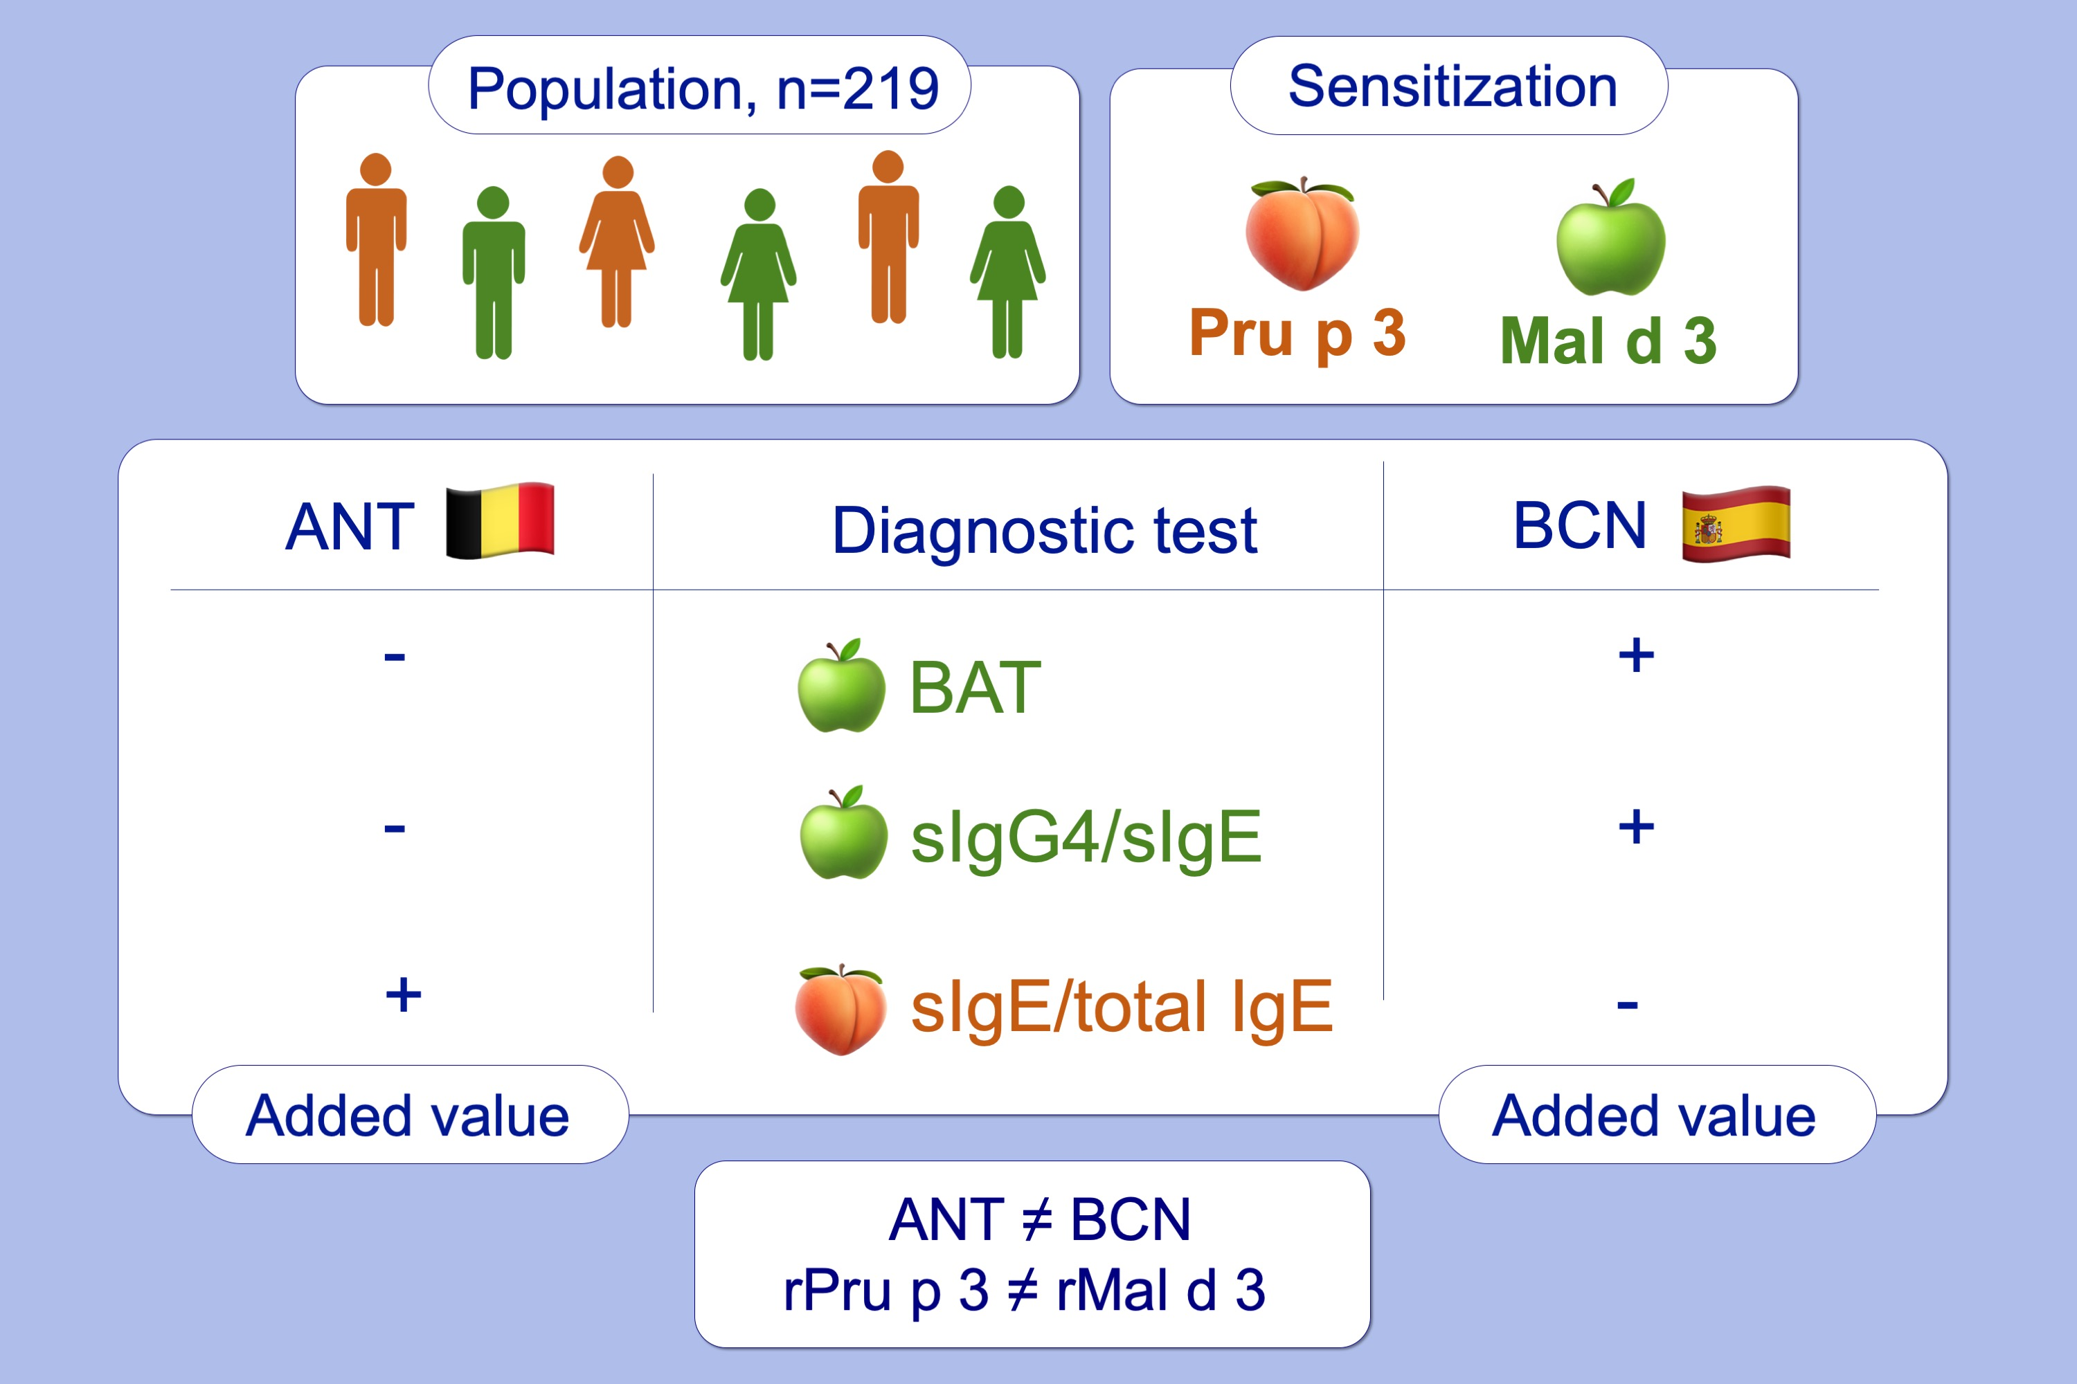
Performance of basophil activation test and specific IgG4 as diagnostic tools in nonspecific lipid transfer protein allergy: Antwerp‐Barcelona comparison
Ine I. Decuyper, Mariona Pascal, Athina L. Van Gasse, Christel Mertens, Araceli Díaz‐Perales, et al.
Allergy. 2020; 616-624 https://doi.org/10.1111/all.14040
© 2019 EAACI and John Wiley and Sons A/S. Published by John Wiley and Sons Ltd.
Notes:
HIGHLIGHTS
• This study explores the performance of BAT, sIgE/total IgE, sIgG4 and sIgG4/sIgE ratio in Pru p 3- and Mal d 3-sensitized populations from Antwerp (ANT) and Barcelona (BCN).
• In BCN, only ratios of sIgG4/sIgE rMal d 3 and BAT rMal d 3 can identify clinically relevant Mal d 3 sensitization, whereas in ANT, only the sIgE/total IgE rPru p 3 ratio shows added value.
• NsLTP sensitization and diagnostic performance cannot be extrapolated from one population to another.
ABBREVIATIONS
BAT, basophil activation test; nsLTP, non-specific lipid transfer protein

