Slide 1
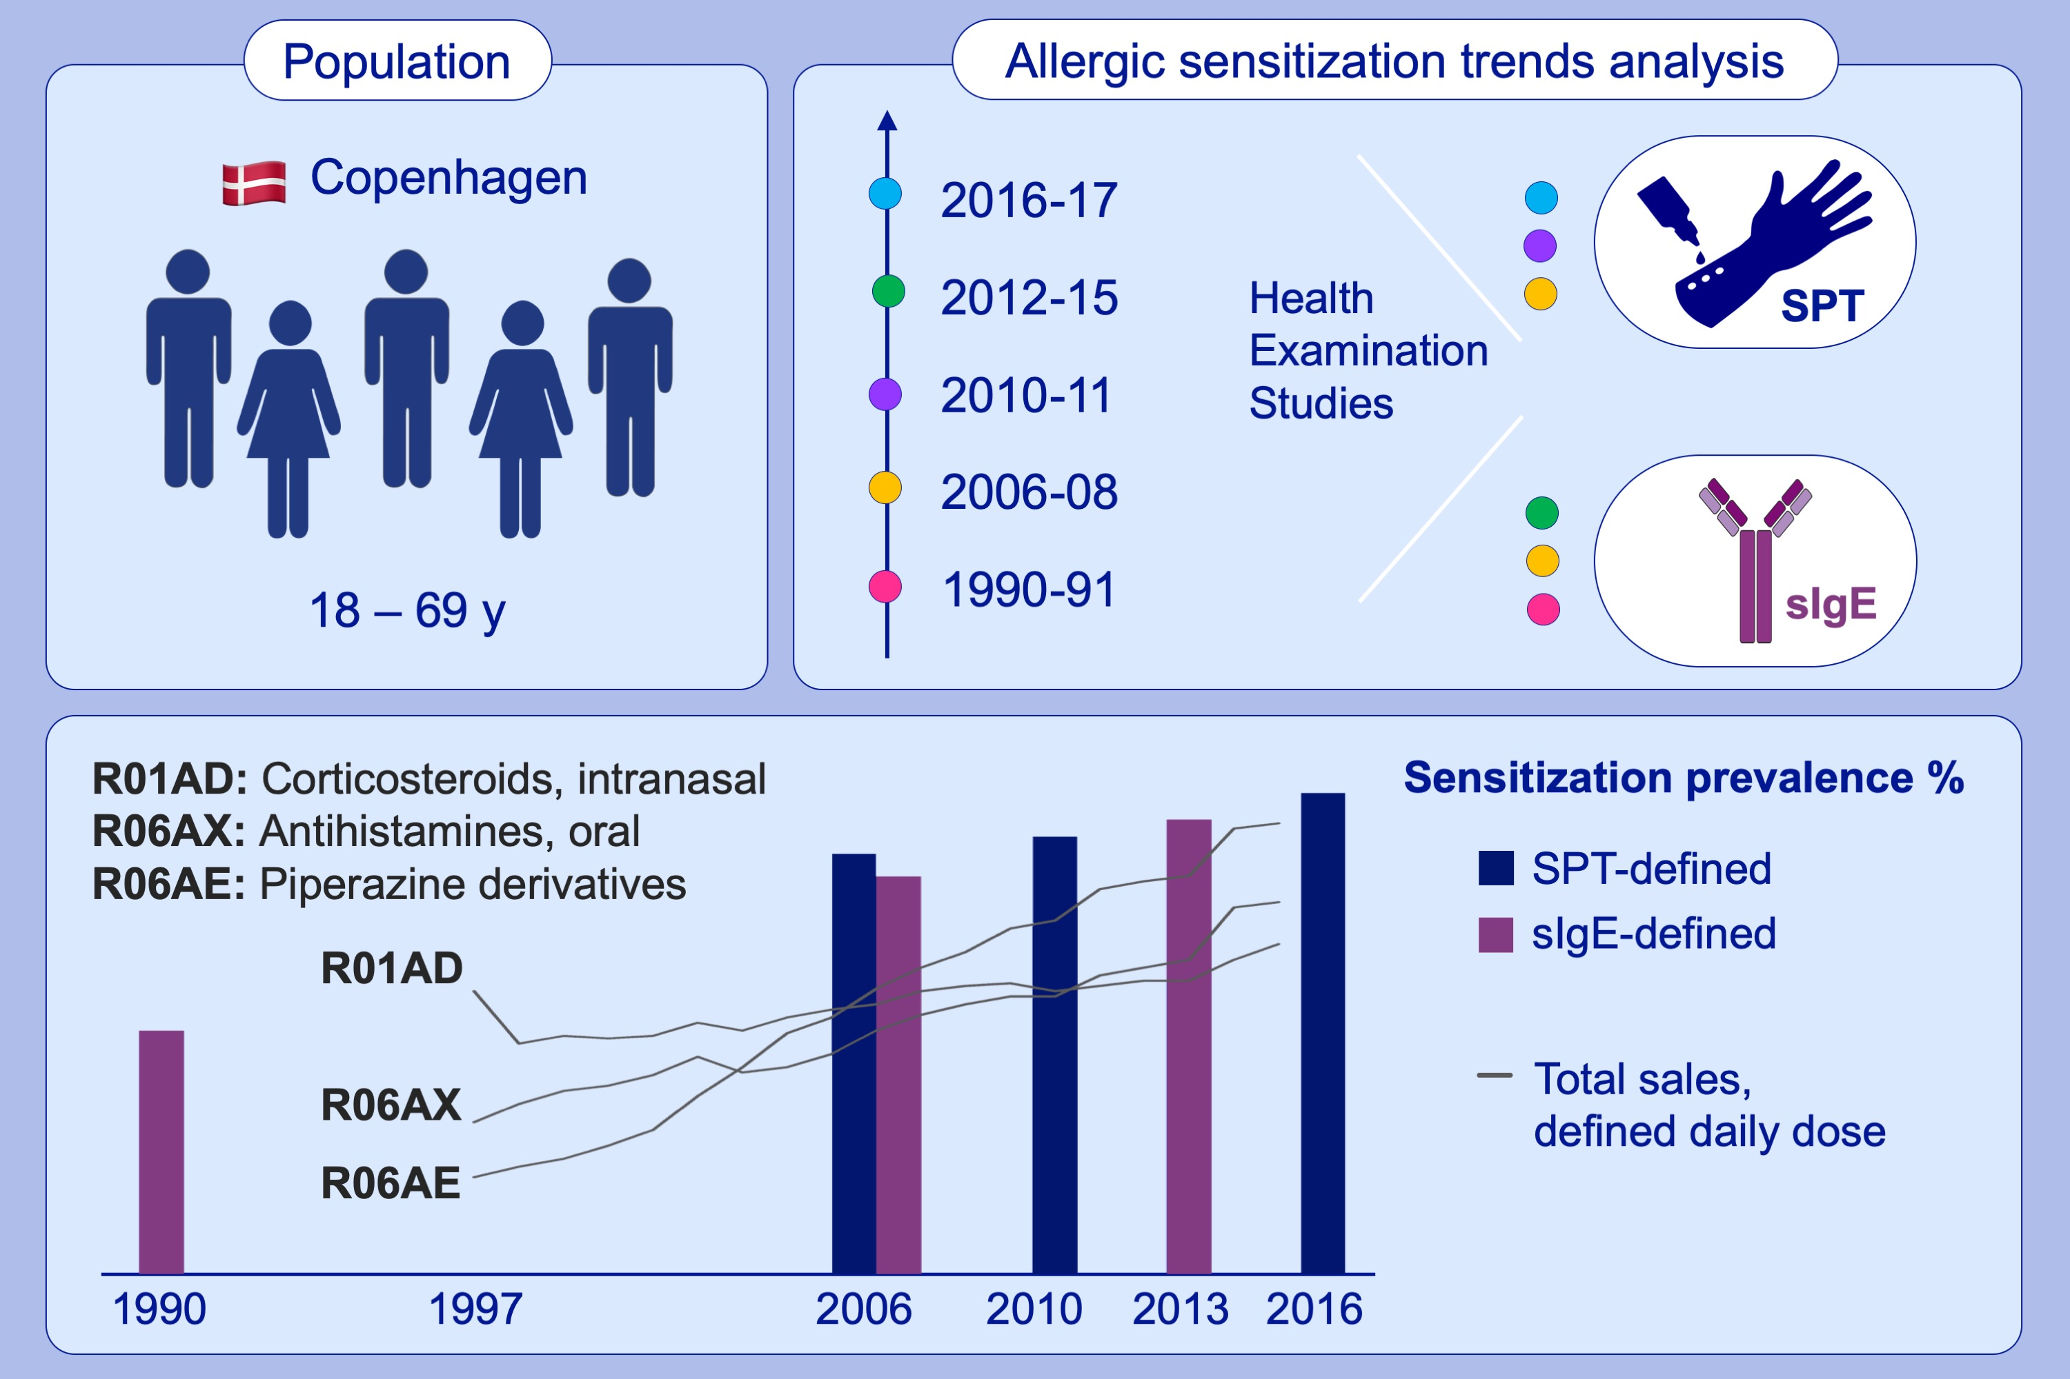
Allergic rhinitis and allergic sensitisation are still increasing among Danish adults
Katja Biering Leth‐Møller, Tea Skaaby, Allan Linneberg
Allergy. 2020; 660-668 https://doi.org/10.1111/all.14046
© 2019 EAACI and John Wiley and Sons A/S. Published by John Wiley and Sons Ltd.
Notes:
HIGHLIGHTS
• We assessed whether the prevalence of allergic respiratory disease has continued to increase in the current millennium among Danish adults.
• Both specific IgE (sIgE) and skin-prick test (SPT) sensitization showed an increase from 2006 to 2013-2016.
• These trends were supported by a nationwide increase in annual sales (including over-the-counter drugs) of intranasal corticosteroids and oral antihistamines from 1997-2015

