Slide 1
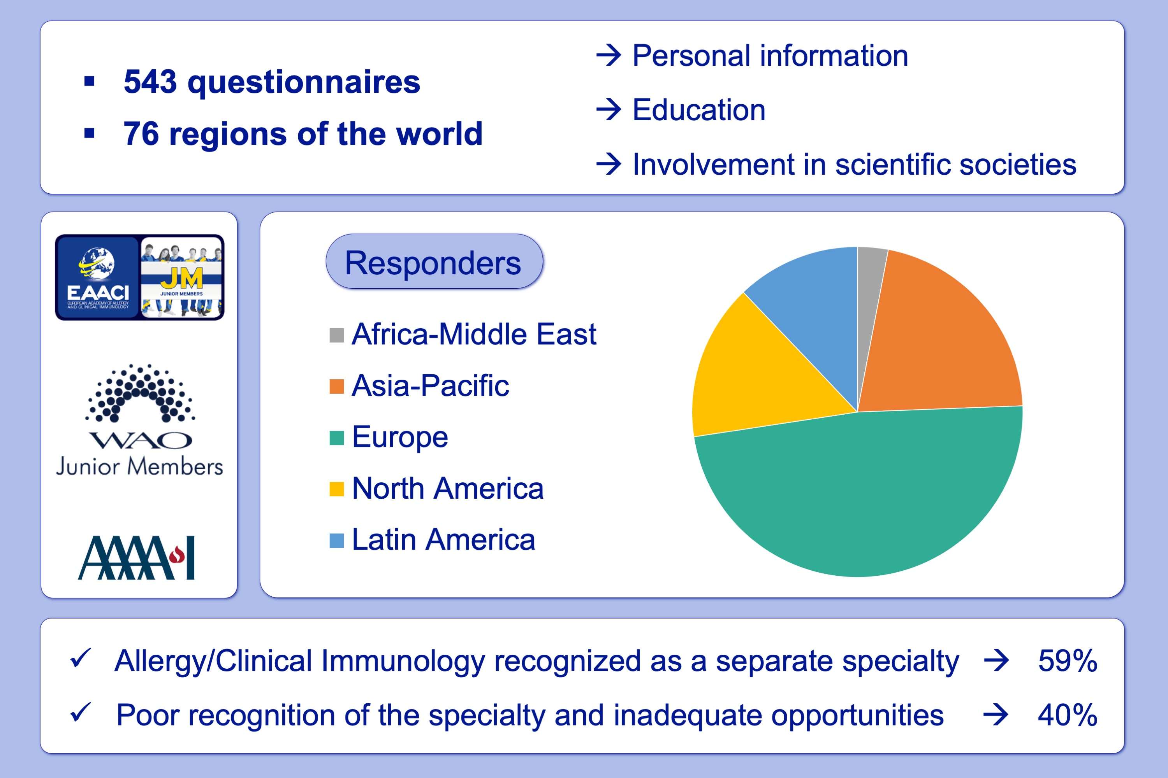
The EAACI‐AAAAI‐WAO Junior Members’ joint survey: A worldwide snapshot of Allergy and Clinical Immunology specialty
Marco Caminati, Darío Antolín‐Amérigo, Matteo Bonini, Becky Buelow, Vanessa Bundy, et al.
Allergy. 2020; 588-595 https://doi.org/10.1111/all.14052
© 2019 EAACI and John Wiley and Sons A/S. Published by John Wiley and Sons Ltd.
Notes:
HIGHLIGHTS
• The first worldwide perspective about Allergy/Immunology (A/I) Specialty, as depicted by the young members of the three main scientific societies in the field, has been realized.
• A great variability among different countries characterizes the specialty in terms of recognition, background formation, job/research/ grants opportunities, and involvement of JMs into the societies’activities.
• Overall, passion and enthusiasm for the specialty remain the strongest motivation for being active in the A/I field, although many critical aspects cannot be avoided.

