Slide 1
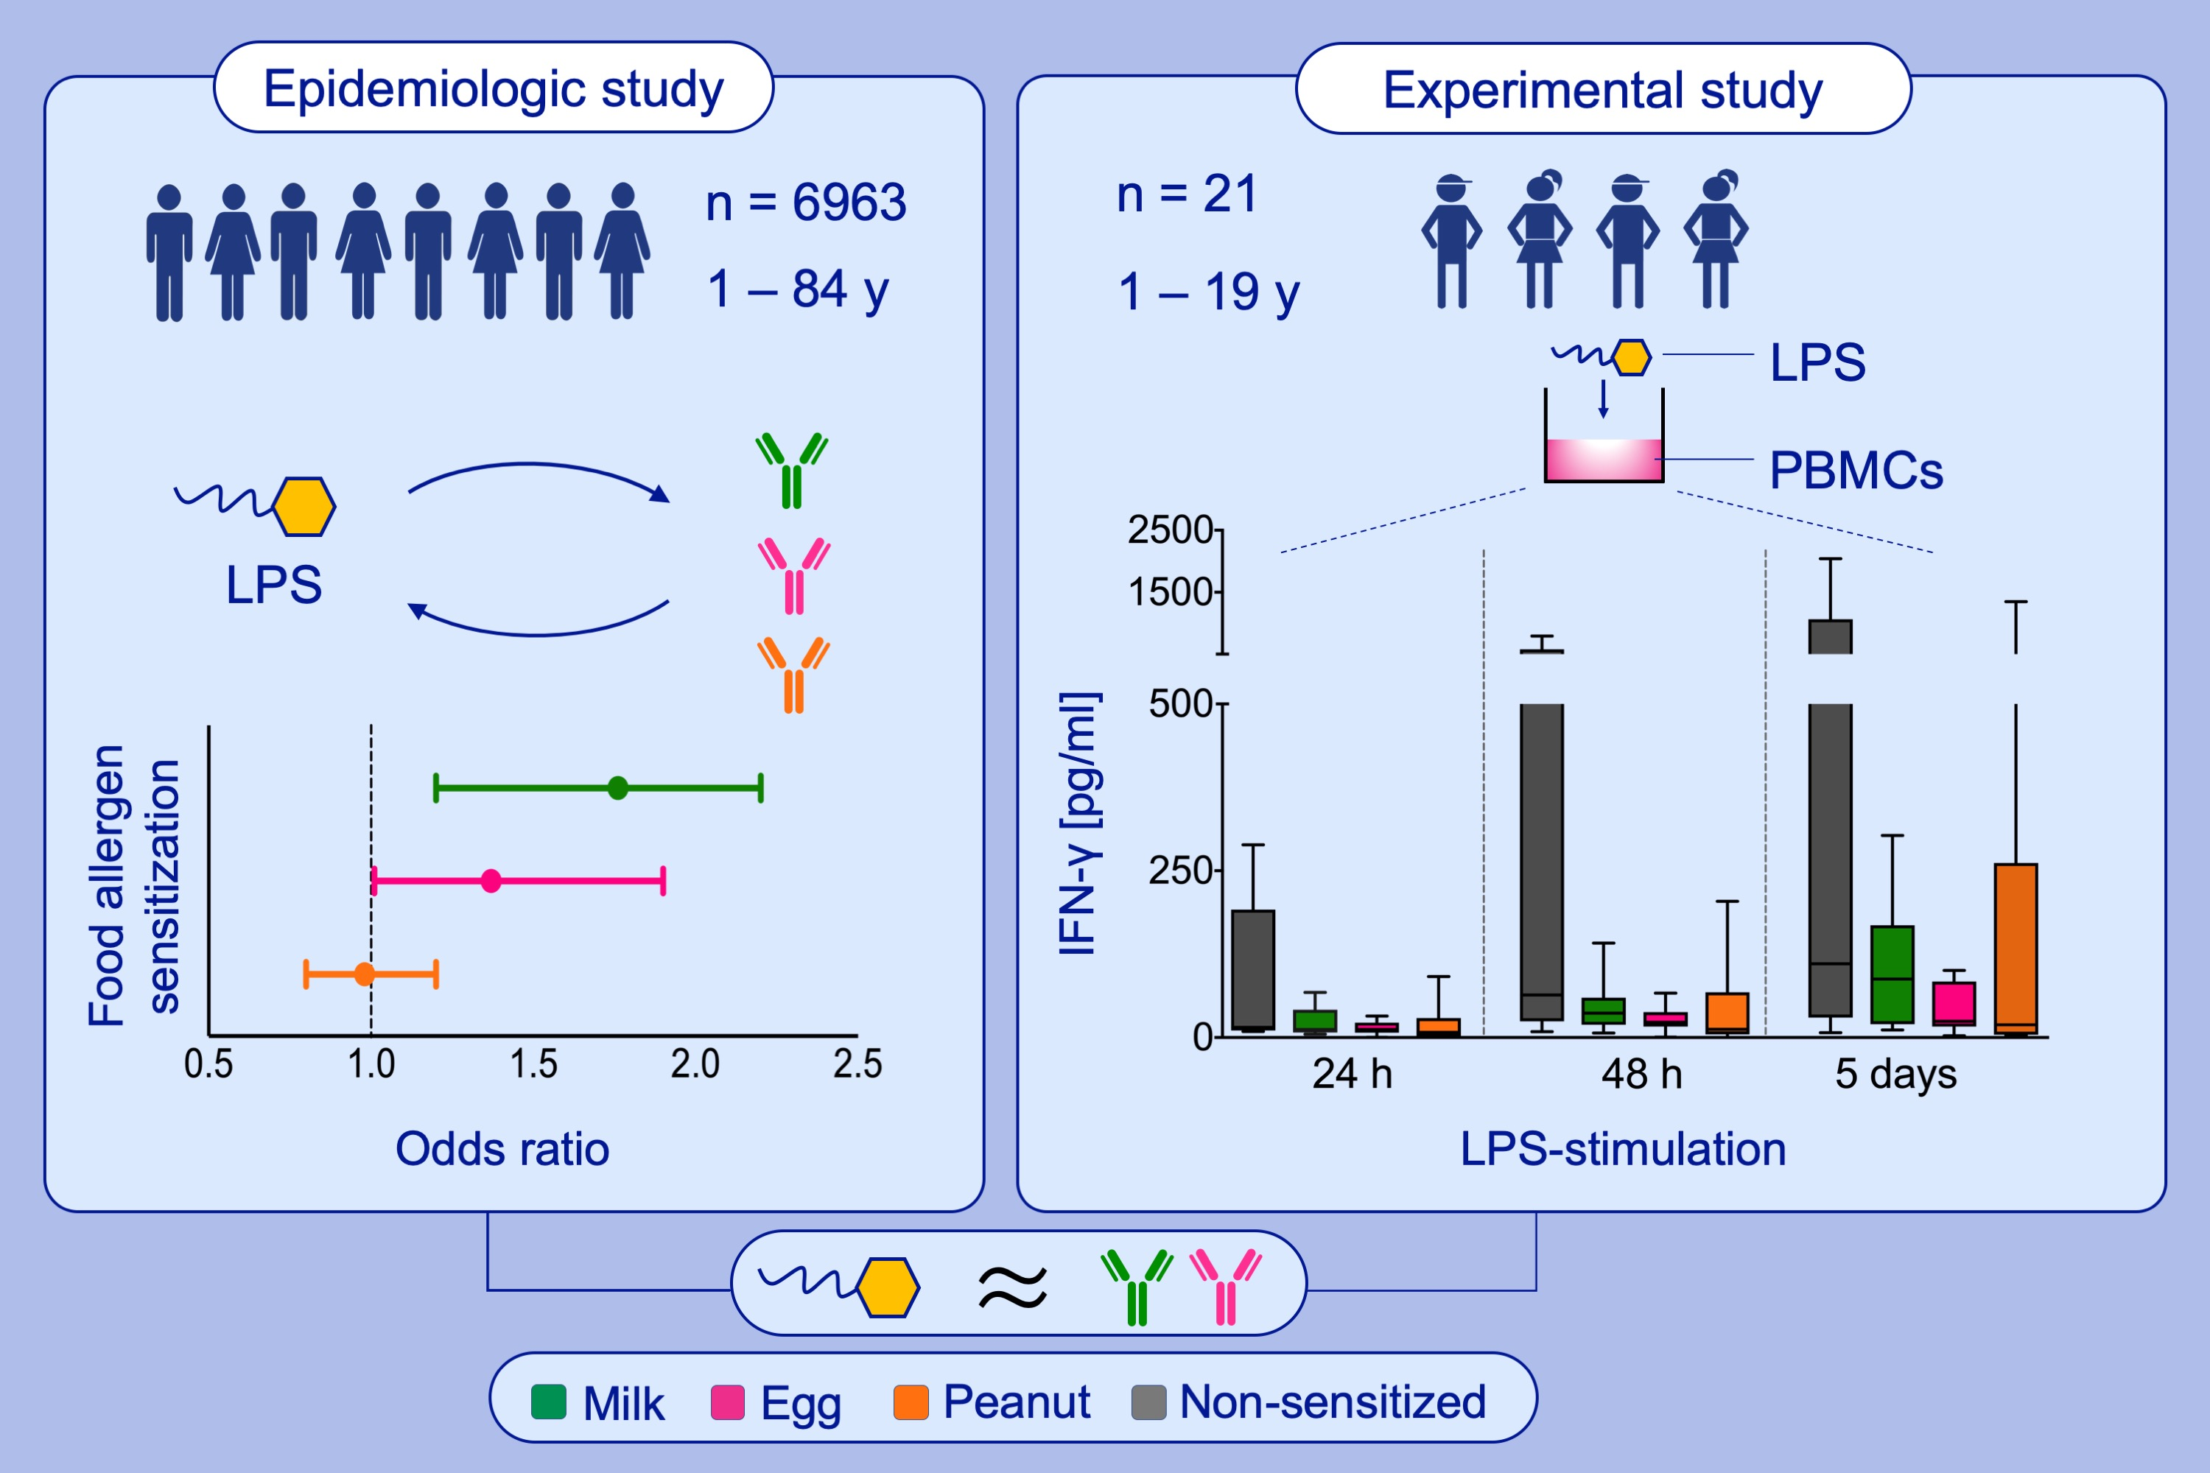
Endotoxin, food allergen sensitization, and food allergy: A complementary epidemiologic and experimental study
Angela Tsuang MD, MSc, Alexander Grishin PhD, Galina Grishina MS, Anh N. Do PhD, Joanne Sordillo ScD, et al.
Allergy. 2020; 625-635 https://doi.org/10.1111/all.14054
© 2019 EAACI and John Wiley and Sons A/S. Published by John Wiley and Sons Ltd.
Notes:
HIGHLIGHTS
• Epidemiologic study of NHANES participants (n = 6963) revealed associations between household endotoxin level and sensitization to milk or egg, but not peanut.
• Complementary experimental study showed attenuated interferon-γ responses from endotoxin stimulation of PBMCs from children with allergy to milk or egg, but not peanut.
• These complementary findings suggest that endotoxin's effects on food sensitization/allergy may differ by food allergy type.
ABBREVIATIONS
NHANES, National Health and Nutrition Examination Survey

