Slide 1
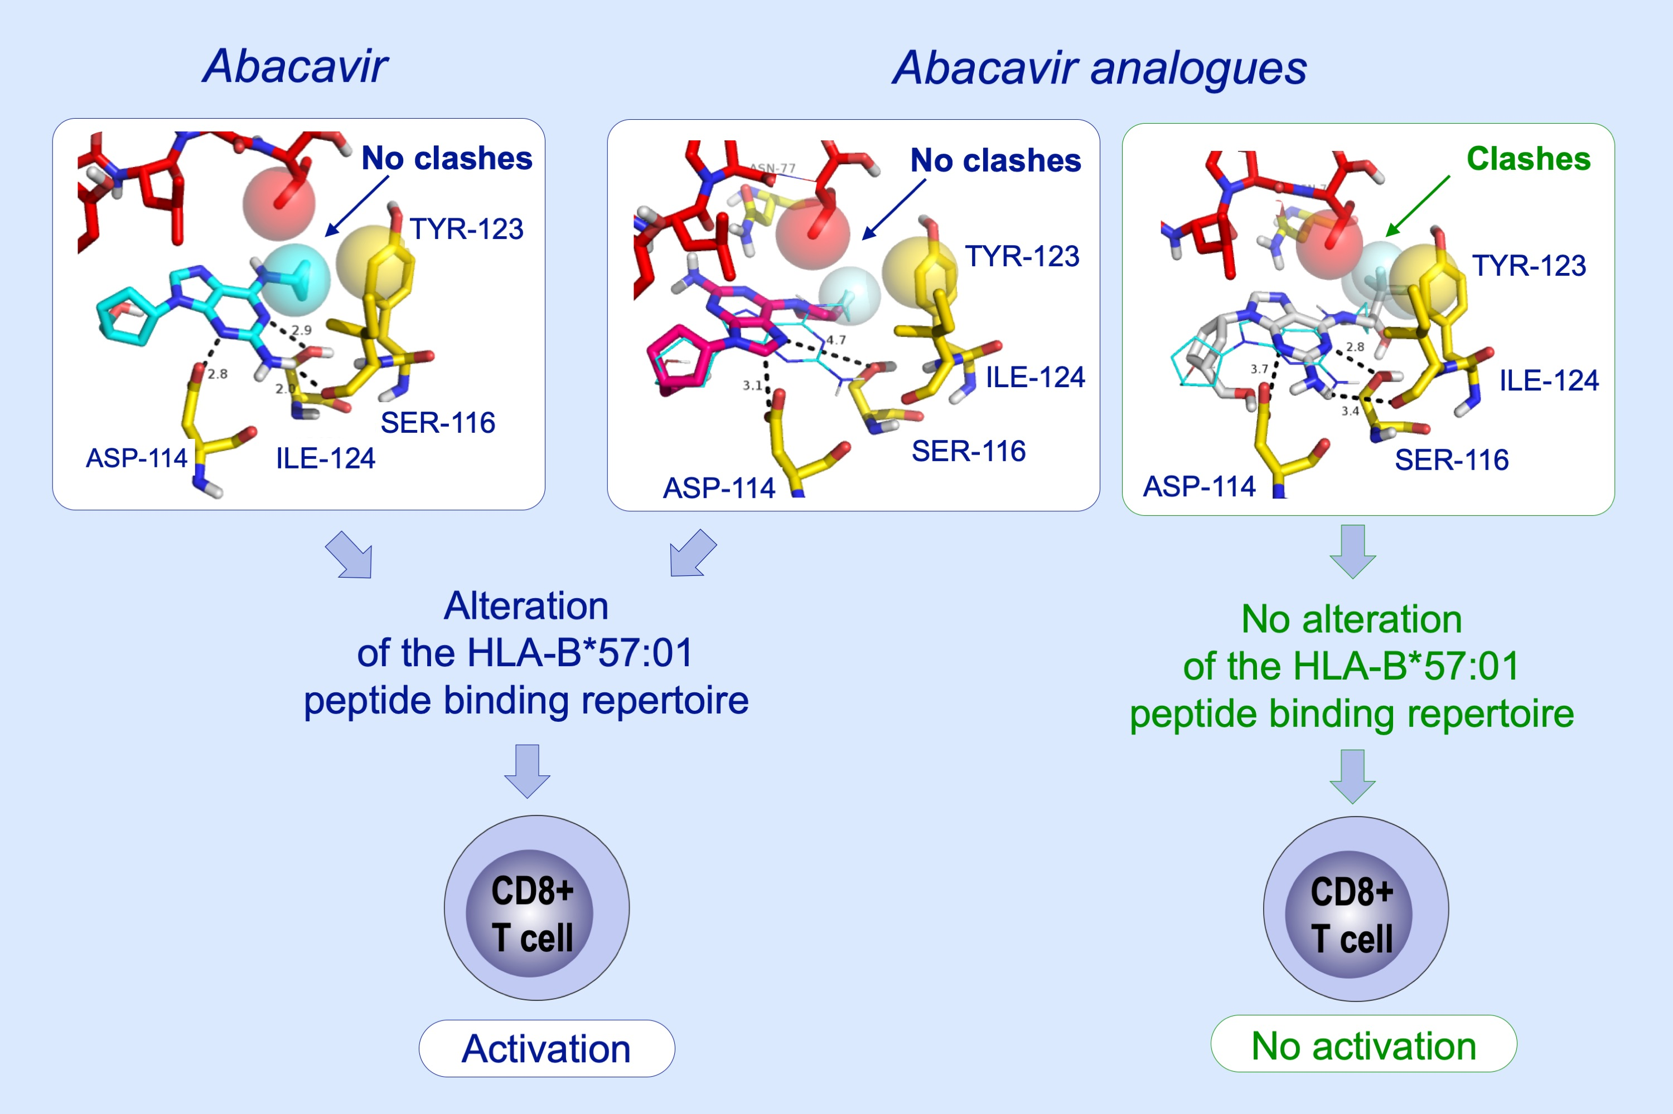
Modification of the cyclopropyl moiety of abacavir provides insight into the structure activity relationship between HLA‐B*57:01 binding and T‐cell activation
Paul J. Thomson, Patricia T. Illing, John Farrell, Mohammad Alhaidari, Catherine C. Bell, et al.
Allergy. 2020; 636-647 https://doi.org/10.1111/all.14057
© 2019 EAACI and John Wiley and Sons A/S. Published by John Wiley and Sons Ltd.
Notes:
HIGHLIGHTS
• Structural modelling aids prediction of the impact of abacavir modifications on the activation of CD8+ T-cells.
• Abacavir analogues that stimulate CD8+ T-cells display a perturbation of natural peptides displayed by HLA-B*57:01.
• Enantiomeric forms of abacavir predicted to adopt different HLA-B*57:01 binding conformations display divergent CD8+ response profiles.

