Slide 1
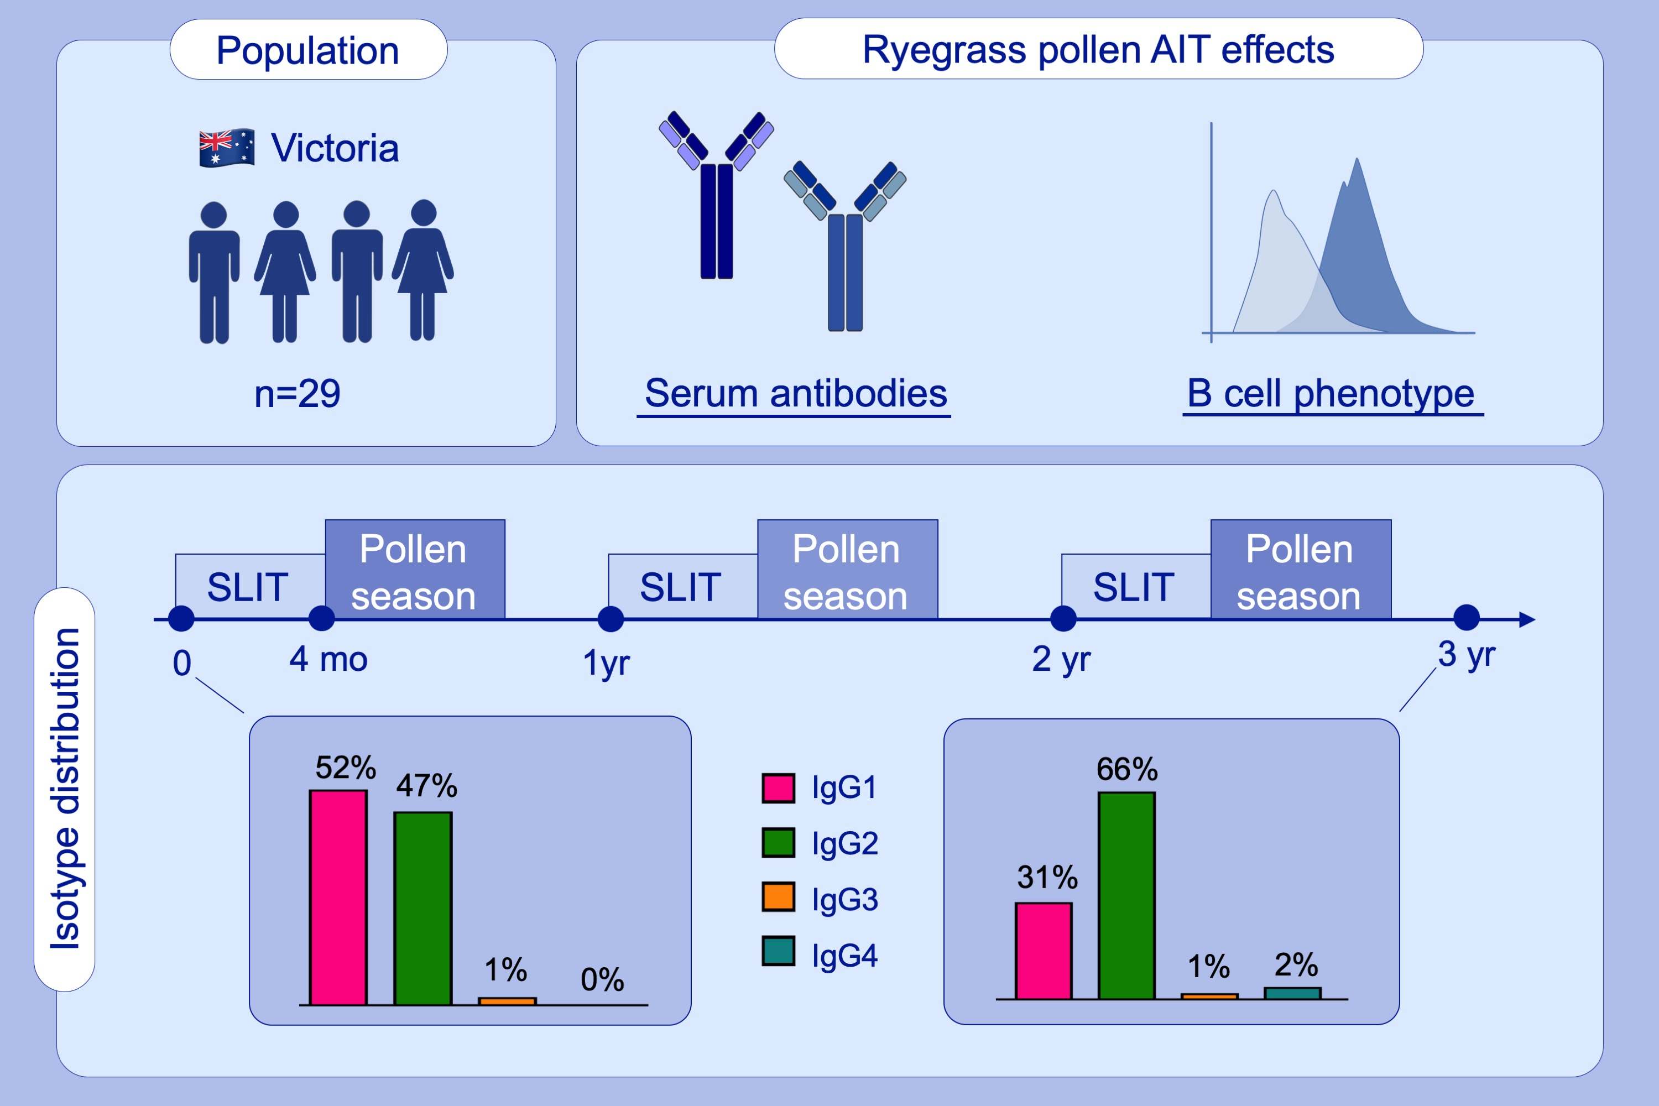
Induction of IgG2 and IgG4 B‐cell memory following sublingual immunotherapy for ryegrass pollen allergy
Jorn J. Heeringa, Craig I. McKenzie, Nirupama Varese, Mark Hew, Amy T. C. M. Bakx, et al.
Allergy. 2020; 1121-1132 https://doi.org/10.1111/all.14073
© 2019 EAACI and John Wiley and Sons A/S. Published by John Wiley and Sons Ltd.
Notes:
HIGHLIGHTS
• This study examines the effect of ryegrass pollen AIT on B‐cell responses in a population of 29 patients with allergic rhinitis.
• Successful immunotherapy for ryegrass pollen allergy increases allergen‐specific IgG2 and IgG4 serum levels, and proportions of IgG2‐ and IgG4‐expressing memory B cells.

