Slide 1
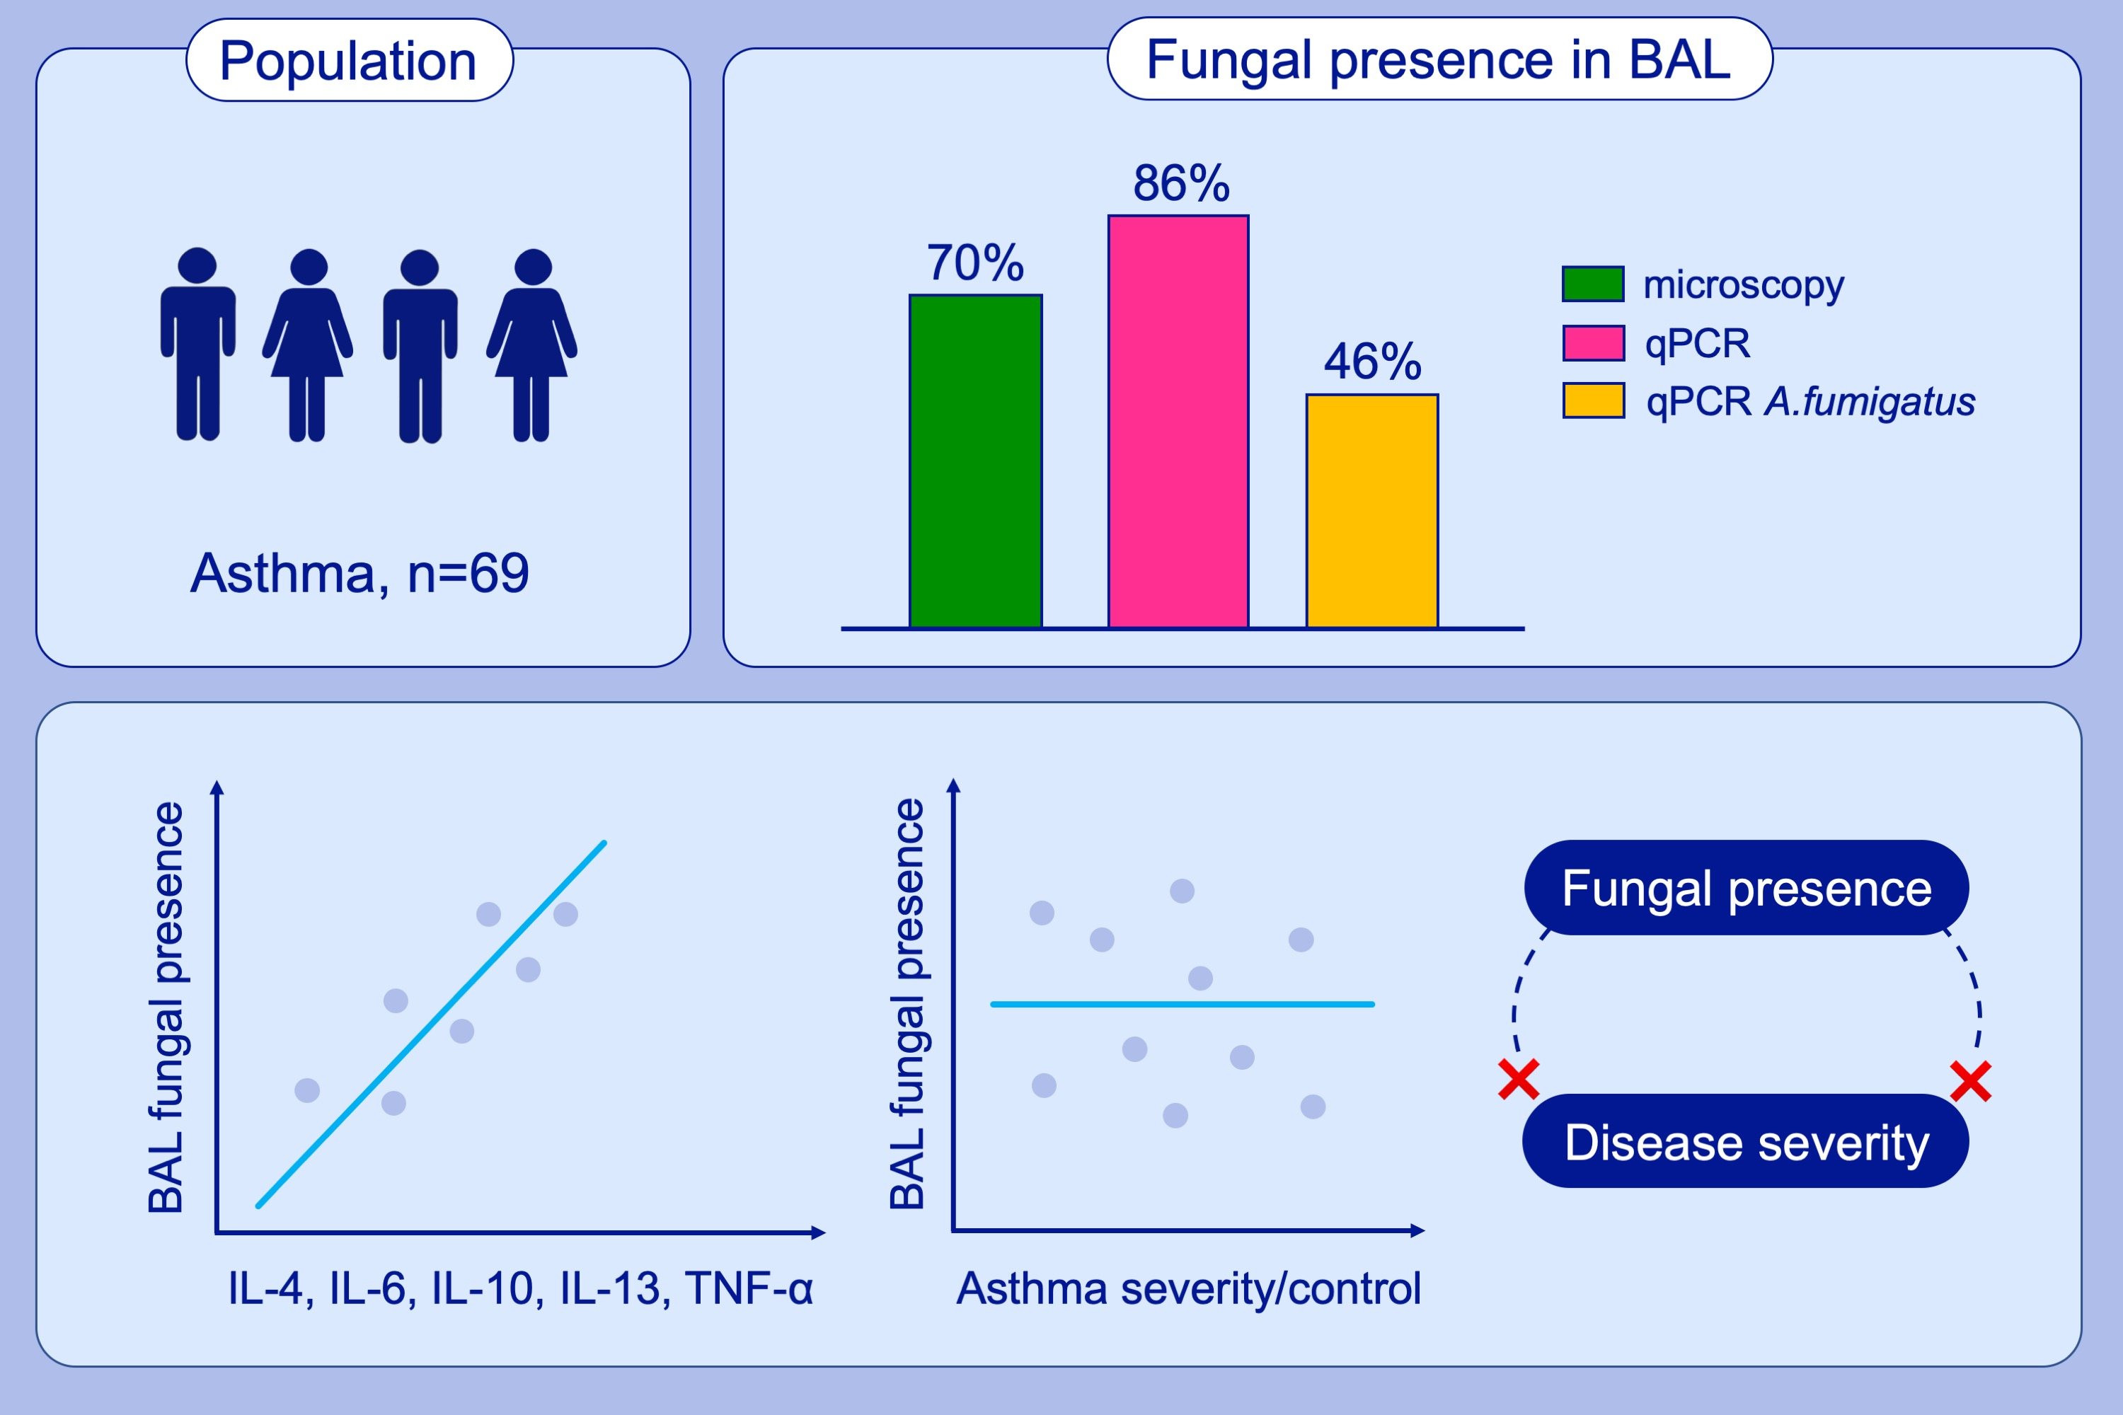
The presence of Aspergillus fumigatus in asthmatic airways is not clearly related to clinical disease severity
Ashley Sullivan, Eoin B. Hunt, Chris Ward, Susan Lapthorne, Joseph A. Eustace, et al.
Allergy. 2020; 1146-1154 https://doi.org/10.1111/all.14087
© 2019 EAACI and John Wiley and Sons A/S. Published by John Wiley and Sons Ltd.
Notes:
HIGHLIGHTS
• In our cohort of asthmatic patients, fungus was observed directly by microscopy in 70% and by qPCR in 86%, while Aspergillus fumigatus was detectable by qPCR in 46%.
• The presence of fungus in BAL correlated with BAL IL‐4, IL‐6, IL‐10, IL‐13 and TNF‐α and with plasma levels of IL‐4, IL‐6, IL‐10, IL‐13, IL‐17 and TNF‐α.
• The presence of fungus or A fumigatus in the airway was not related to levels of asthma control or severity.
• Abbreviation: BAL, bronchoalveolar lavage.

