Slide 1
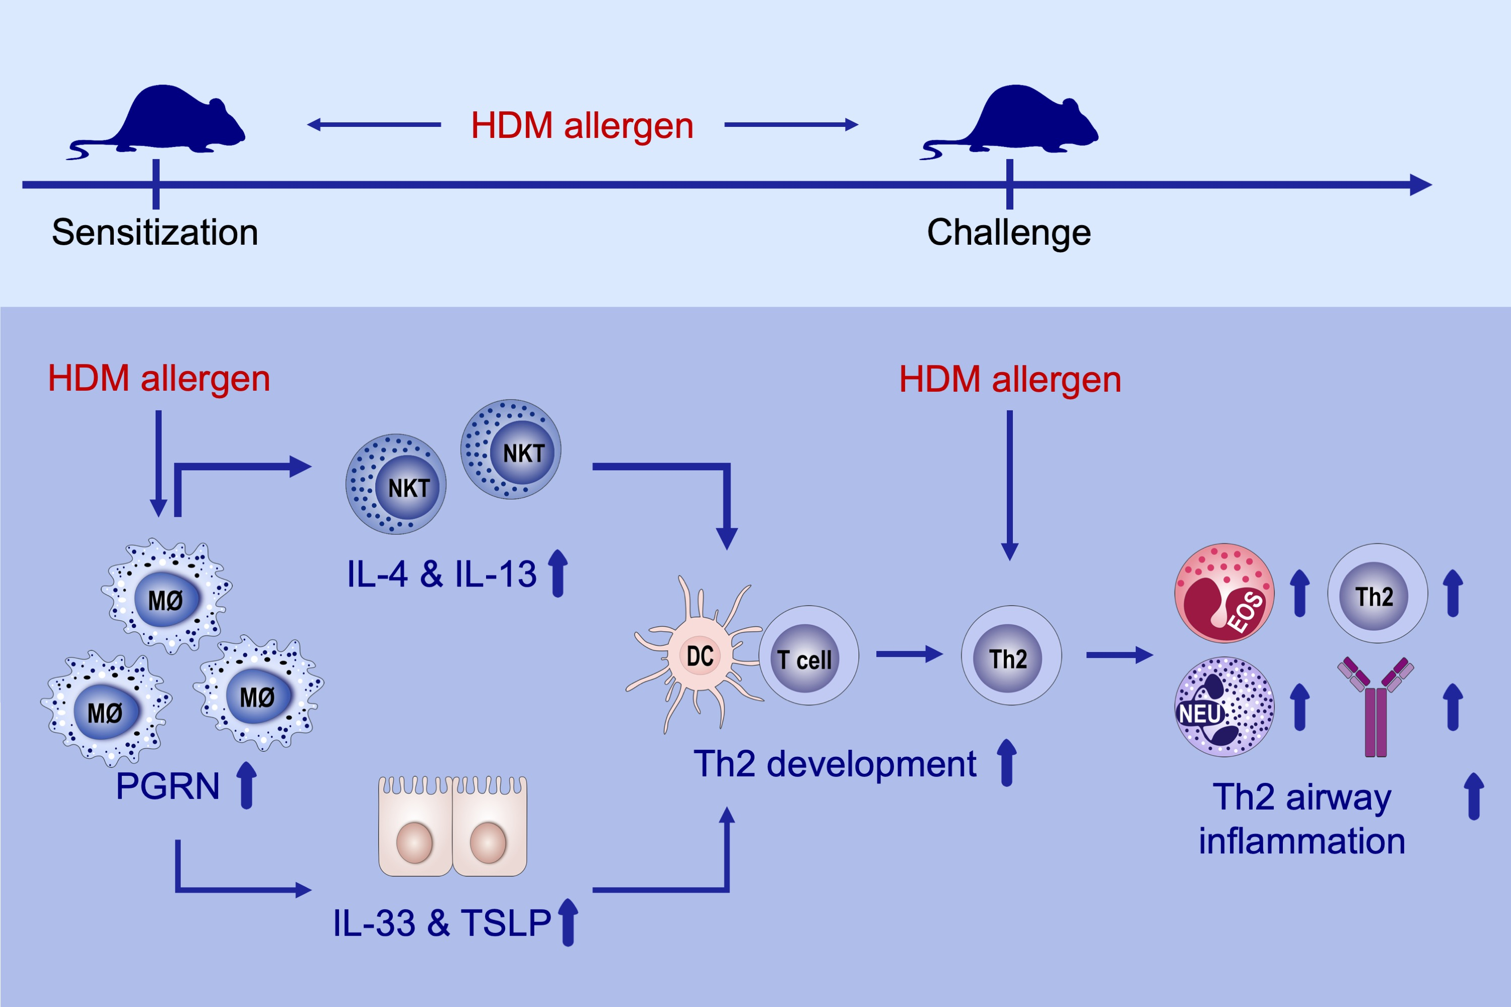
Macrophage‐derived progranulin promotes allergen‐induced airway inflammation
Jun‐Pyo Choi, So Young Park, Keun‐Ai Moon, Eun Hee Ha, Yeon Duk Woo, et al.
Allergy. 2020; 1133-1145 https://doi.org/10.1111/all.14129
© 2019 EAACI and John Wiley and Sons A/S. Published by John Wiley and Sons Ltd.
Notes:
HIGHLIGHTS
• During allergen sensitization, PGRN, produced mainly from alveolar macrophages, induces type 2 cytokines (IL‐4, IL‐13, IL‐33, and TSLP) via NKT cells and lung epithelial cells.
• The absence of alveolar macrophage‐derived PGRN or NKT cells in sensitization period induces downregulation of type 2 cytokines and development of allergen‐specific Th2 airway inflammation.
• Abbreviations: PGRN, progranulin; TSLP, thymic stromal lymphopoietin.

