Slide 1
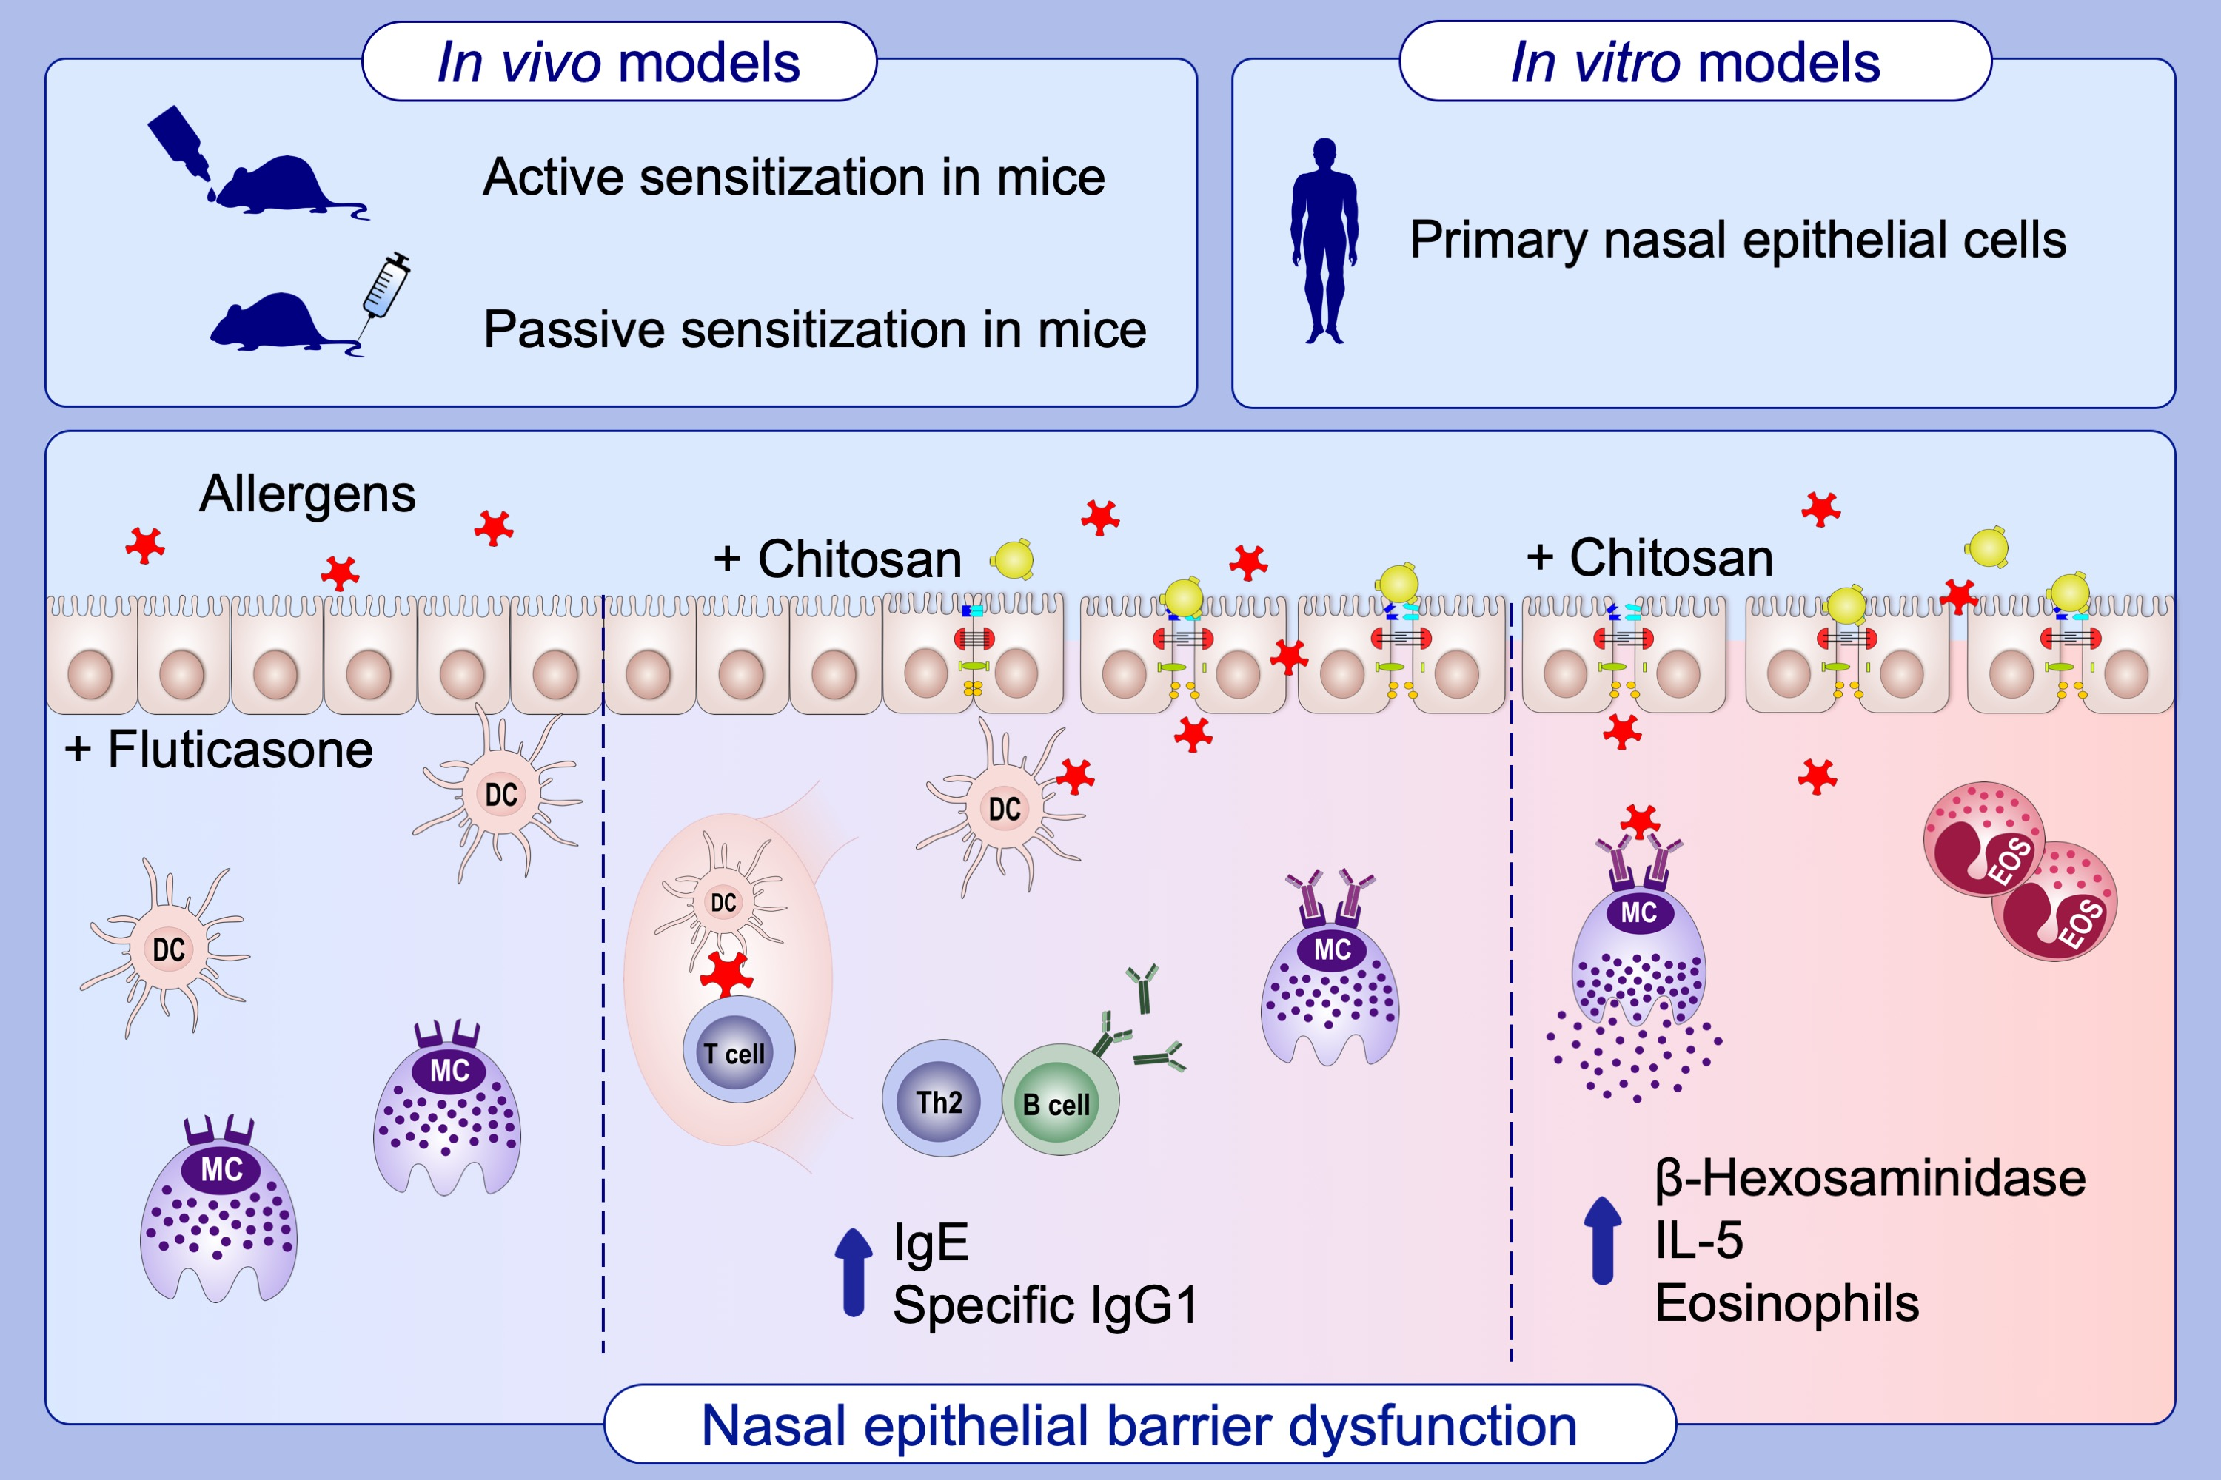
Nasal epithelial barrier dysfunction increases sensitization and mast cell degranulation in the absence of allergic inflammation
Inge Kortekaas Krohn, Sven F. Seys, Gitte Lund, Anne‐Charlotte Jonckheere, Isabelle Dierckx de Casterlé, et al.
Allergy. 2020; 1155-1164 https://doi.org/10.1111/all.14132
© 2019 EAACI and John Wiley and Sons A/S. Published by John Wiley and Sons Ltd.
Notes:
HIGHLIGHTS
• Maintenance of the epithelial barrier function is essential to prevent allergic sensitization and mast cell degranulation.
• Fluticasone propionate is effective to preserve an intact epithelial barrier.
• Epithelial barrier dysfunction increases allergen passage and facilitates allergic sensitization.

