Slide 1
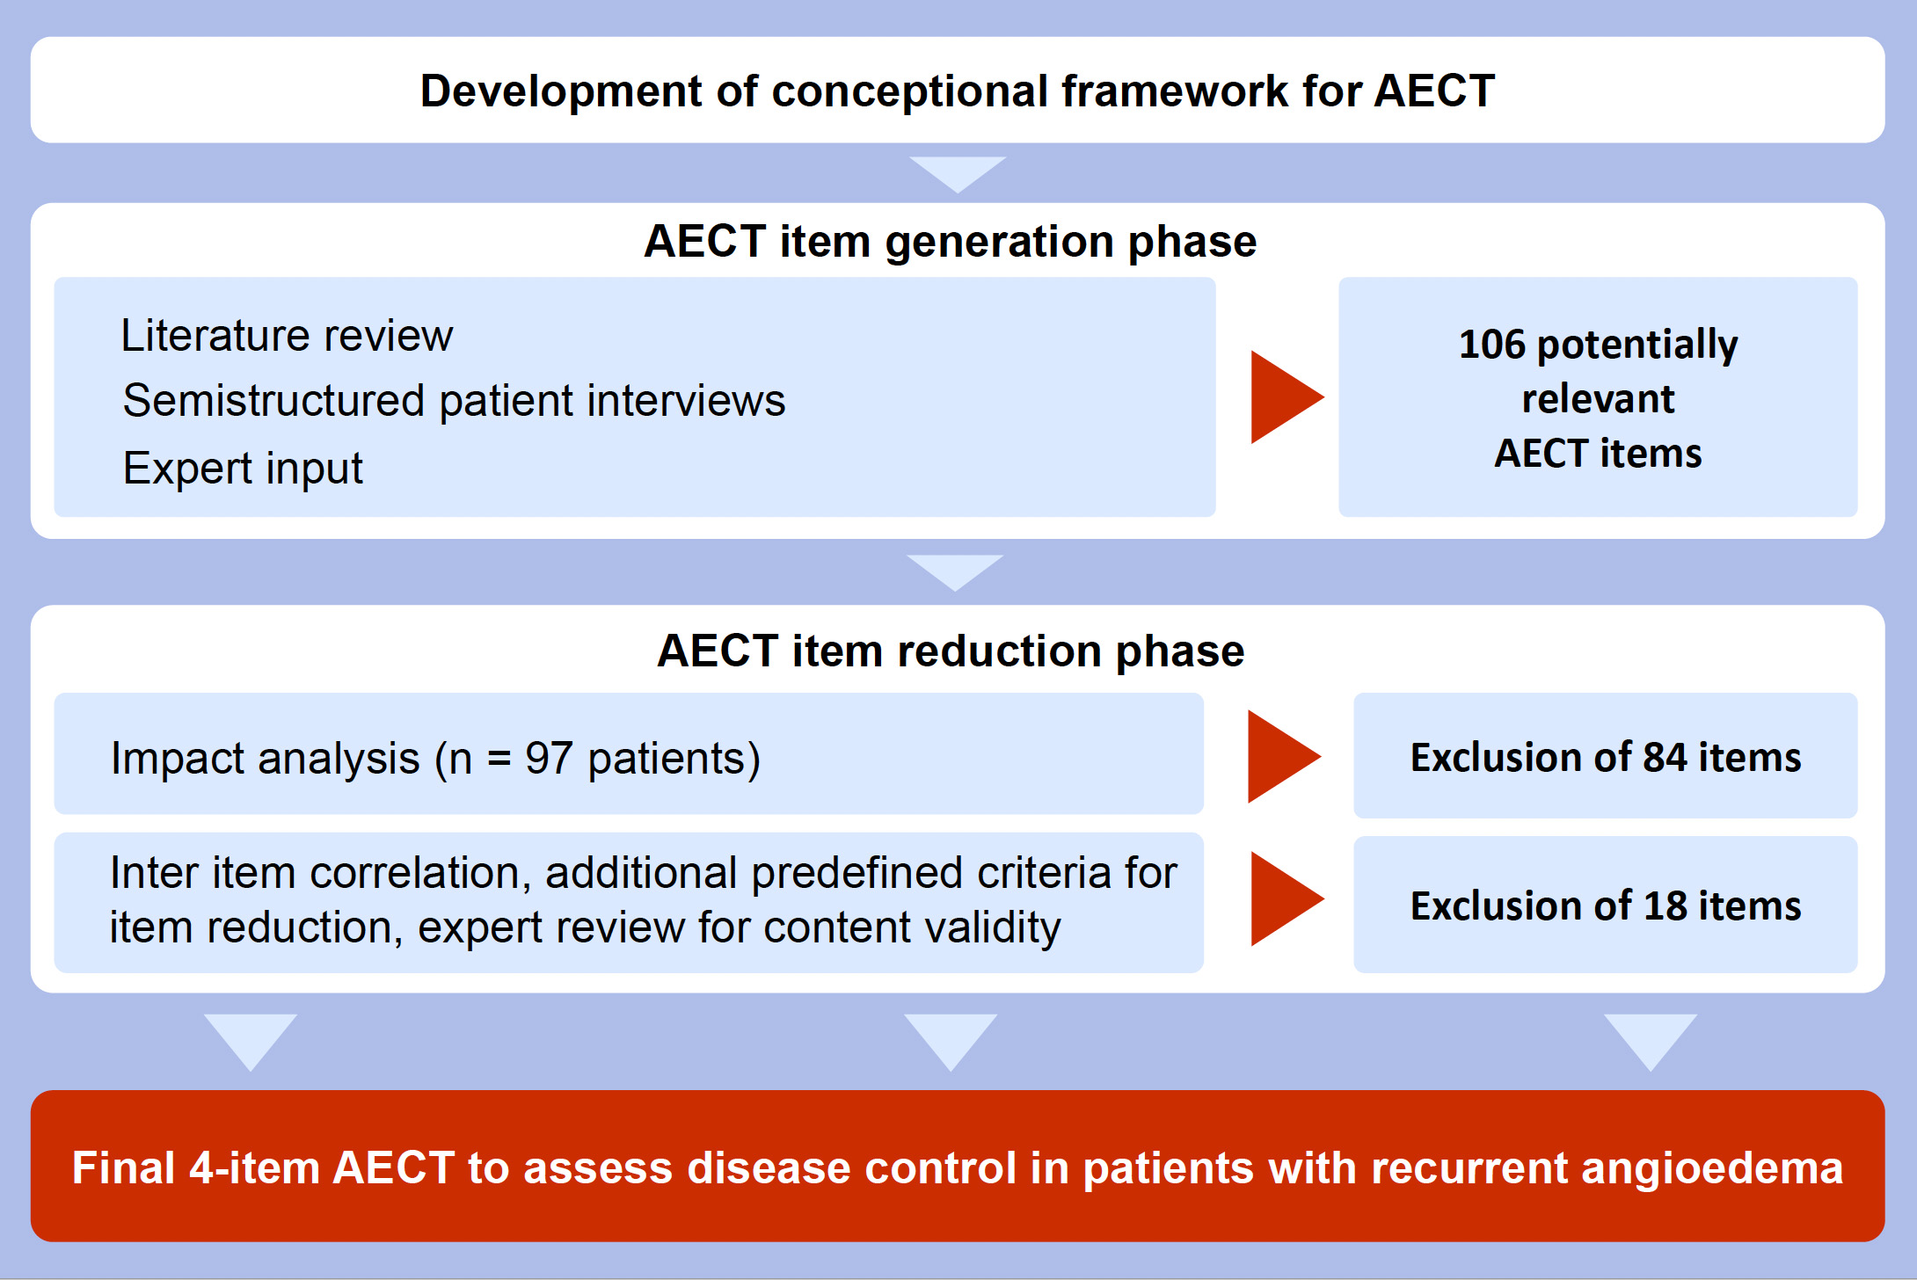
Development of the Angioedema Control Test—A patient‐reported outcome measure that assesses disease control in patients with recurrent angioedema
Karsten Weller, Tamara Donoso, Markus Magerl, Emel Aygören‐Pürsün, Petra Staubach, et al.
Allergy. 2020; 1165-1177 https://doi.org/10.1111/all.14144
© 2019 EAACI and John Wiley and Sons A/S. Published by John Wiley and Sons Ltd.
Notes:
HIGHLIGHTS
• After a conceptional framework was developed for the AECT, 106 potentially relevant questions were identified during the item generation phase.
• The subsequent item reduction process, based on a combined approach of impact analysis and additional methods, selected a final set of 4 questions.
• The final 4‐item‐AECT is easy‐to‐administer, easy‐to‐complete, and easy‐to‐score which makes it ideally‐suited for clinical practice and trials.
• Abbreviation: AECT, angioedema control test.

