Slide 1
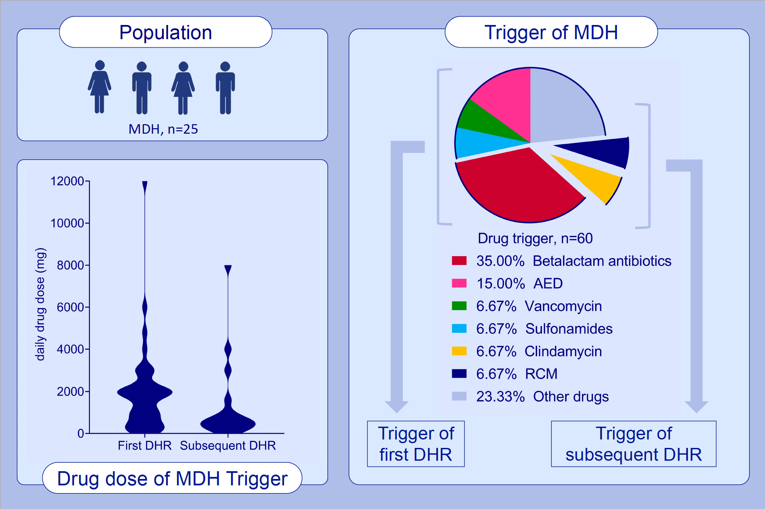
The role of drug, dose, and the tolerance/intolerance of new drugs in multiple drug hypersensitivity syndrome
Lukas Jörg, Daniel Yerly, Arthur Helbling, Werner Pichler
Allergy. 2020; 1178-1187 https://doi.org/10.1111/all.14146
© 2019 EAACI and John Wiley and Sons A/S. Published by John Wiley and Sons Ltd.
Notes:
HIGHLIGHTS
• The most common drug trigger in MDH are beta‐lactam antibiotics, AED, vancomycin, and sulfonamides.
• Cephalosporins, clindamycin, and RCM are often elicitors of subsequent DHR.
• Most drug trigger are highly dosed drugs.
• The daily drug dose in subsequent DHR is significantly lower than at the first DHR, indicating that MDH patients with subsequent DHR are able to react to lower drug doses.

