Slide 1
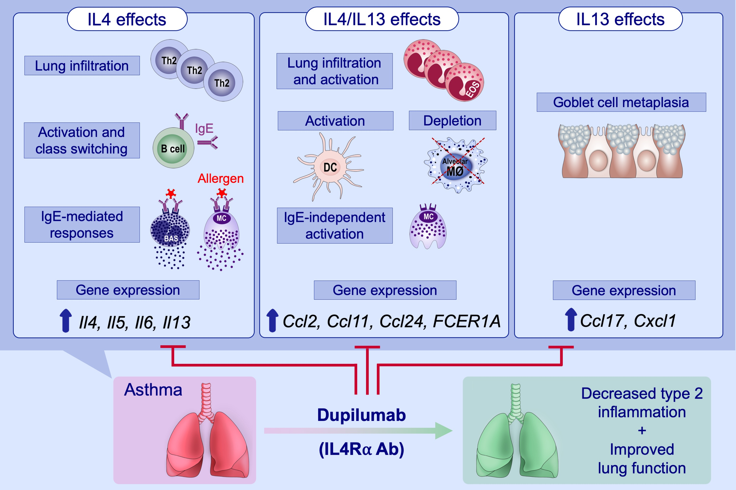
Dual blockade of IL‐4 and IL‐13 with dupilumab, an IL‐4Rα antibody, is required to broadly inhibit type 2 inflammation
Audrey Le Floc’h, Jeanne Allinne, Kirsten Nagashima, George Scott, Dylan Birchard, et al.
Allergy. 2020; 1188-1204 https://doi.org/10.1111/all.14151
© 2019 EAACI and John Wiley and Sons A/S. Published by John Wiley and Sons Ltd.
Notes:
HIGHLIGHTS
• The IL‐4Rα antibody, dupilumab, binds IL‐4Rα with high affinity, directly blocks IL‐4 and IL‐13/IL‐13Rα1 complex binding to IL‐4Rα, and thereby prevents IL‐4Rα‐mediated signaling induced by both IL‐4 and IL‐13.
• IL‐4 and IL‐13 play distinct and overlapping roles and blockade of both cytokines is required to broadly block type 2 inflammation, which translates to protection from allergen‐induced lung function impairment.

