Slide 1
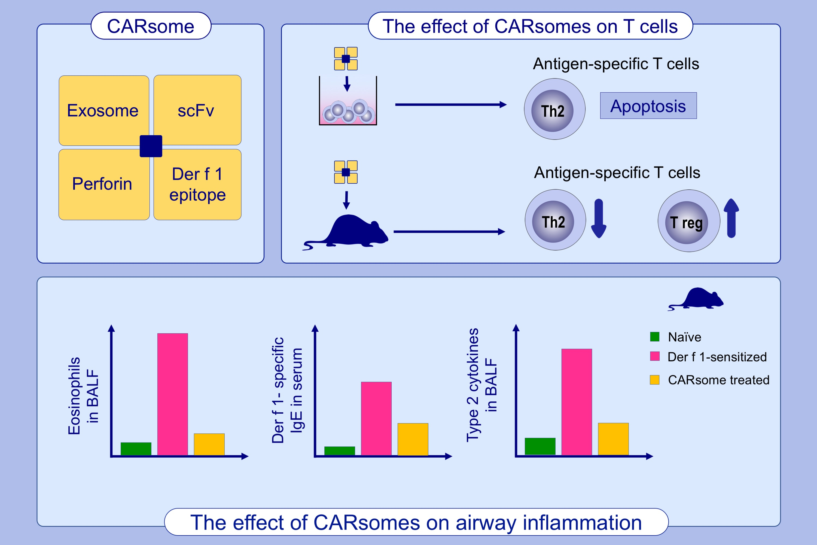
CARsomes inhibit airway allergic inflammation in mice by inducing antigen‐specific Th2 cell apoptosis
Huan‐Ping Zhang, Ying‐Xue Sun, Zhi Lin, Gui Yang, Jiang‐Qi Liu, et al.
Allergy. 2020; 1205-1216 https://doi.org/10.1111/all.14157
© 2019 EAACI and John Wiley and Sons A/S. Published by John Wiley and Sons Ltd.
Notes:
HIGHLIGHTS
• Epicutaneous immunization via laser‐generated micropores is more potent than subcutaneous injection in induction of regulatory T cells and suppression of cytokines.
• EPIT induces higher levels of blocking IgG and less as well as shorter‐lived therapy‐associated IgE compared to SCIT with or without alum.
• EPIT suppresses airway hyperresponsiveness and lung inflammation in mice.
• Abbreatiations: EPIT, epicutaneous immunotherapy; SCIT, subcutaneous immunotherapy.
.

