Slide 1
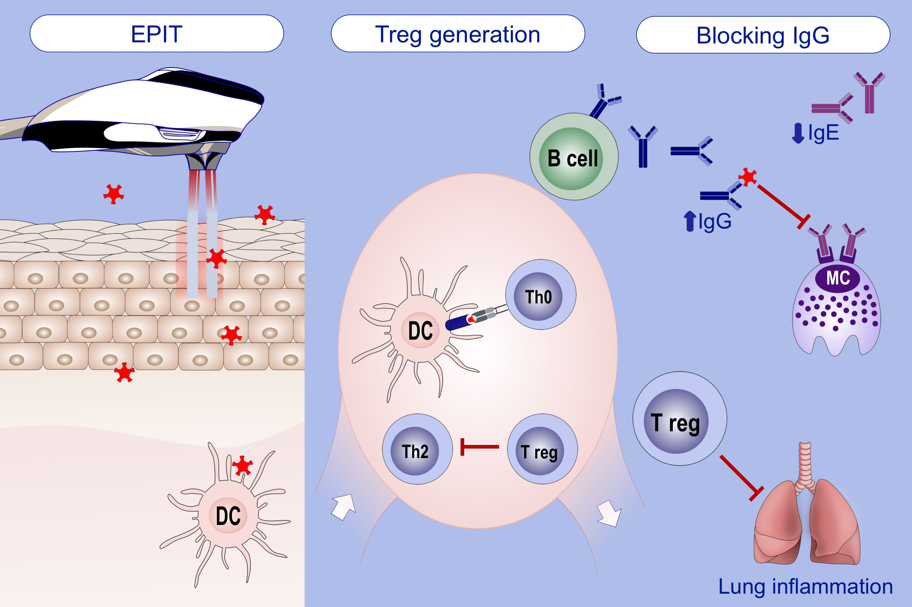
Laser‐facilitated epicutaneous immunotherapy with depigmented house dust mite extract alleviates allergic responses in a mouse model of allergic lung inflammation
Evgeniia Korotchenko, Raquel Moya, Sandra Scheiblhofer, Isabella A Joubert, Jutta Horejs‐Hoeck, et al.
Allergy. 2020; 1217-1228 https://doi.org/10.1111/all.14164
© 2019 EAACI and John Wiley and Sons A/S. Published by John Wiley and Sons Ltd.
Notes:
HIGHLIGHTS

