Slide 1
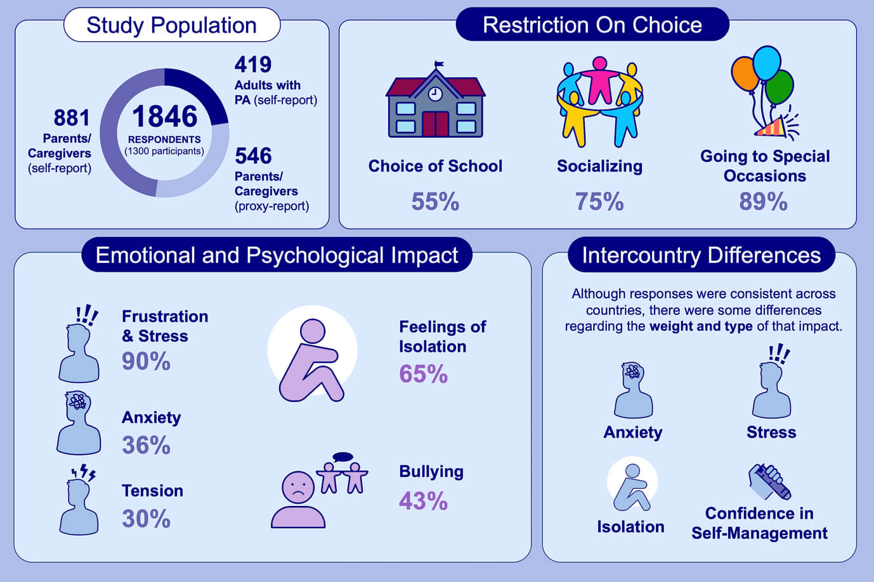
APPEAL‐1: A multiple‐country European survey assessing the psychosocial impact of peanut allergy
Audrey DunnGalvin, Katharina Blumchen, Frans Timmermans, Lynne Regent, Sabine Schnadt, et al.
Allergy. 2020; 2899-2908 https://doi.org/10.1111/all.14363
© 2019 EAACI and John Wiley and Sons A/S. Published by John Wiley and Sons Ltd.
Notes:
HIGHLIGHTS
• The APPEAL-1 study – multidimensional, pan-European investigation of the impact of living with PA – revealed that PA imposes an adverse psychosocial impact on patients and caregivers.
• Study findings deepen our knowledge and understanding of the impact of PA on everyday lives.
•The study also underscores unmet needs and provides signposts for clinicians and policymakers on how these may be addressed.
Abbreviation: PA, peanut allergy

