Slide 1
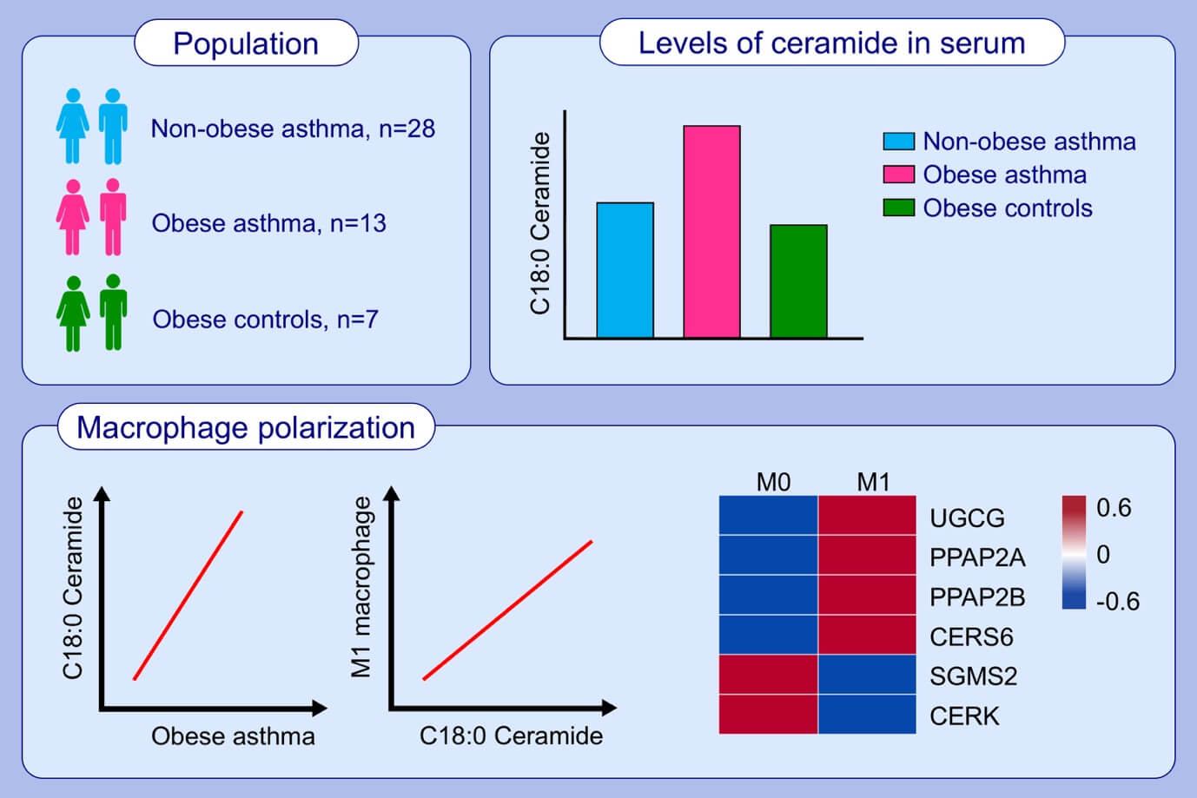
Metabolic shift favoring C18:0 ceramide accumulation in obese asthma
Youngwoo Choi, Minji Kim, Su Jung Kim, Hyun‐Ju Yoo, Seung‐Hyun Kim, et al.
Allergy. 2020; 2858-2866 https://doi.org/10.1111/all.14366
© 2019 EAACI and John Wiley and Sons A/S. Published by John Wiley and Sons Ltd.
Notes:
HIGHLIGHTS
• This study evaluates the association between sphingolipid metabolism and development of obese-related asthma phenotype.
• Serum C18:0 ceramide is increased in patients with obese asthma.
• Gene expression involved in macrophage polarization may be associated with ceramide accumulation.
Abbreviations: CERK, ceramide kinase; CERS6, ceramide synthase 6; PPAP2A, phosphatidic acid phosphatase type 2A; PPAP2B, phosphatidic acid phosphatase type 2B; SGMS2, sphingomyelin synthase 2; UGCG, UDP-glucose ceramide glucosyltransferase

