Slide 1
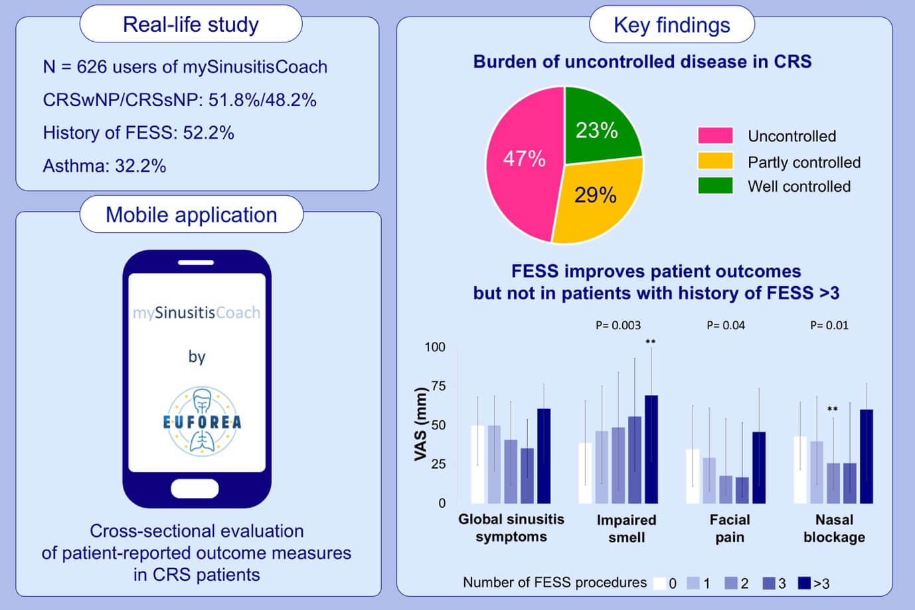
Real‐life assessment of chronic rhinosinusitis patients using mobile technology: The mySinusitisCoach project by EUFOREA
Sven F. Seys, Shana De Bont, Wytske J. Fokkens, Claus Bachert, Isam Alobid, et al.
Allergy. 2020; 2867-2878 https://doi.org/10.1111/all.14408
© 2019 EAACI and John Wiley and Sons A/S. Published by John Wiley and Sons Ltd.
Notes:
HIGHLIGHTS
• This study reports on the cross-sectional evaluation of patient-reported outcome measures in 626 chronic rhinosinusitis patients of which half reported nasal polyp disease.
• Over 40% of patients were uncontrolled, which clearly impacted their quality of life.
•Sinus surgery improved patient-reported outcomes, but not in patients with a history of more than 3 procedures.
Abbreviations: CRSw/sNP, chronic rhinosinusitis with/without nasal polyps; FESS, functional endoscopic sinus surgery; VAS, visual analogue scale

