Slide 1
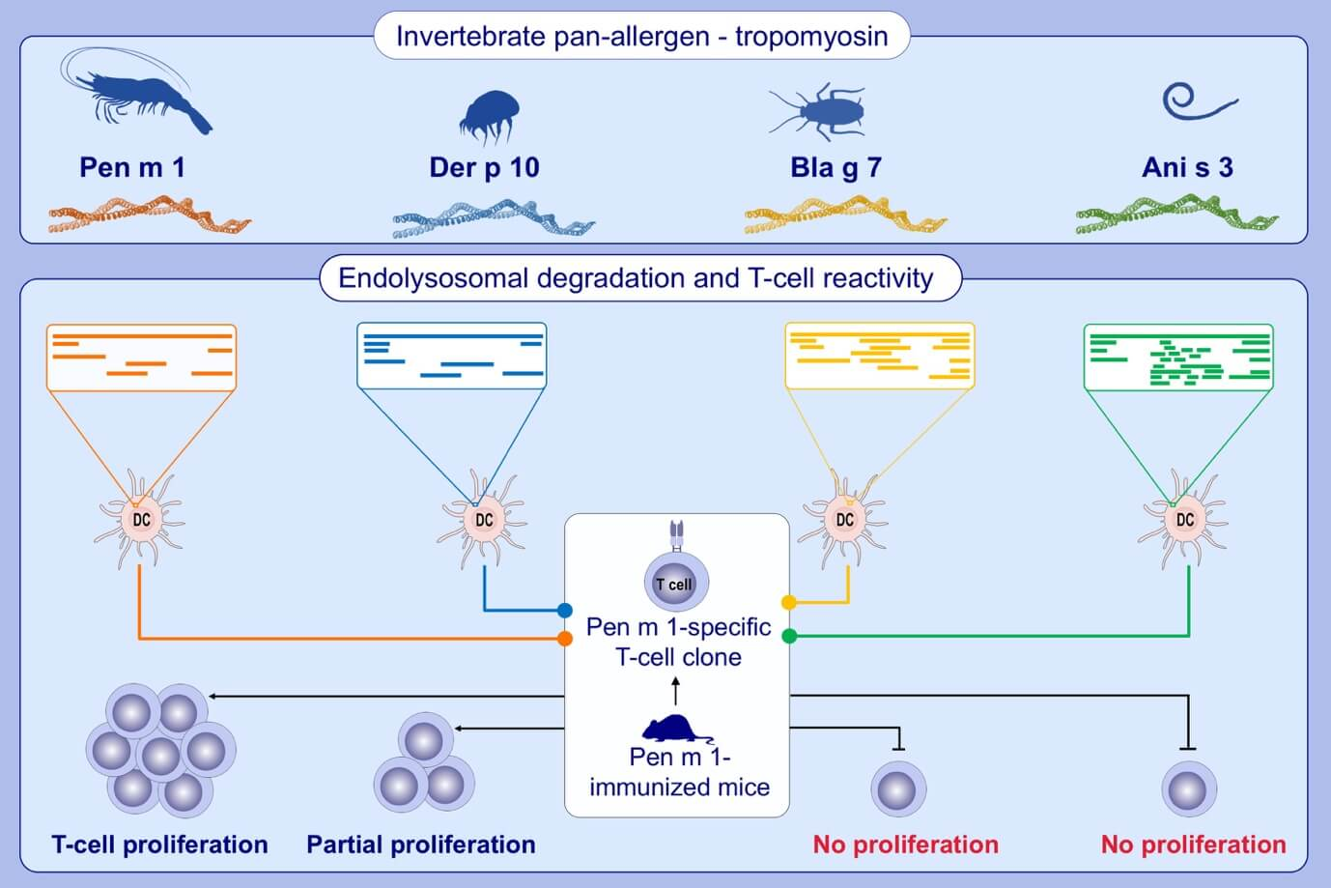
Effect of structural stability on endolysosomal degradation and T‐cell reactivity of major shrimp allergen tropomyosin
Sandip D. Kamath, Sandra Scheiblhofer, Christopher M. Johnson, Yoan Machado, Thomas McLean, et al.
Allergy. 2020; 2909-2919 https://doi.org/10.1111/all.14410
© 2019 EAACI and John Wiley and Sons A/S. Published by John Wiley and Sons Ltd.
Notes:
HIGHLIGHTS
• Allergenic tropomyosins have dissimilar structural stabilities despite having high amino acid sequence similarity.
• Tropomyosins are differentially degraded in the endolysosomal compartment of antigen-presenting cells due to differences in their structural stability.
•Tropomyosin T-cell cross-reactivity, unlike IgE antibody cross-reactivity, is dependent on structural stability rather than amino-acid sequence similarity.

