Slide 1
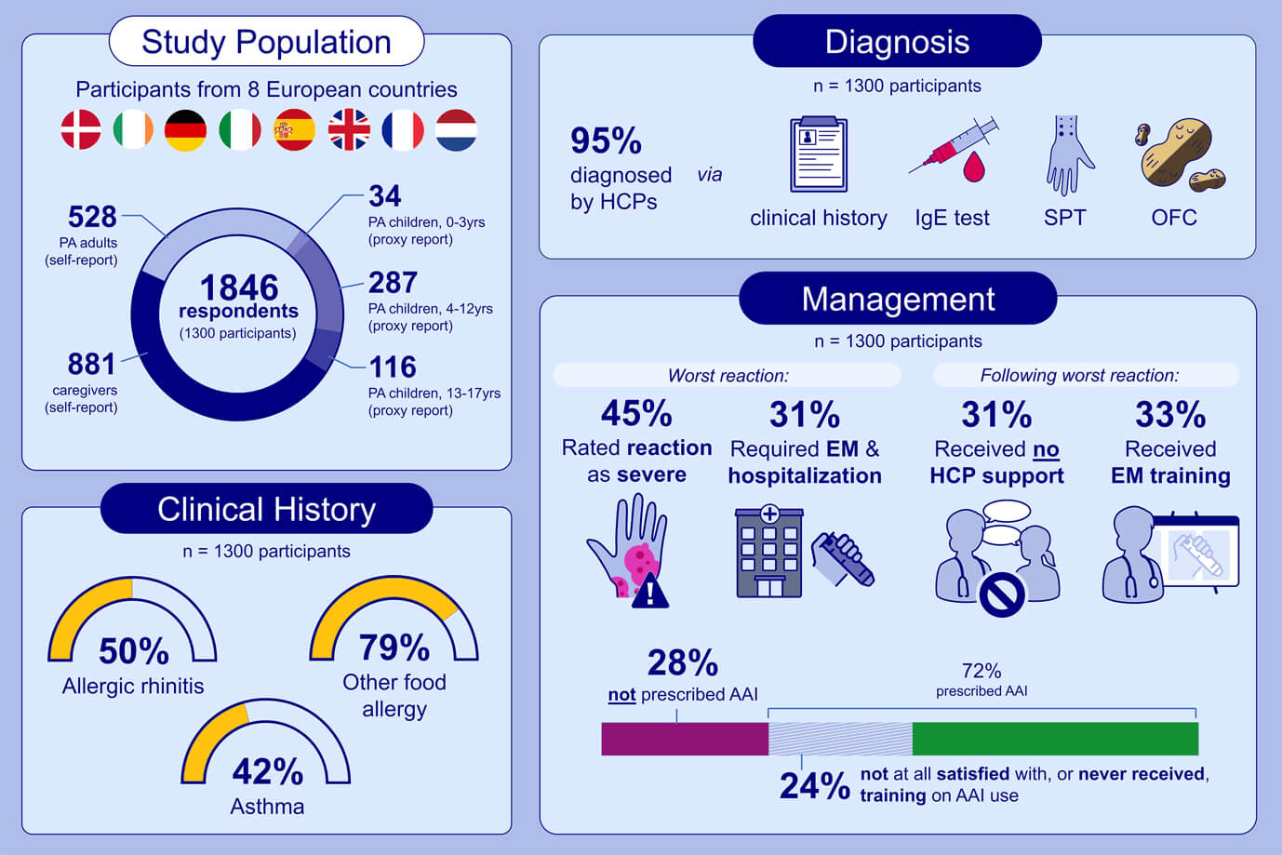
APPEAL‐1: A pan‐European survey of patient/caregiver perceptions of peanut allergy management
Katharina Blumchen, Audrey DunnGalvin, Frans Timmermans, Lynne Regent, Sabine Schnadt, et al.
Allergy. 2020; 2920-2935 https://doi.org/10.1111/all.14414
© 2019 EAACI and John Wiley and Sons A/S. Published by John Wiley and Sons Ltd.
Notes:
HIGHLIGHTS
• The APPEAL-1 study – pan-European quantitative investigation of the burden of living with peanut allergy – provides essential insight on diagnosis and management of peanut allergy.
• Study results expand our understanding of management of peanut allergy and provide insight into diagnosis, comorbidities, and severity of symptoms.
• The study suggests a widespread need for improved quality of peanut allergy health management and education.
Abbreviations: AAI, adrenaline auto-injector; HCP, healthcare professional; OFC, oral food challenge; PA, peanut allergy; SPT, skin prick test
.

