Slide 1
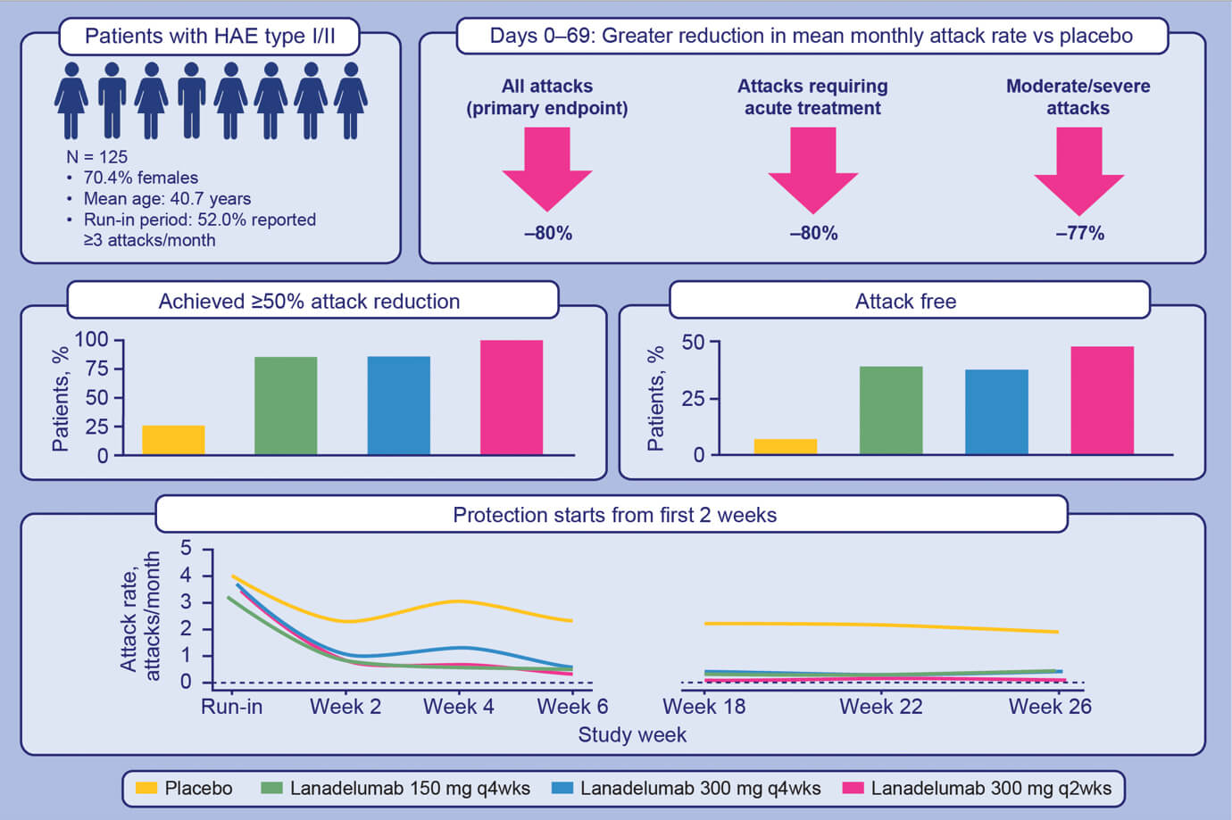
Lanadelumab demonstrates rapid and sustained prevention of hereditary angioedema attacks
Marc A. Riedl, Marcus Maurer, Jonathan A. Bernstein, Aleena Banerji, Hilary J. Longhurst, et al.
Allergy. 2020; 2879-2887 https://doi.org/10.1111/all.14416
© 2019 EAACI and John Wiley and Sons A/S. Published by John Wiley and Sons Ltd.
Notes:
HIGHLIGHTS
• During days 0-69, lanadelumab-treated patients had a significantly lower mean monthly HAE attack rate versus placebo and were more likely to be responders and attack free.
• Protection starts early and is sustained; during steady state, lanadelumab efficacy was similar or improved versus days 0-69.
•Prophylactic agents with rapid onset, sustained effect, and convenient dosing frequency can improve HAE management plans.
Abbreviations: HAE, hereditary angioedema; q2wks, every 2 weeks

