Slide 1
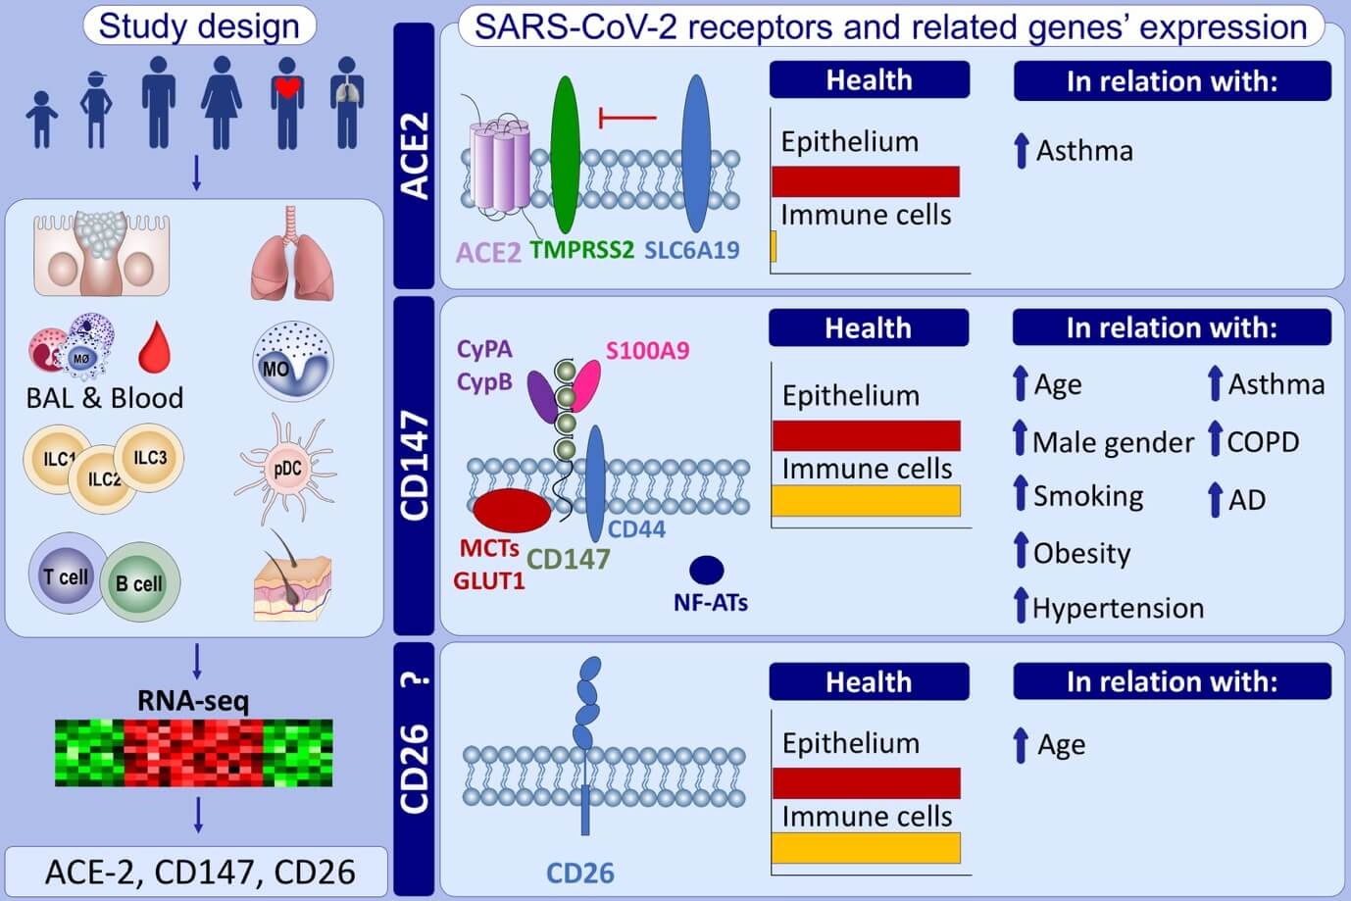
Distribution of ACE2, CD147, CD26, and other SARS‐CoV‐2 associated molecules in tissues and immune cells in health and in asthma, COPD, obesity, hypertension, and COVID‐19 risk factors
Urszula Radzikowska, Mei Ding, Ge Tan, Damir Zhakparov, Yaqi Peng, et al.
Allergy. 2020; 2829-2845 https://doi.org/10.1111/all.14429
© 2019 EAACI and John Wiley and Sons A/S. Published by John Wiley and Sons Ltd.
Notes:
HIGHLIGHTS
• ACE2 and TMPRSS2 expression is unique for the epithelial barrier sites, whereas CD147, cyclophilins, and CD26 is expressed in both, epithelial and immune cells.
• Age is a factor associated with the differential expression profiles of ACE2-, CD147- and CD26-related genes in the PBMCs and naïve CD4+ T cells from healthy children and adults.
• Asthma, COPD, hypertension, smoking, obesity, and male gender generally lead to the higher expression of ACE2- and CD147-related genes in the bronchial biopsy, BAL or blood.
Abbreviations: ACE2, angiotensin-converting enzyme 2; AD, atopic dermatitis; BAL, bronchoalveolar lavage; COPD, chronic obstructive pulmonary disease; CypA, cyclophilin A; CypB, cyclophilin B; GLUT1, glucose transporter 1; ILC, innate lymphoid cell; MCTs; monocarboxylate transporters; NF-ATs, nuclear factor of activated T cells; PBMCs, peripheral blood mononuclear cells; SARS-CoV-2; severe acute respiratory syndrome coronavirus 2; SLC6A19, sodium-dependent neutral amino acid transporter B(0)AT1; S100A9, protein S100-A9; TMPRSS2, transmembrane protease serine

