Slide 1
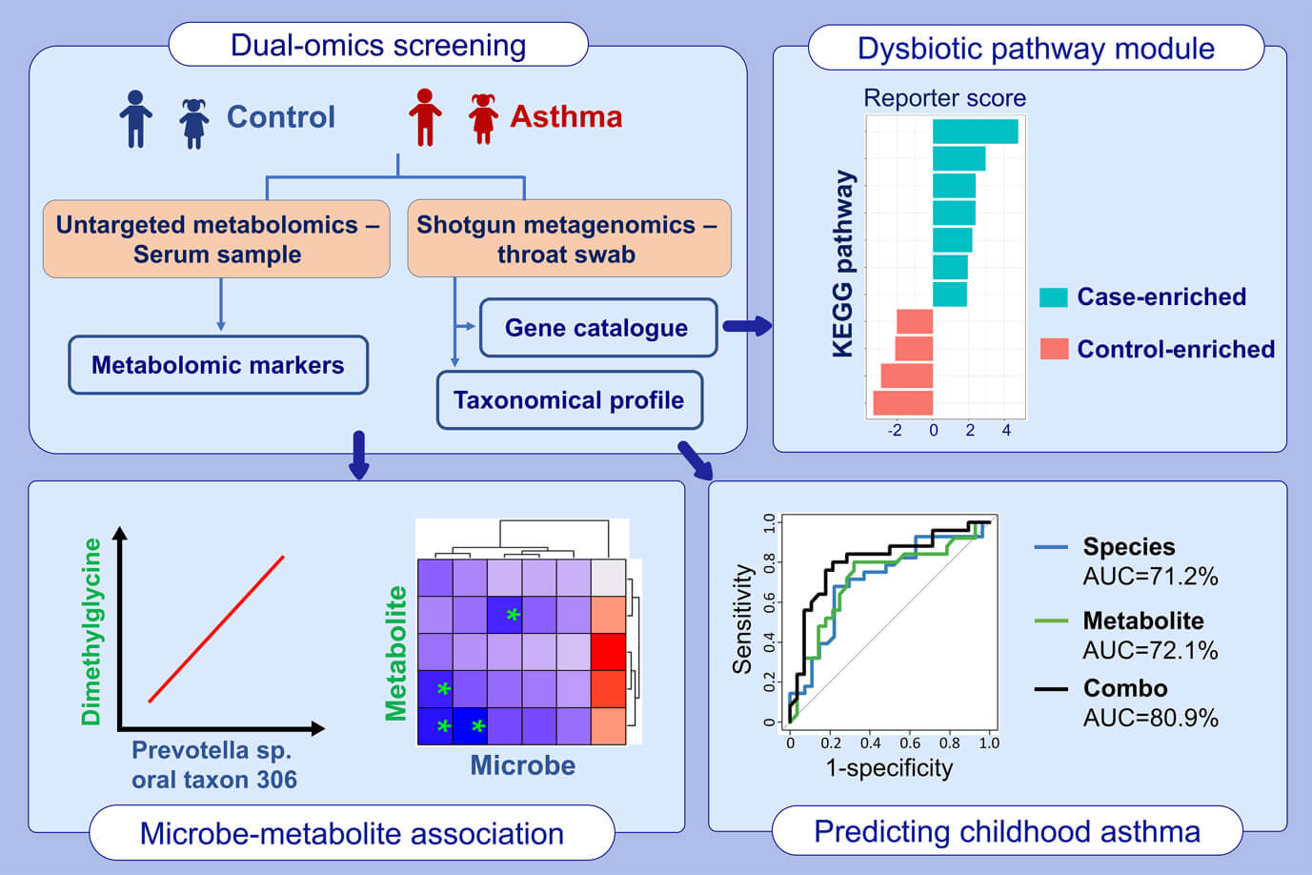
Integration of metagenomics‐metabolomics reveals specific signatures and functions of airway microbiota in mite‐sensitized childhood asthma
Chih‐Yung Chiu, Hsin‐Cheng Chou, Lun‐Ching Chang, Wen‐Lang Fan, Michael Cong Vinh Dinh, et al.
Allergy. 2020; 2846-2857 https://doi.org/10.1111/all.14438
© 2019 EAACI and John Wiley and Sons A/S. Published by John Wiley and Sons Ltd.
Notes:
HIGHLIGHTS
• This study demonstrates shotgun sequencing of airway microbiome and untargeted metabolomics profiling of serum samples in children with mite-sensitized asthma and non-asthmatic controls.
• Integrative analysis identifies specific airway dysbiosis at the species level and its associated functional shift in strong associations with circulating metabolites and IgE responses to mites.
• Overall, dual-omics integration reveals microbe-metabolite connections perturbed in mite-sensitized pediatric asthma.
Abbreviations: KEGG, Kyoto Encyclopedia of Genes and Genomes; AUC, area under the receiver operating characteristic curve

