Slide 1
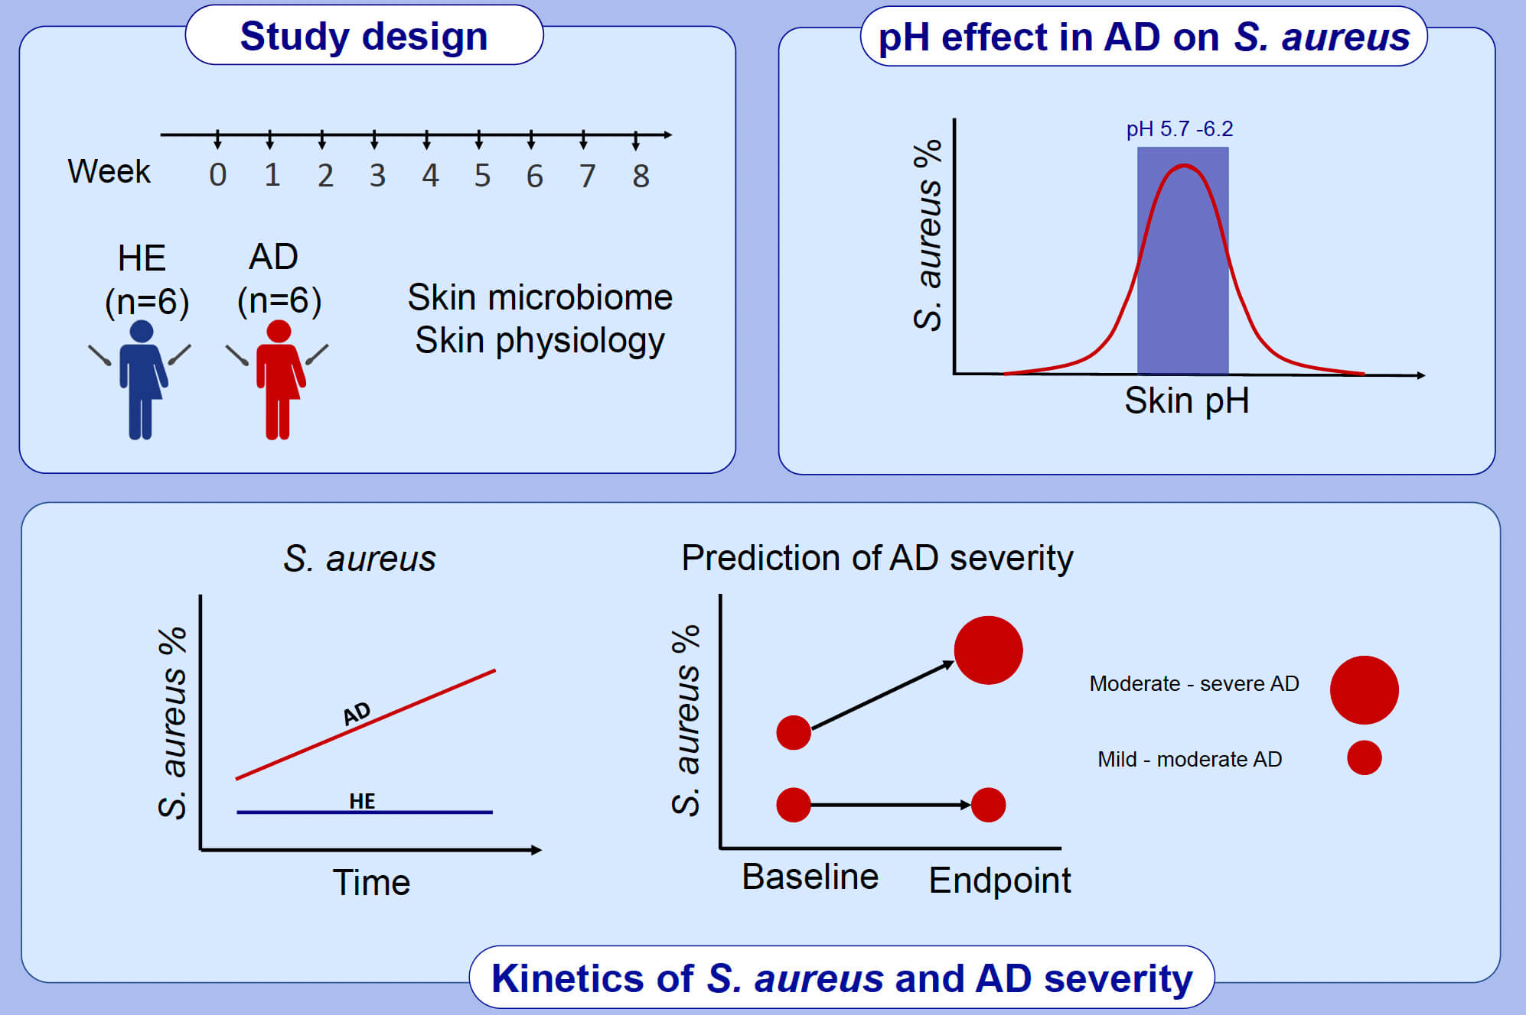
Skin pH–dependent Staphylococcus aureus abundance as predictor for increasing atopic dermatitis severity
Claudia Hülpüsch, Karolina Tremmel, Gertrud Hammel, Madhumita Bhattacharyya, Amedeo de Tomassi, et al.
Allergy. 2020; 2888-2898 https://doi.org/10.1111/all.14461
© 2019 EAACI and John Wiley and Sons A/S. Published by John Wiley and Sons Ltd.
Notes:
HIGHLIGHTS
• In healthy individuals skin microbiome is stable over 8 weeks, but not in atopic dermatitis patients who show significant increase in Staphylococcus aureus over time.
• Skin pH of 5.7 -6.2 allows growth of S. aureus in atopic dermatitis individuals.
• Higher S. aureus abundance at baseline is a predictor for increased S. aureus and AD severity at endpoint.
Abbreviations: AD, atopic dermatitis; HE, healthy

