Slide 1
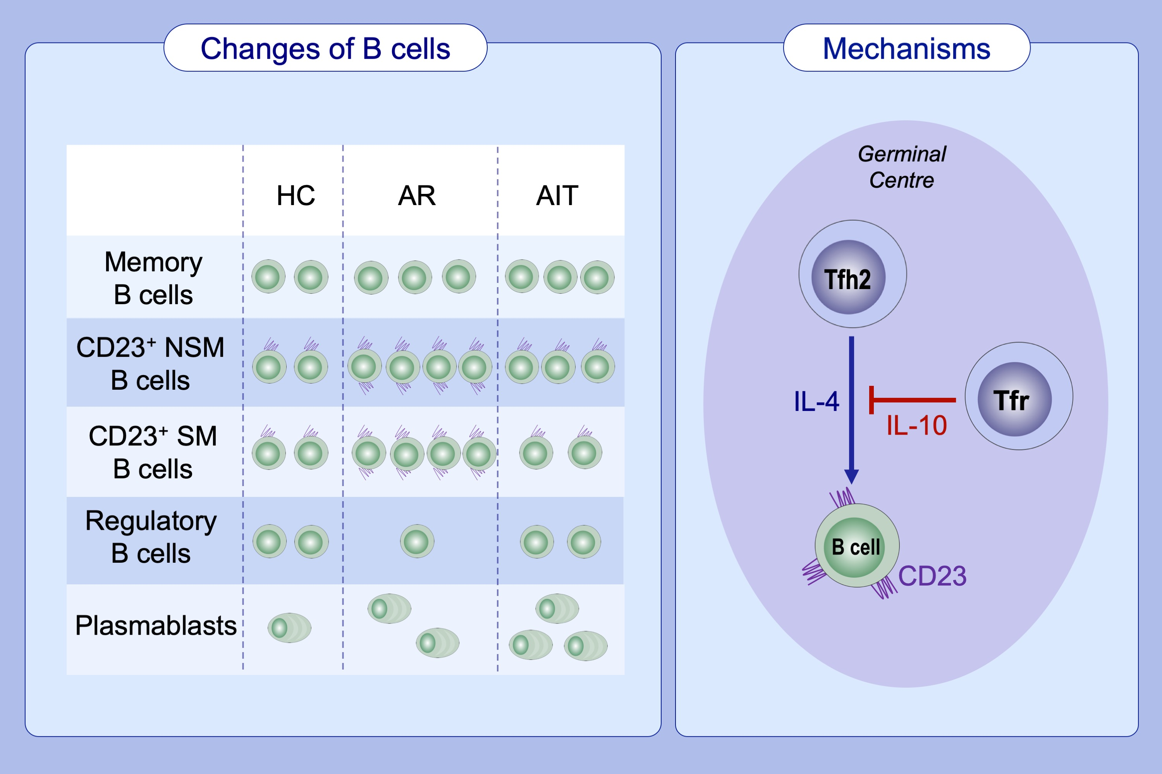
CD23 expression on switched memory B cells bridges T‐B cell interaction in allergic rhinitis
Yin Yao, Nan Wang, Cai‐Ling Chen, Li Pan, Zhi‐Chao Wang, et al.
Allergy. 2020; 2599-2612 https://doi.org/10.1111/all.14288
© 2019 EAACI and John Wiley and Sons A/S. Published by John Wiley and Sons Ltd.
Notes:
HIGHLIGHTS
• Circulating memory B cells are increased in AR patients.
• The enhanced expression of CD23 on switched memory B cells correlates with antigen-specific IgE levels, symptom scores, and allergen immunotherapy efficacy in AR patients.
Abbreviations: AIT, allergen immunotherapy; AR, allergic rhinitis; HC, healthy controls; NSM, nonswitched memory; SM, switched memory; Tfh2, type 2 follicular helper T cells; Tfr, follicular regulatory T cell

